Slide 1
QM CONNECTLX
ONLINE CONFERENCE

Slide 5
Story about Trauma in the Classroom

Slide 16
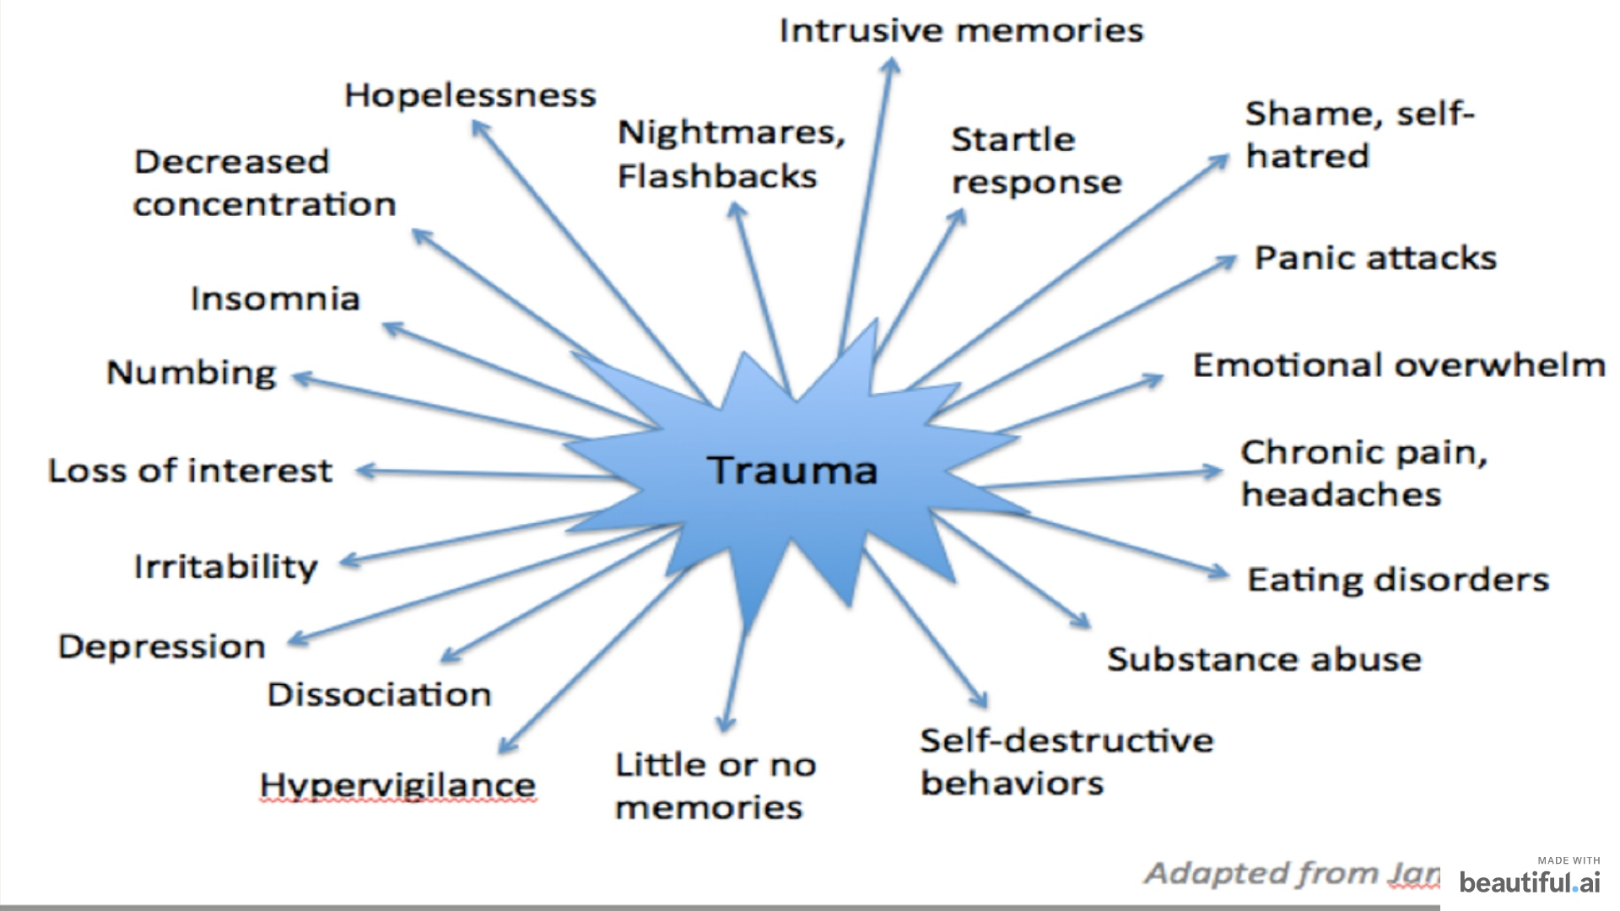

Slide 23
Trauma-Informed Practices
Physical, Emotional, Social, & Academic Respect
Trustworthiness & Transparency
Support & Connection
Collaboration & Mutuality
Empowerment, Voice, & Choice
Cultural, Historical, & Gender Contexts
Resilience, Growth, & Change
(Source: Baez, Marquart, Garay, & Chung, 2020)

Slide 29
Caroline Toscano, PhD caroline.toscano@century.edu

