Slide 1
“ABCs of Online Course Development”
APPQMR, Backward Design, & Collaboration
Lisa Clark, Larissa Cremeens, Christine Nelson, & JD Weagley​

Slide 2
Presentation Overview
Objectives
Identify strategies and support for faculty in online course design and development.
Discuss ways to implement APPQMR as a partnership in course development.
Analyze an online course development program
Agenda
Overview of the Online Course Development Program
A: APPQMR
B: Backward Design
C: Collaboration
OCDP Impact
Q & A Discussion

Slide 3
POLL Who do we have with us? Please tell us your title/position (i.e. ID, Faculty, P-12, Admin)

Slide 4
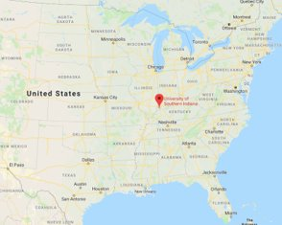
Who We Are
Founded in 1965​
Enrollment: 10,734​
​
The University employs:​
659 full-time faculty and administrative staff​
251 part-time faculty​
369 full-time support staff​
333 part-time staff​

Slide 5
Online Course Development Program (OCDP)
Stipend-based professional development to support faculty in the design and development of quality online courses​
Target Learners- Faculty across colleges and disciplines ​
Offered 3x a year​
Developing courses for the following semester​
Instructional Designer Support​
Quality Matters Rubric & Peer Review Process​
Phase 1: Course Planning ​
Phase 2: Course Development​
Phase 3: Course Review

Slide 6
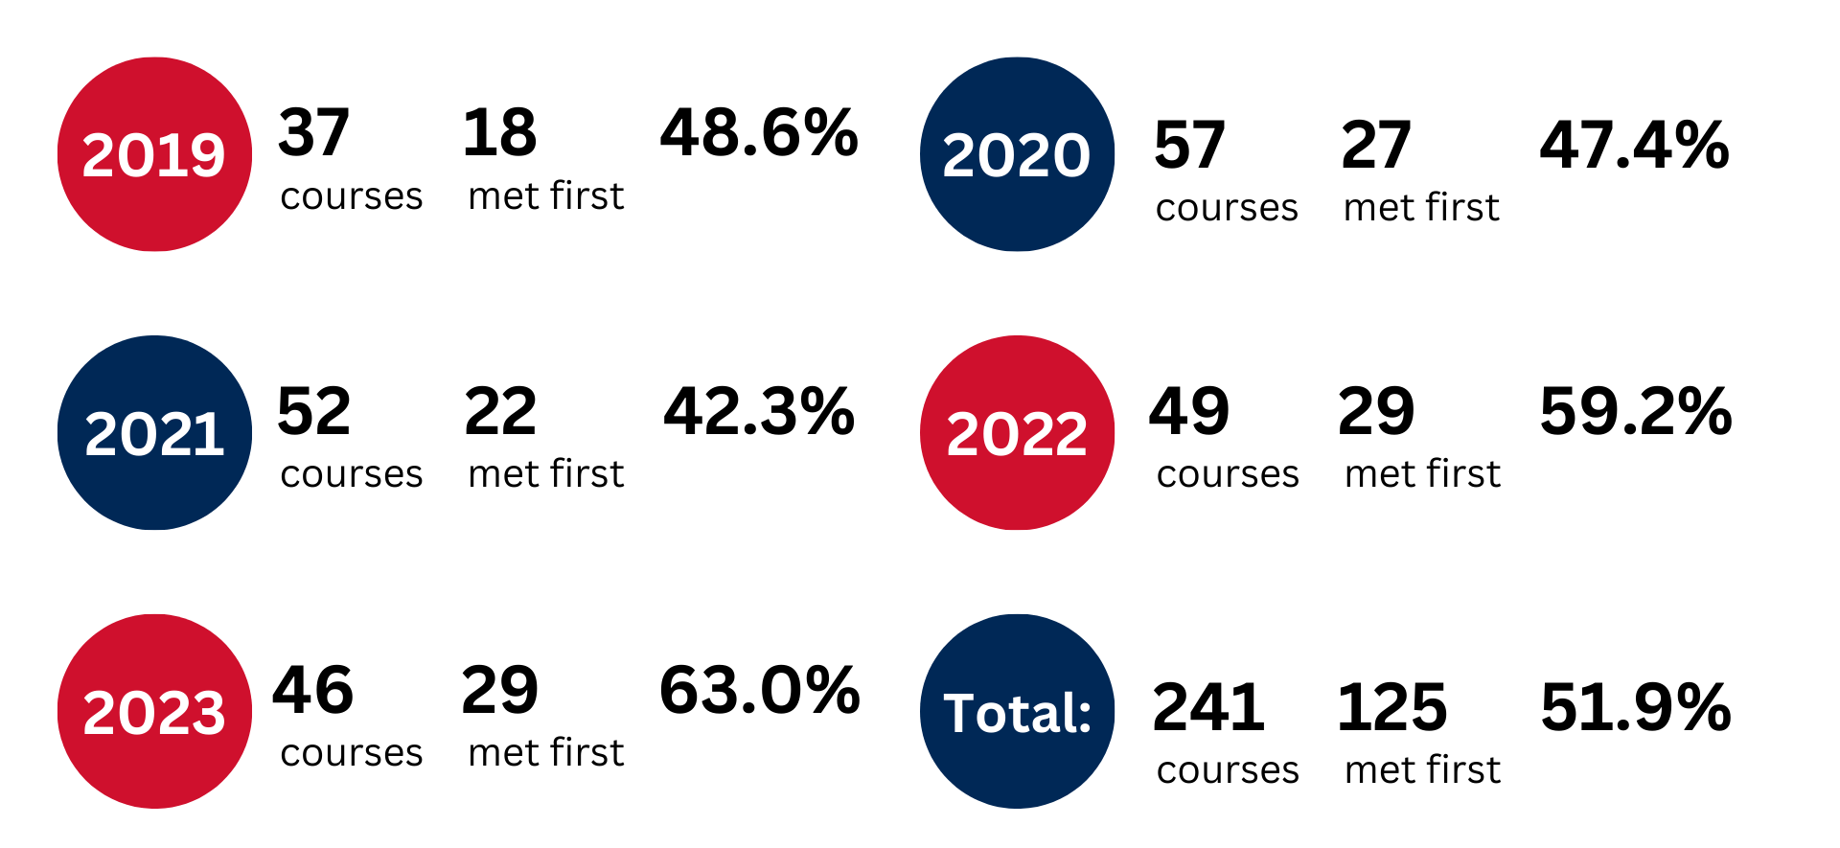
By the Numbers

Slide 7
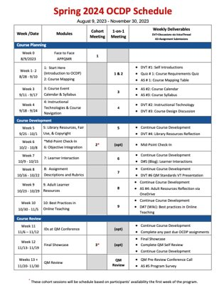
Spring 2024 OCDP Schedule

Slide 8
Program Requirements
Attend APPQMR QM Workshop ​
Attend 2 cohort meetings​
Complete all OCDP Modules on Bb site​
Attend scheduled meetings w/ ID​
Present work at the faculty final showcase​
Develop the entire course prior to QM Review​
Complete a self-review​
Participate in QM review and make changes (as needed)

Slide 9
A: APPQMR

Slide 10
APPQMR
Benefits of starting with APPQMR
Familiar with QM Rubric
Familiar with Online Learning Team
Outside Source
Get a feel for a Peer Review
Compare/Contrast difference between before QM and after QM
Ideas for Course Design

Slide 11
POLL How do you utilize APPQMR at your institution?

Slide 12
B: Backwards Design

Slide 13
OCDP Schedule – Course Planning

Slide 14
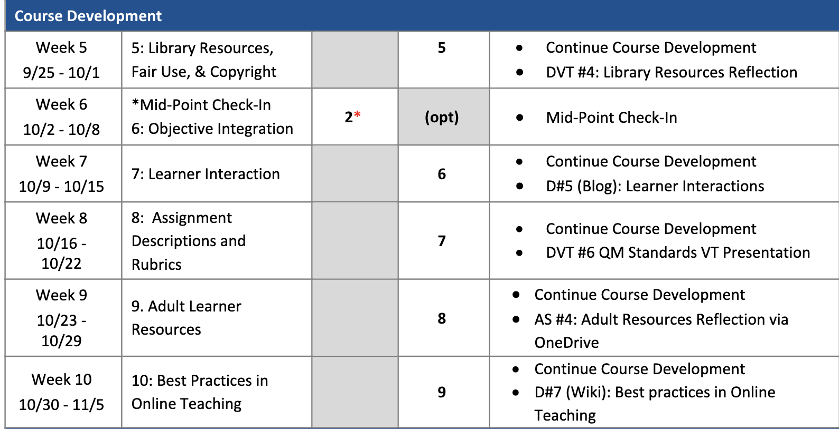
OCDP Schedule – Course Development

Slide 15
OCDP Schedule – Course Review

Slide 16
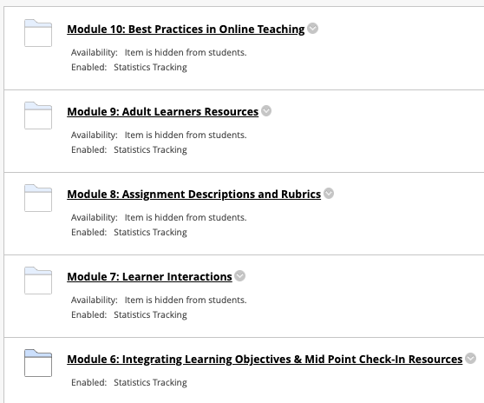
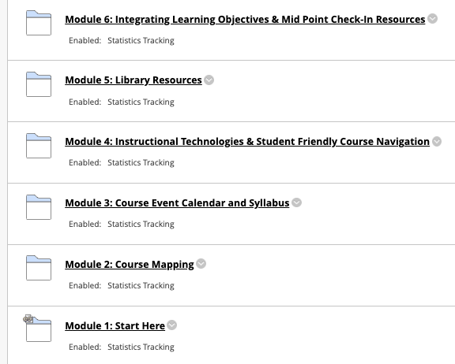
OCDP Modules

Slide 17
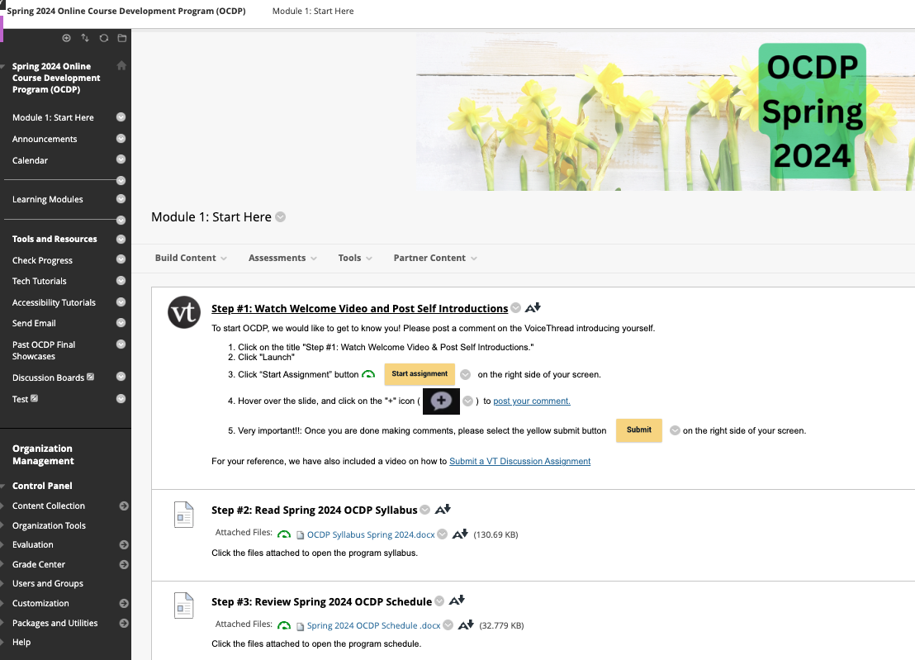
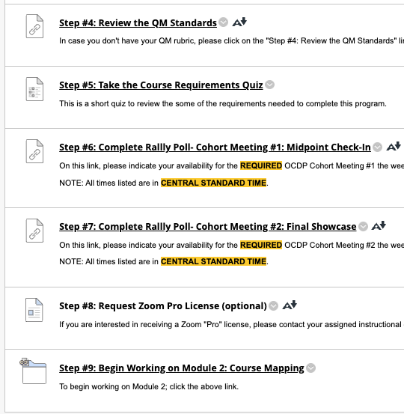
OCDP Start Here

Slide 18
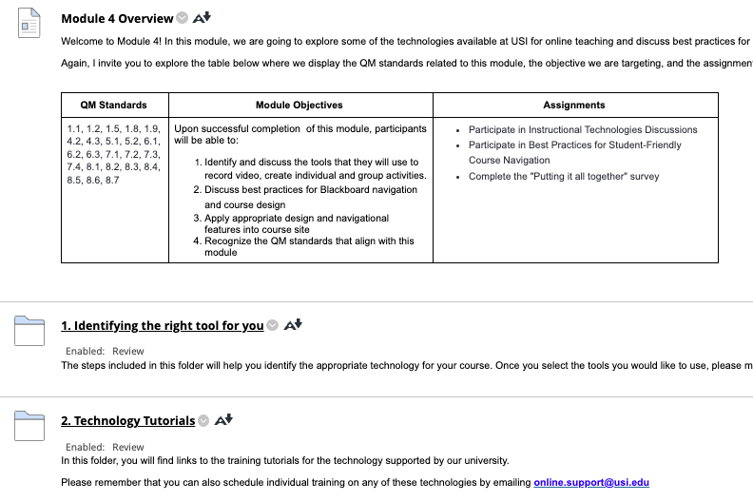
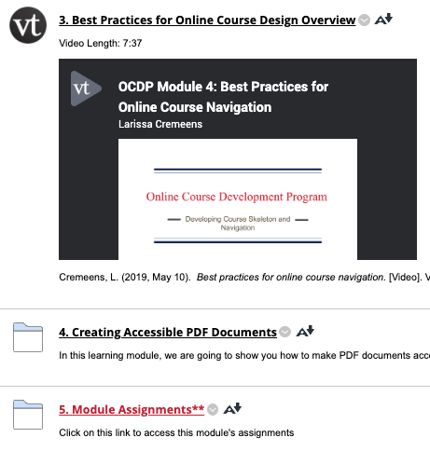
Module 4 Instructional Technologies & Student-Friendly Course Navigation

Slide 19
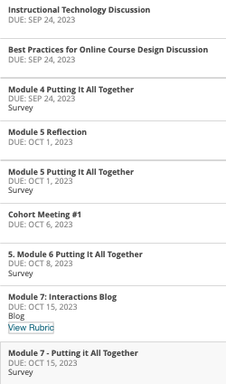
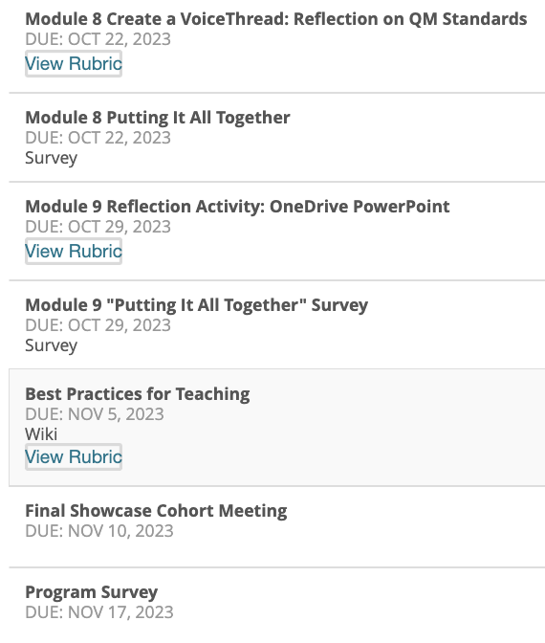
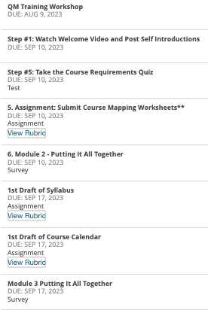
OCDP Assignments

Slide 20
OCDP Capstone
Submitting for QM-Managed review is the "cumulative final" for the OCDP.
The final step before submission is for the ID and faculty to complete the SELF-REVIEW

Slide 21
POLL How do you incentivize your online course development program?

Slide 22
C: Collaboration

Slide 23
Collaboration is Key
Library
Mid-Point Check In
Embedded Module in Organization Site
Online Resources
Streaming Services
Research Services
Open Educational Resources (OER)
Incorporating
Modifying
Creating
Share best practices for online course delivery
Copyright overview
Disability Resources
Tech Take-Aways
Mid-Point Check-in
Highlights Standard 8 specifically
Reviewing Blackboard Ally
IT
Overview best technical practices
Stay up to date with upcoming events/dates
Tutorials
+ More opportunities for collaboration!

Slide 24
OCDP Impact

Slide 25
Courses Developed
400
Over Courses Developed
Since Spring 2015
16
Courses Currently in Development
275
More Than Faculty Members
Since Spring 2015
242
QM-Certified Courses Since 9/2018
+4 Courses Currently in Review

Slide 26
Course Survey
Small Sample QM-Reviewed Courses
4 Key Areas
Start of the Course (4 questions)
Learning Objectives (7 questions)
Tools, Interaction, & Support (7 questions)
Grading Policy (3 questions)

Slide 27
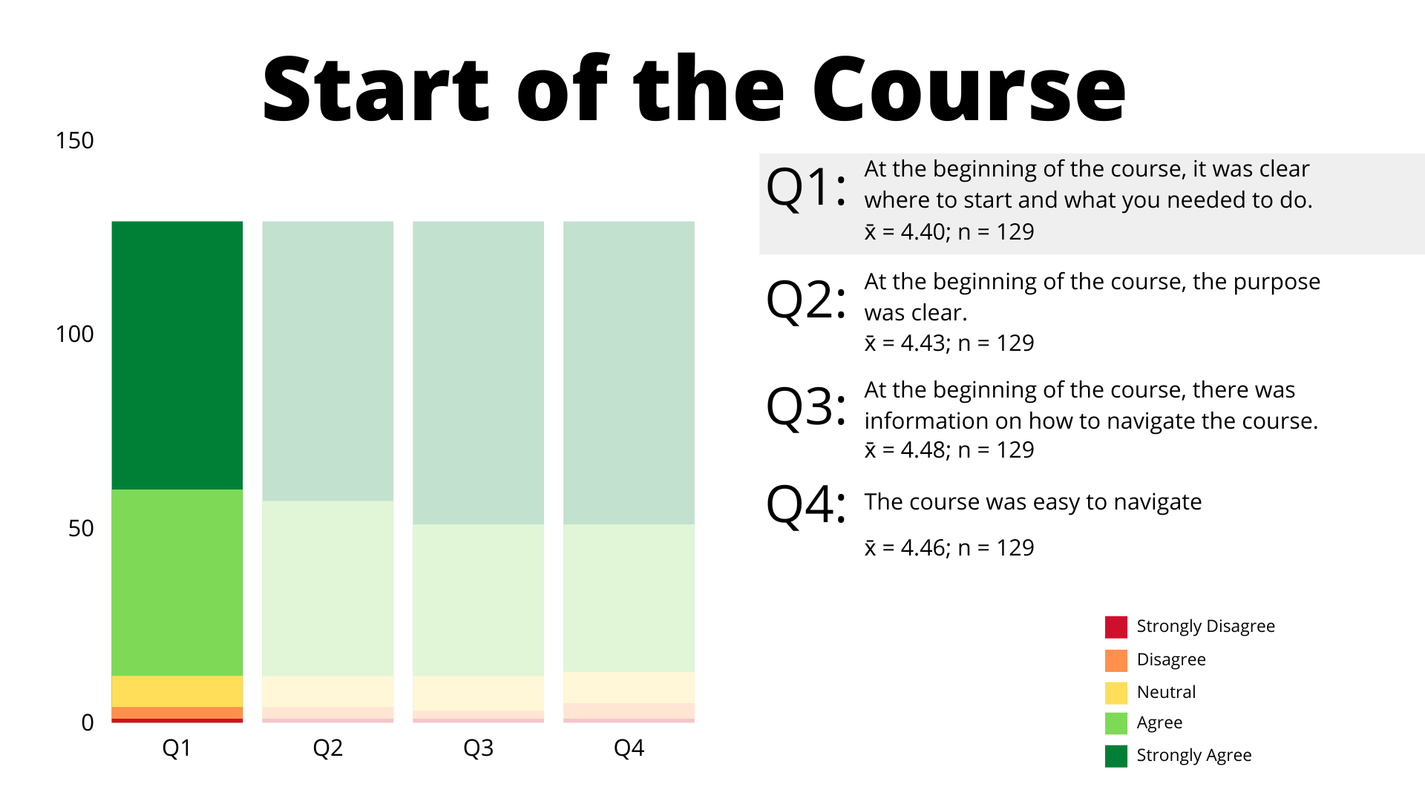
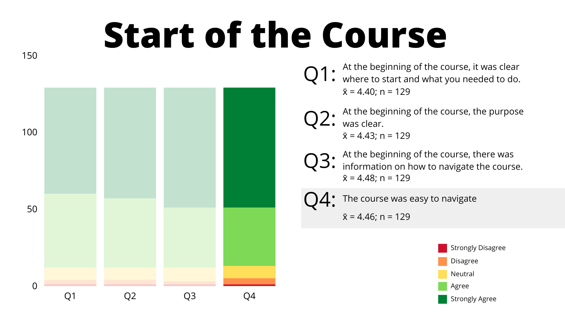
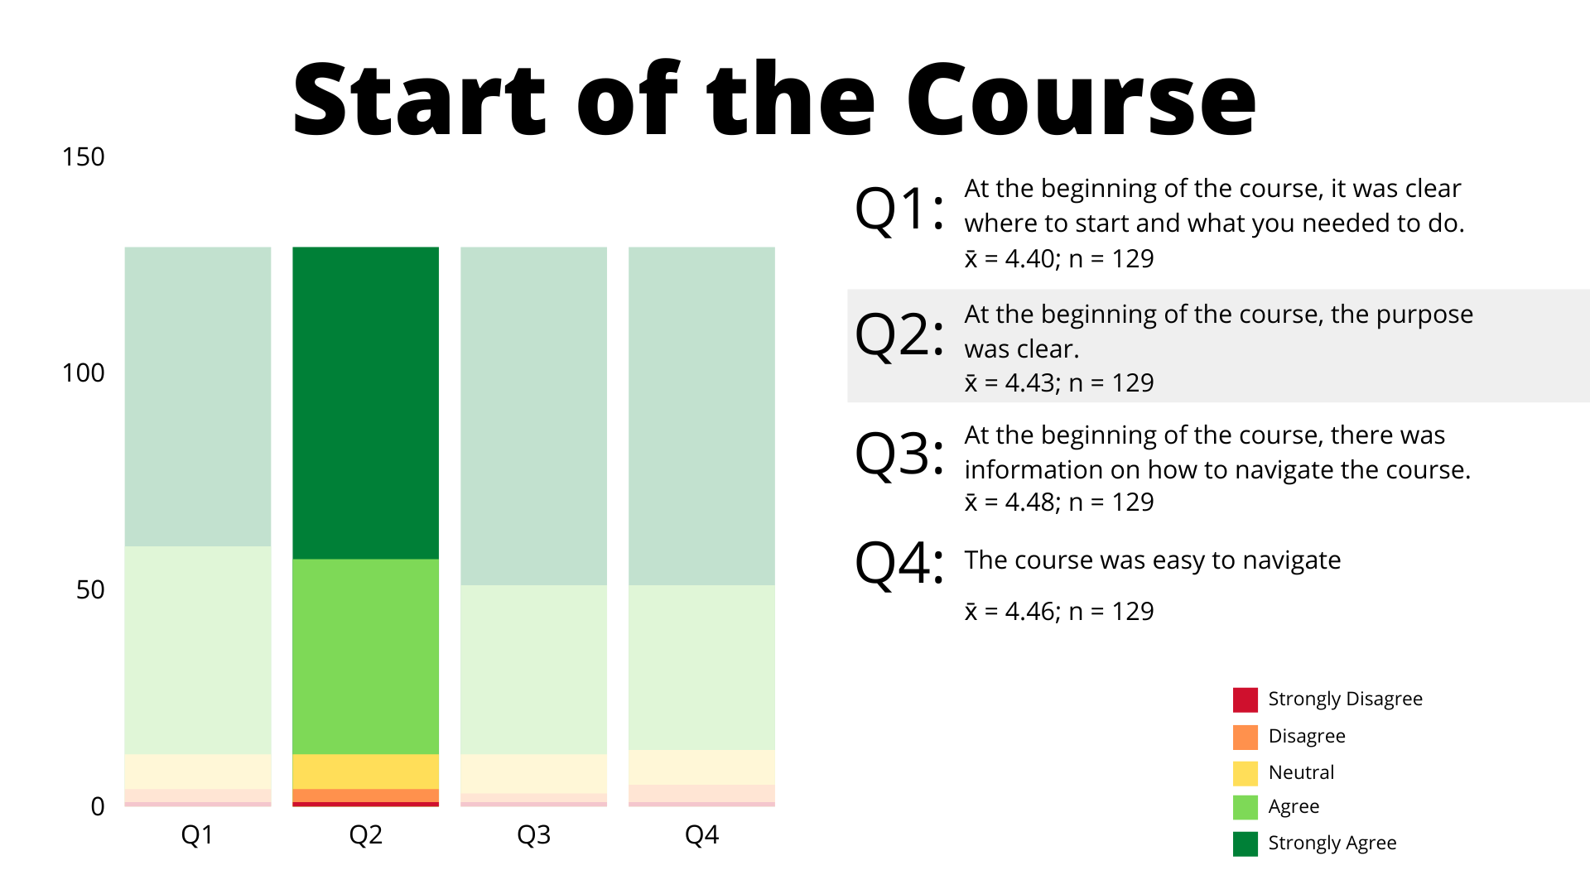
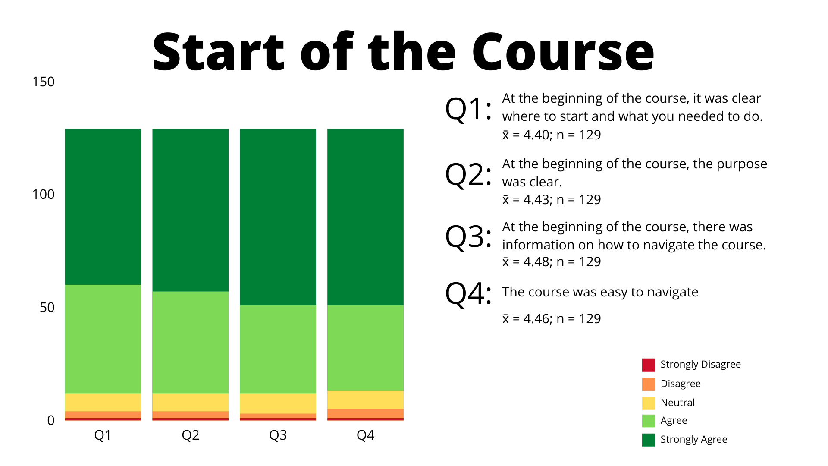
Start of the Course 1

Slide 28
Learning Objectives

Slide 29
Tools, Interaction, & Support

Slide 30
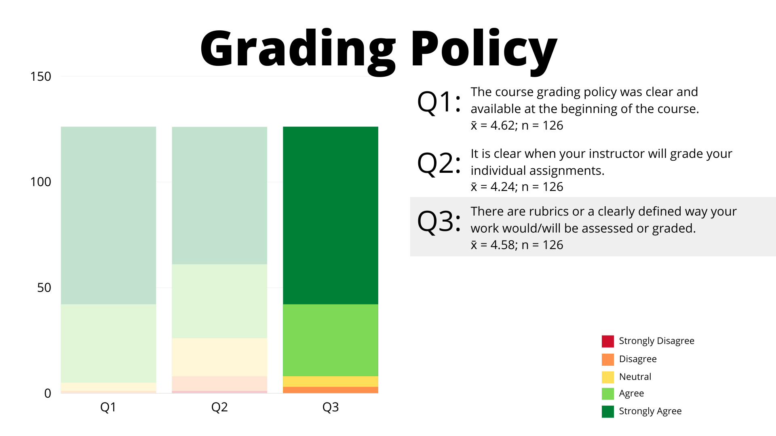
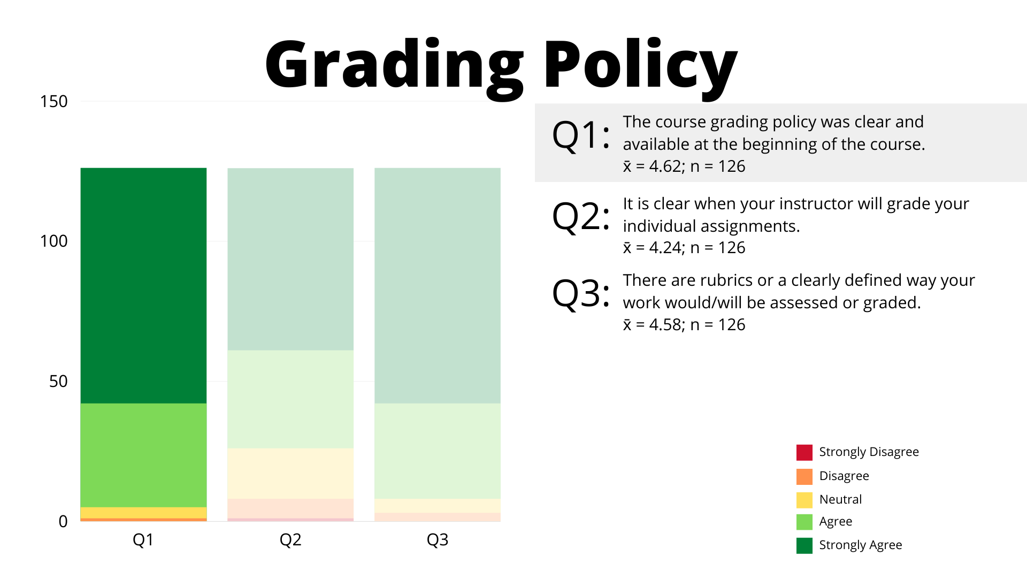
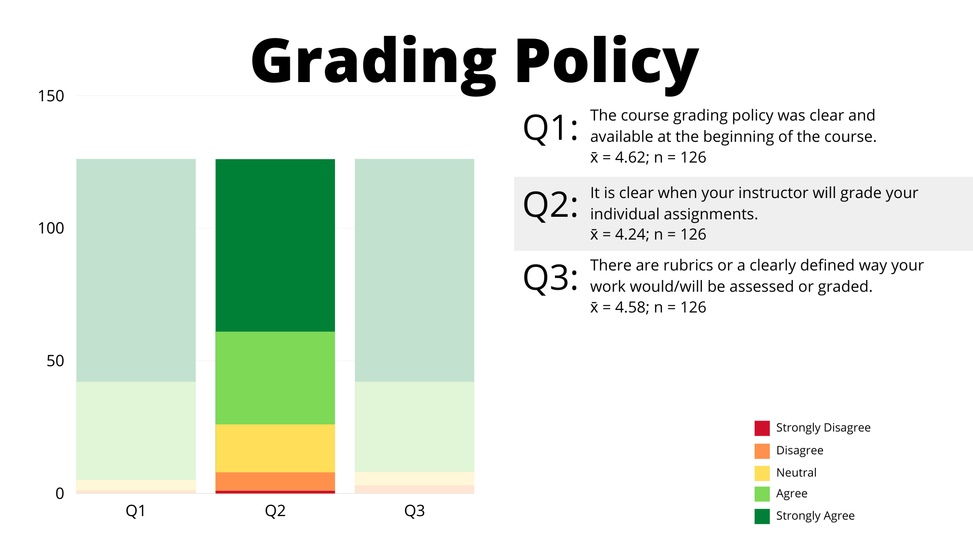
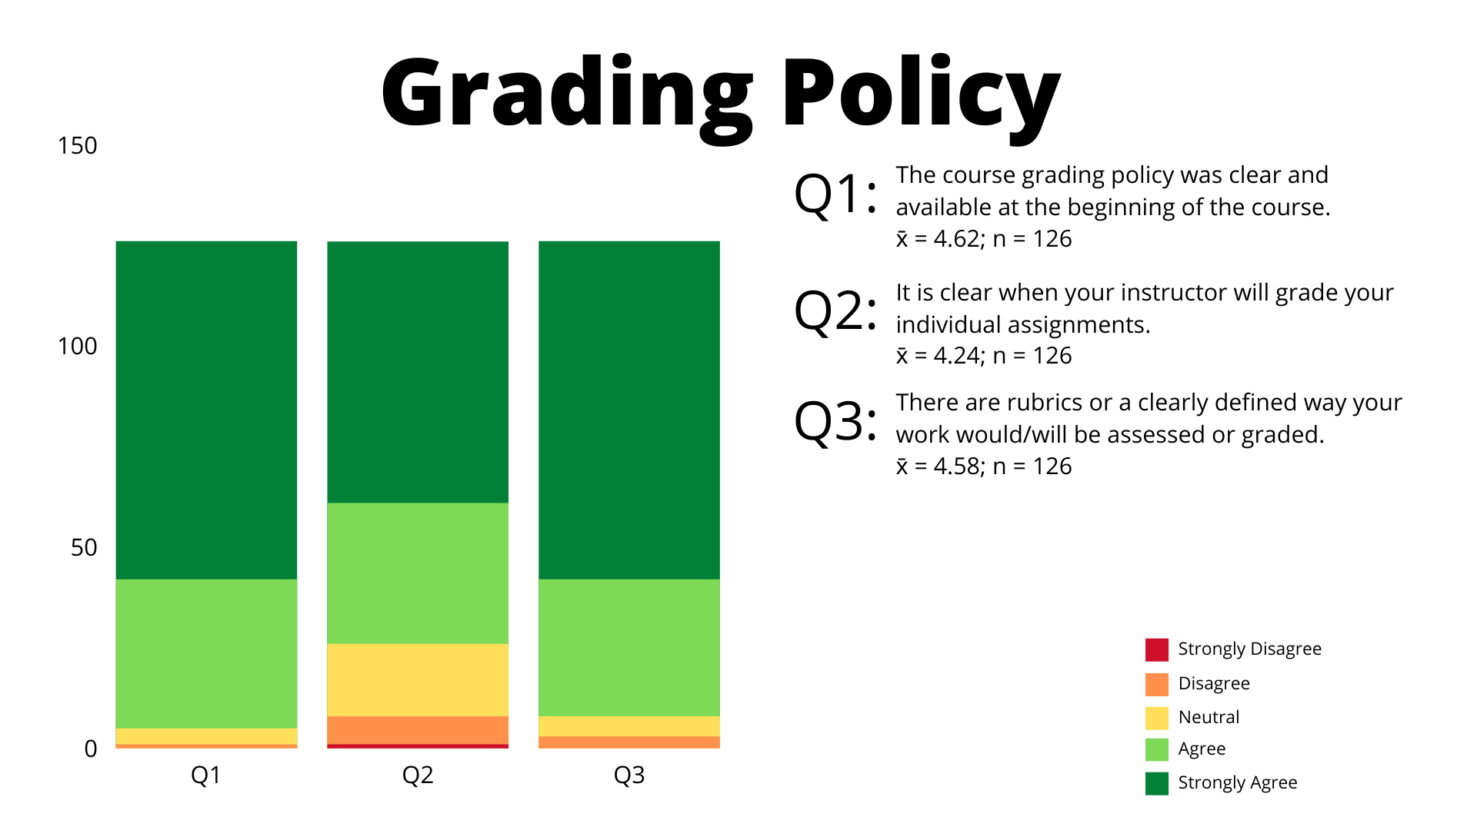
Grading Policy

Slide 31
POLL How do you measure the impact of your online course development program?

Slide 32
Thank you!
online.support@usi.edu​

