Slide 1
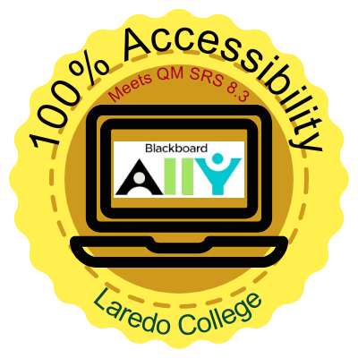
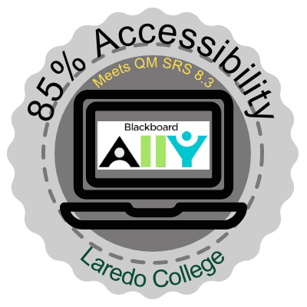
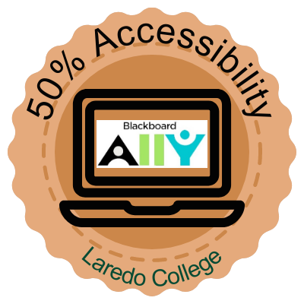
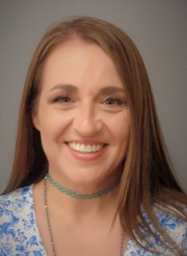
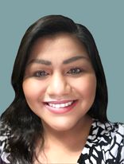
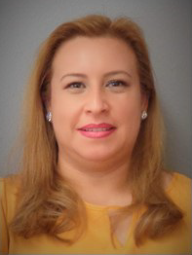
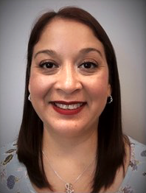
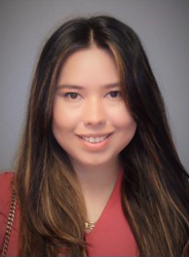
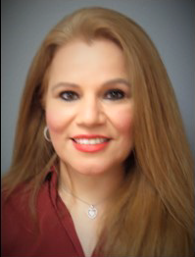
AIM FOR THE SILVER AND GOLD: CHAMPIONING ACCESSIBILITY
“Be the CONNECTION between your course content and your learners; not the BROKEN LINK!”
Accessibility Guidelines:
Universal Design for Learning (UDL)
Web Content Accessibility Guidelines(WCAG)
Quality Matters Rubric
Specific Review Standard (SRS) 8.3: The course provides accessible text and images in files, documents, LMS Pages, and web pages to meet the needs of diverse learners.
Representation
Action & Expression
Engagement
Section 508
ACCESSIBILITY EVENTS:
BB ALLY Accessibility Report
Accessibility Checker
Link Validator
Quality Matters Official Review
ACHIEVEMENTS: Championing SRS 8.3 in an Official QM Review
ACCESSIBILITY DISCIPLINES:
Headings
Alt-Texts
Alt-Tags
Selectable & Searchable Texts
Color Contrast
Hyperlinks
Table Settings
LAREDO COLLEGE BADGE COUNT: 72
Silver: 48
Bronze: 13
Gold: 11
Laredo College Badge Count | Gold 11 | Silver 48 | Bronze 13 | Total 72
FACULTY TRAINING CAMP:
QM Professional Development
Accessibility & Blackboard Ally Workshop
LMS Training
ReadSpeaker Guide
VidGrid Workshop
PRESENTED BY THE LAREDO COLLEGE INSTRUCTIONAL DESIGN TEAM
December 2015
November 2018
December 2020
Assessment of Very Important SRS 8.3 in an Official QM Review
Assessment of Essential SRS 8.3 in an Official QM Review
Accessibility Application Workshops Launched
October 2022
Assessment of Essential SRS 8.3 in an Official QM Review
1st Laredo College Course QM Certified
November 2020
CHAMPIONING SRS 8.3 IN AN
OFFICIAL QM REVIEW TIMELINE
Elizabeth C. Rodriguez, Ed.D.
Dean of Academic Innovation & Technology
QMC, CRM, PR, AOFC, MR
Beatriz Flores-Martinez, M.S.
eLearning & Instructional Design Specialist
QMC, CRM, PR, AOFC
Alicia J. Reed, M.B.A.
eLearning & Instructional Innovation Center Director
QMC, CRM, PR, AOFC
Guadalupe Castillo, M.A.
eLearning & Instructional Design Specialist
QMC, CRM
Anna Gonzalez, B.S.
Lead eLearning & Instructional Design Specialist
QMC, CRM, PR, AOFC, AFFC, AFFR, & ADFFC
Veronica Juarez, M.A.
eLearning & Instructional Design Specialist
QMC, CRM
Contact our team at QMCoordinator@Laredo.edu
QM CONNECT - 7TH OF NOVEMBER 2022

