Slide 1
Designing for All
Implementing Specific Review Standards 8.3 & 8.4
Sally Hughes
Linda Reed
Notes:
Sally
Welcome to Designing for All: Implementing Specific Review Standards 8.3 and 8.4
My name is Sally Hughes and my co-presenter is Linda Reed. We are both Instructional Design Specialists with Blinn College in Central Texas.

Slide 2
Blinn College
19,000 +/- students
5 campuses
20 years of online courses
Significant enrollment in DL courses
Academic Partnerships
Notes:
Linda
Information about Blinn College
19,000 +/- students
5 campuses
20 years of online courses
Significant enrollment in DL courses
Academic partnerships with Texas A & M University and the Texas A & M System

Slide 3
Learning Objectives
Compare presenters' implementation process to participant’s.
Identify key components of and effective strategies in implementing Standards 8.3 and 8.4.
Identify the benefits of meeting Standards 8.3 and 8.4 for all students.
Notes:
Sally
Our learning objectives for this session are:
Compare presenters' implementation process to participant’s.
Identify key components of and effective strategies in implementing Standards 8.3 and 8.4.
Identify the benefits of meeting Standards 8.3 and 8.4 for all students.

Slide 4
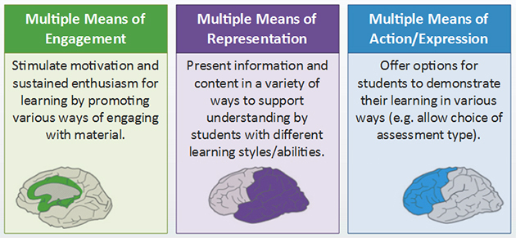
Universal Design
Notes:
Sally
Before we begin, we’d like to take a moment to create a baseline of understanding. Standards 8.3 and 8.4 are based on Universal Design for Learning.
Universal Design for Learning (UDL) is a way of thinking about teaching and learning that gives all students equal opportunity to learn.
Multiple means of engagement-tap into learners' interests, offer appropriate challenges, and increase motivation
Multiple means of representation-give learners various ways of acquiring information and knowledge
Multiple means of expression-provide learners alternatives for demonstrating what they know

Slide 5
Specific Review Standard 8.3
The course provides accessible text and images in files, documents, LMS pages, and web pages to meet the needs of diverse learners.
Notes:
Sally
Specific Review Standard 8.3 was rewritten and upgraded to an Essential standard in the Sixth Ed. QM Rubric.
“The course provides accessible text and images in files, documents, LMS pages, and web pages to meet the needs of diverse learners.”
Key parts: meet Web Content Accessibility Guidelines (WCAG)
Text-formatting using styles, headings, color can’t convey meaning, no underlining, lists created using list tools, links are descriptive
Images- alt-tag descriptions, table formatting (captions/alt-tags & headers)
LMS pages & Webpages- all text and images use the same styles, color requirements

Slide 6
Specific Review Standard 8.4
The course provides alternative means of access to multimedia content in formats that meet the needs of diverse learners.
Notes:
Sally
Specific Review Standard 8.4 deals solely with multimedia and was separated from 8.3 in the Sixth Ed. QM Rubric. Although it is not an Essential standard, it is the law.
“The course provides alternative means of access to multimedia content in formats that meet the needs of diverse learners. “
Key parts: meet WCAG guidelines
Multimedia- Video and animations have captions or a transcript to convey the same meaning. Captions must be edited to be considered accessible. Industry standard is 99% accuracy, most programs produce ~70% accuracy

Slide 7
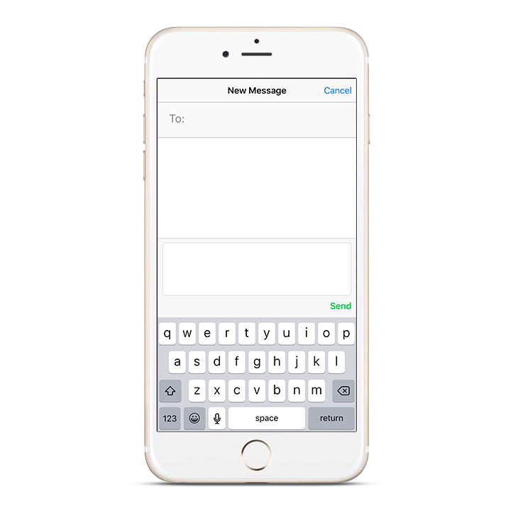
Responding with Poll Everywhere
Notes:
Linda
Directions:
Now we would like to know about you and your journey toward accessibility. You’ll use your phone, tablet, or laptop to respond, just like on American Idol. Please pull out your device and participate, but remember to keep devices in silent mode.”
“You’ll participate by sending a text message or visiting the URL from any web browser. You don’t need to download anything.”
“Let’s do a quick poll now to get the hang of it. Everyone take out your device and tell me – Have you ever attended a QM conference before?”
Responding by text message: “Start a new message, and put this five-digit code (or phone number) in the “to” line. Type in the username, followed by your answer, in the body of the message.”

Slide 8
Let’s Practice
Insert first Question – Have you ever attended a QM conference before?
Yes
No
Notes:
Linda
QM Connect Survey - Next slides include the remaining questions.
1. Has your institution implemented SRS 8.3 & SRS 8.4?
Yes, 8.3 only
Yes, 8.4 only
Yes, both 8.3 & 8.4
No, neither 8.3 or 8.4
2. Are you required to meet SRS 8.3/8.4 in your courses?
Yes
Somewhat
No
3. Does your institution provide UDL support personnel for course design?
Yes
Somewhat
No

Slide 9
Survey Question 1
Placeholder Question 1
Notes:
Linda
Survey
1. Has your institution implemented SRS 8.3 & SRS 8.4?
Yes, 8.3 only
Yes, 8.4 only
Yes, both 8.3 & 8.4
No, neither 8.3 or 8.4

Slide 10
Survey Question 2
Placeholder Question 2
Notes:
Linda
Survey
2. Are you required to meet SRS 8.3/8.4 in your courses?
Yes
Somewhat
No

Slide 11
Survey Question 3
Placeholder Question 3
Notes:
Linda
Survey
3. Does your institution provide UDL support personnel for course design?
Yes
Somewhat
No

Slide 12
Blinn College - Journey
Stage 1: Early Review Process
Stage 3: Early QM – No SRS 2
Stage 5: QM 6th Edition Two-Tiered System
Stage 2: QM Database-Blinn Standards
Stage 4: Early QM Two-Tiered System
Notes:
Linda:
Blinn College online course history and QM implementation
Early Review Process :
Blinn College has offered Distance Learning courses for about 20 years starting with interactive television courses offered at remote locations. About 10 years ago with the growth in home internet and personal computers, Blinn College begin to offer online and hybrid courses and it became apparent that some type of guidelines were needed for faculty. A Learning Management System was purchased and the Distance Learning Division developed research based guidelines. The next step was to create some type of checklist or review process to measure the online courses against the standards.
The Next Step- QM Database with Blinn Standards
The need for an efficient review system lead Blinn College to Quality Matters. The database was adopted but the decision was to enter the Blinn Standards as a custom rubric to evaluate our online courses. Universal Design was taught outside the course design process to begin awareness of the need to start developing accessible courses. The Department of Disability Services begin to request online faculty to start moving in this direction.
Early QM – No SRS 2
The Distance Learning Dept. and instructional Designers approached the Distance Learning Advisory committee to request Blinn College to explore adopting the QM rubric to replace the Blinn College DL Standards. The College leadership adopted the QM rubric and we begin a transition form the Blinn College Standards to the QM rubric. The first step was to adopt the standards incorporating Standard 2.1 and alignment into the course design but it was not part of the rubric for the first year. Accessibility was discussed with faculty when they begin the course review process but the focus of the course was on readability.
Early QM – Essentials ONLY
The next phase was to incorporate all of the Essential standards into an individual faculty designed course. A template was designed by Instructional Design to incorporate many of General Standard 1, 6 and 7. If the instructor used the template and met all of the Essential standards, their course would have met the QM requirements. If the division decided to create a Master course to share with instructors, this course had to meet all QM standards. Accessibility was discussed with faculty when they begin the course review process but was not a major focus.
QM 6th Edition Incorporation into the Internal Course Review Process.
With the adoption of the 6th edition rubric and SRS 8.3, accessibility now became a focus with course design. It is required as one of the essential standards. All online/ hybrid faculty are strongly encouraged to take a UDL course. Additionally a module with resources to help the instructor meet 8.3 is added to the template when a faculty begins the course design process.

Slide 13
Training
Blinn Standards
QM database Internal training/ Peer & Division Review
QM 6th Ed. Two-Tiered System / QM training/ Peer & Division Review
QM Database-Blinn Standards
Two-Tiered System, QM Training, Peer & Division Review
Stage 1:
Stage 2:
Stage 3:
Stage 4:
Stage 5:
Notes:
Linda:
Stage 1- Distance Learning and Instructional Design were the reviewers using Blinn College standards but no training over Blinn standards. A checklist was created to aid the reviewers.
Stage 2- Distance Learning created an informal review process, used QM database with Blinn’s standards and course rep. worksheet. Blinn Standards continued to use the checklist which incorporated research based standards similar to General Standards 1, 7, and readability from standard 8. The emphasis was on getting started and overall readability while content was approved by the divisions.
Stage 3- Formalized process; used QM rubric without General Standard 2 or 8. Division Review developed (SMEs).
Stage 4- New Process: QM training in IYOC or APPQMR for any instructor developing online/blended course, QM Rubric Essential standards used, all courses complete review. Individual and Master Review.
Stage 5- Current format, all instructors/courses must meet 8.3 for review; St. 8.4 does not have to be met for review; but instructors are told they must meet 8.4 because it is required by law.

Slide 14
Implementation of 8.3 & 8.4
Implementation
Introduction
Awareness
Awareness
Notes:
Sally
Stages of QM implementation, the implementation of meeting digital accessibility standards was done in stages. Initially instructors needed to be aware of the needs of students in their online and blended courses. Some of these students had handicapping conditions that would impact their ability to access their courses in the LMS.
Stage 2 (Awareness): Professional Development offered on Universal Design Learning (UDL) when we adopted QM (database).
The next stage was introducing instructors to various ways they could implement UDL principles in their own courses. We gave them some simple ways to make their existing course usable for all learners.
Stage 3 & 4 (Introduction): Standard 8 (5th ed.)- included in Instructional Design worked with instructors (colored text, consistent font size and types). At this stage, ID completed QM Accessibility training.
Finally we have arrived at Implementation of the WCAG guidelines for our online and blended courses, brought about by the adoption of the QM 6th ed. Rubric.
Stage 5: Implement SRS 8.3; develop and offer UDL workshop, offered monthly. ID Accessibility Specialist Certification. Collaborated with other institutions on Accessibility efforts and Perkins grants to support digital accessibility ; Adoption decisions now include mostly consider ADA.

Slide 15
Activity
Find a spot on the continuum:
Awareness (red)
Introduction (yellow)
Implementation (green)
Get one of your group’s colored papers.
Why did you put yourself in this group? Discuss.
How can I get to the next stage or what barriers do I need address? Discuss.
Notes:
Sally
Now that you have seen our three levels of Accessibility implementation (Awareness, Introduction, and Implementation), we want to see where you or your institution falls on this continuum. On the floor, you will see three colors of tape that represent the continuum of implementation of St. 8.3 and 8.4.
RED – Awareness
YELLOW – Introduction
GREEN – Implementation
Please stand and place yourself on the or near the tape at the stage at which you deem yourself or your institution. <1-2 min of movement>
Now that you are in one of the three groups, please take one of the colored papers that matches your tape color. Next talk with the people in your group to answer this question:
Why did you put yourself in the spot you did on the continuum? Discuss.
Then, depending on the number in your group, get into smaller mixed groups. Try to have a person from each stage of the continuum, (a group with at least one of each RED, YELLOW, and GREEN). Please get into this new group by the time the timer ends. <1-2 min of movement, Attention getter sound!>
Now that you’re in a mixed group, how would you answer this question? Please discuss within your group. Get input from other people in your group.
How can I get to the next stage or what barriers do I need to address? Discuss.

Slide 16
Implementation Strategies
Notes:
Linda
When left without support, faculty will focus on content development as this is where most of their education has concentrated. To move a person outside their comfort zone, it is important to provide training and constant support.
Begin with training individuals to provide support:
Assigned support staff (Instructional Design, Distance Learning, Media Specialist)
Train – the – trainer modules (Faculty technology leaders)
Provide flexible professional development with a clear reason and purpose for the training, as well as, specific goals:
Face to face for those who need guided training
Online for independent leaners
Workshops:
Universal Design for Learning pedagogy/andragogy
Captioning software
Accessibility workshops on meeting SRS 8.3 and 8.4 in courses
Provide opportunities for individuals to have work sessions or one-on-one appointments to work through individual areas of concern.

Slide 17
Survey Question 4
Set up Poll Everywhere survey.
Notes:
Linda
Open ended:
What strategies have you tried to move to the next level of full implementation of St. 8.3 and St 8.4?

Slide 18
Sixth Ed. QM Rubric Impact
Instructional Designer
Course Reviewer
Course Representative
Notes:
Linda
Instructional Designers-
Completed accessibility training;
Developed and offered internal, hands-on training to faculty and staff;
Practice and model adhering to ADA digital accessibility guidelines.
Stay current on accessibility of technologies, hardware,, adoption of new programs. ID bring accessibility to every conversation.
Course representatives –
spend much more time in development; seek ADA training.
are asking more questions about ADA, & assistive technology. They understand benefit of UDL beyond ADA. More motivated for student success efforts.
Faculty teams have increased requirements of our publishers. STEM/Health Science instructors have huge burden. We are exploring ways to reduce this burden.
There are resistant people (remove all images, decide not to teach online, do bare minimum course).
Course Reviewers –
Faculty who have complete APPQMR review courses.
Faculty had to learn how to check for accessibility.
Reviews take longer to complete.
We have been asked many questions about what 85% meeting 8.3 would look like.

Slide 19
What is next?
Survey Question 5
What is your next step in full implementation?
Notes:
Linda
Poll Everywhere open ended
What is your next step in full implementation?

Slide 20
Challenges Moving Forward
STEM!
Additional support personnel
Accessible publisher materials
Acquisition of software
https://www.growthengineering.co.uk/wp-content/uploads/2018/10/Crossroads-01-1024x792.png
Notes:
Sally
Challenges: Moving forward –
One of our biggest challenges is the time!
As Linda mentioned, meeting accessibility in STEM courses is a huge issue. Using the Math Type that assistive technology programs and devices can access is an added step for our MATH, CHEM, and PHYS instructors. Formatting images with Alt-Text or Alt- Tags in some instances can provide learners who are using assistive technology an unfair advantage. Showing solved problems or equations as a key for homework is another frequently done task, but is not accessible.
We would definitely like to have a multimedia specialist who can format for accessibility and edit captions.
We have had push-back from some publishers who will not provide accessible materials.
We still have some room to go in making sure every purchase of software, hardware, publisher materials includes accessibility considerations.
What we would like you to know, though, is we have come a long way in just over a year (since 6th ed. was released). If we can move this far, this fast, you and your institution can as well. You have to have advocates and systems that support this move. Hopefully that doesn’t come in the form of a lawsuit, though lawsuits have been the catalyst for change for many institutions.

Slide 21
QM Accessibility & Usability Resource Site (AURS)
Register Here:
The AURS is provided in response to requests for access to resources to assist in course design that "reflects a commitment to accessibility and usability for all learners" (General Standard 8).
The topics include all of Alt-tag, captioning, hyperlinks, and readability. Special topics and additional resources and information will continue to be added.
Notes:
Sally
QM has developed a resource site in response to institutions like Blinn that were at the beginning of implementing accessibility requirements of online and blended courses. It is now open to all who have a Quality Matters affiliation.
This QR Code will link you to the site to join AURS.
The AURS covers ALL of Gen St. 8, not just 8.3 and 8.4, which was covered today.

Slide 22
What questions do you have?
Notes:
Sally
What questions do you have for us?

Slide 23
Contact Us
sally.hughes@blinn.edu
linda.reed@blinn.edu
Notes:
Thank you for your attendance and participation. Here is our contact information. Please feel free to contact us.

