Slide 1




How Goldilocks and the Three Bears used QM to Bolster their Quality Assurance Programs
Ray Lum, MPhil, MS – Director of eLearning and Associate Teaching Professor
Karyn Holt, CNM, Ph D – Director of Online Quality and Clinical Professor
Notes:
Ray 1-12, 19-20 and 25-31
Karyn 13-18, 21-24, 32-38

Slide 2


Learning Objectives
  Identify the right mixture of Quality Matters into your program
  Demonstrate how different mixtures of Quality Matters can withstand shocks and disruptions to your quality assurance program.

Slide 3
Drexel University
Background and Context
Online Learning Successes
U.S. News and World Report
  ranks Drexel University at # 37 in the nation for Best Online Bachelor’s Programs for 2015 with graduate program rankings of 24th for graduate nursing, 29th for graduate engineering, and 48th for graduate education programs (2015-16)
    ranks #2 in the United States for best Online Graduate Nursing Program (2014)
    Ranks #2 in the U.S. for best RN to BSN Online Nursing Program (2016-17)
  Sloan-C 2010
    Award for Excellence in Institutional-Wide Online Education
United States Distance Learning Association
  21st Century Distance Learning Award
Professional Development for Online Faculty (2013) : Presented by Drexel University Online Council Fellows

Slide 4
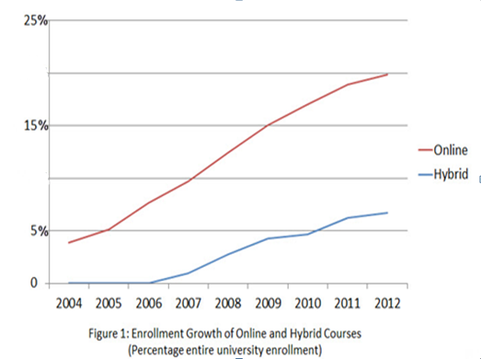
Drexel University
Background and Context
Tremendous Growth

Slide 5
Total Student Enrollment ~26,000
Online Scalability Challenges
  115 online programs – 15 undergraduate, 44 graduate, 56 certificate
  20,000 students or 77% of all students have taken at least one online course this academic year
  6700 or 26% are fully online students includes 2459 undergraduate, 4147 graduate and 75 certificate program students
  ~650 faculty members teach online including 336 graduate and 318 undergraduate level.

Slide 6
Academic Units
COAS
BioMed
LeBow
Education
Pennoni
DUCOM
Professional Studies
CNHP
SPH
iSchool
Law School
Engineering
Westphal

Slide 7
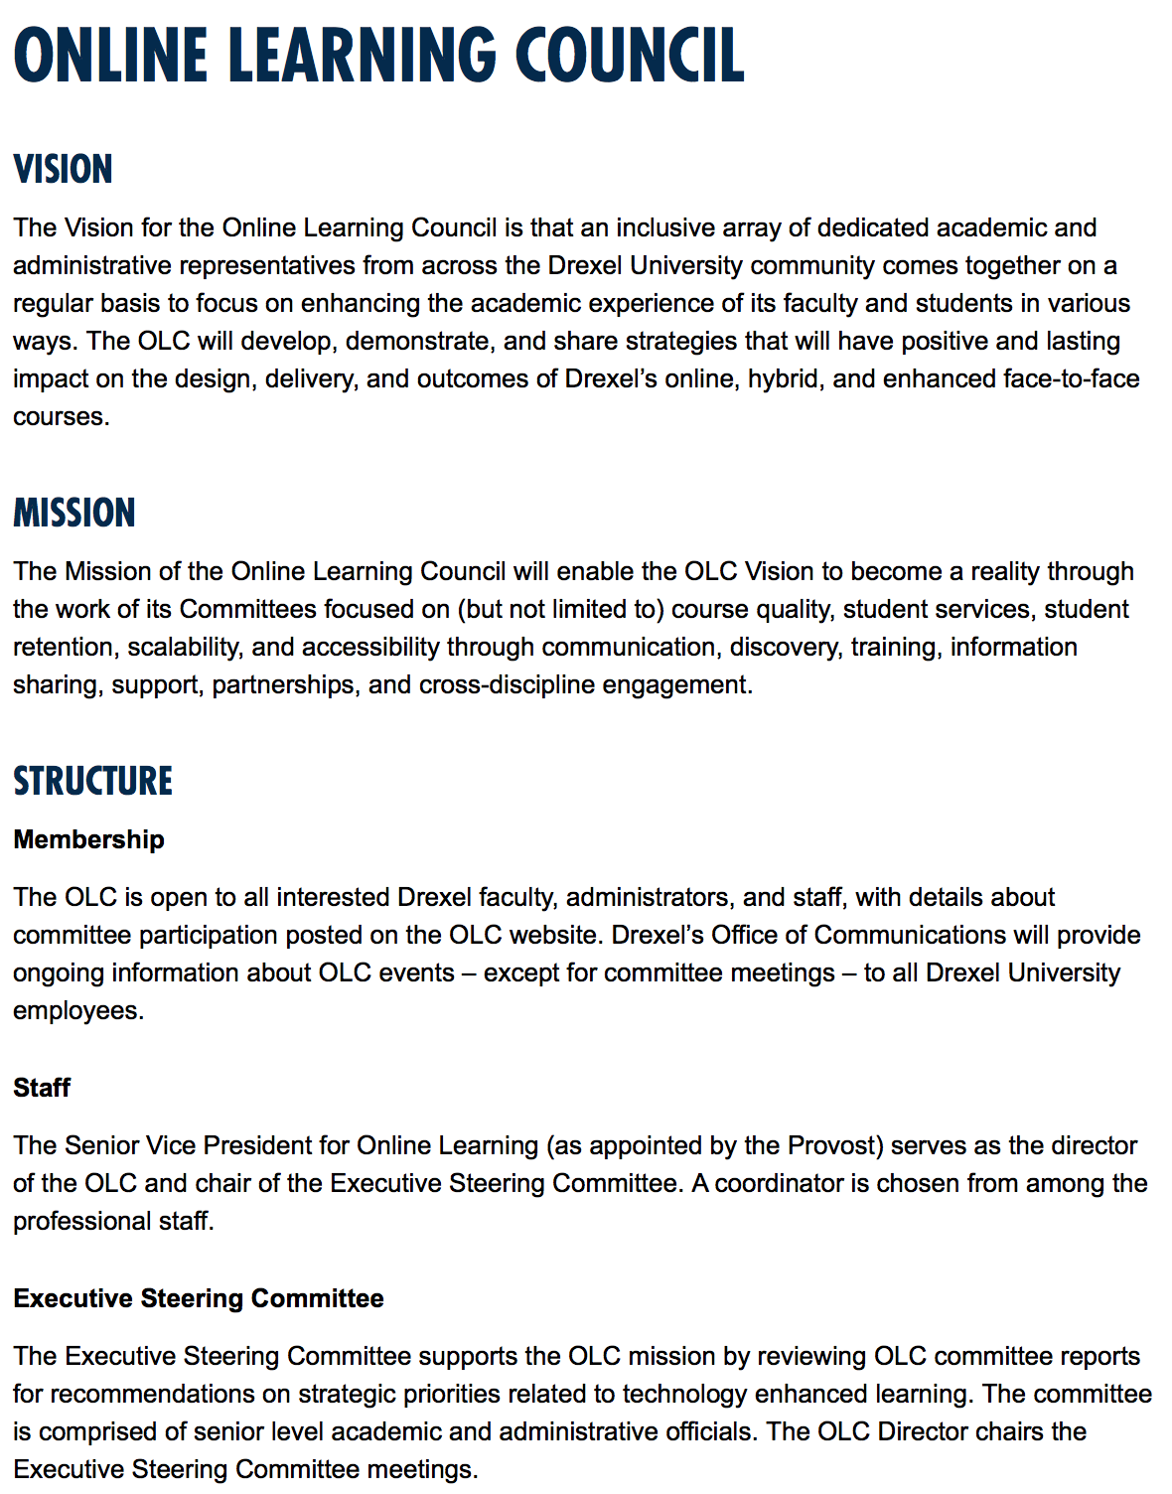

Online Learning Council
(2010)
Online Learning Council Stand-up 100 members

Slide 8

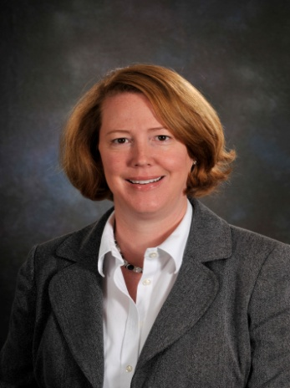


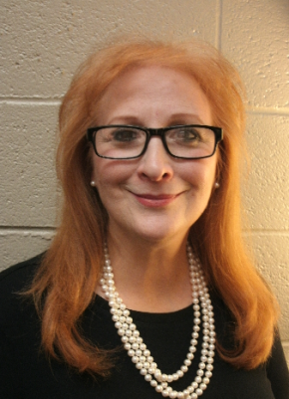
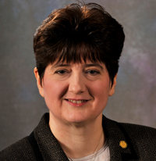
The Inaugural OLC FELLOWS 2012
FRAN CORNELIUS
JUDY GIERING
ALLEN GRANT
KARYN HOLT
MARLIN KILLEN
RAY LUM
ANN SOLAN
LINDA MARION

Slide 9






2017-2018 THE OLC FELLOWS
Fran Cornelius
College of Nursing and
Health Professions
Jonathan Deutsch
Center for Food and Hospitality
Management and Department
of Nutrition Sciences
Allan Grant
School of Education
Karyn Holt, Chair
College of Nursing and Health Professions
Dana Kemery
College of Nursing and Health Professions
Deirdre McMahon
College of Arts and Sciences
Beth Haas
School of Law

Slide 10
Fellows are ambassadors and champions of the Online Learning Council serving the Drexel community
Professional Development
Mentorship
Quality Assurance
  Course Design
  Consultation
    individual course owner (Faculty)
    program or departmental groups

Slide 11
MSCHE’s Hallmarks of Quality
Institution evaluates the effectiveness on its online offerings
Institution provides sufficient resources to support and expand its online offering
Faculty responsible for delivering online learning curricular are appropriately qualified and effectively supported.

Slide 12
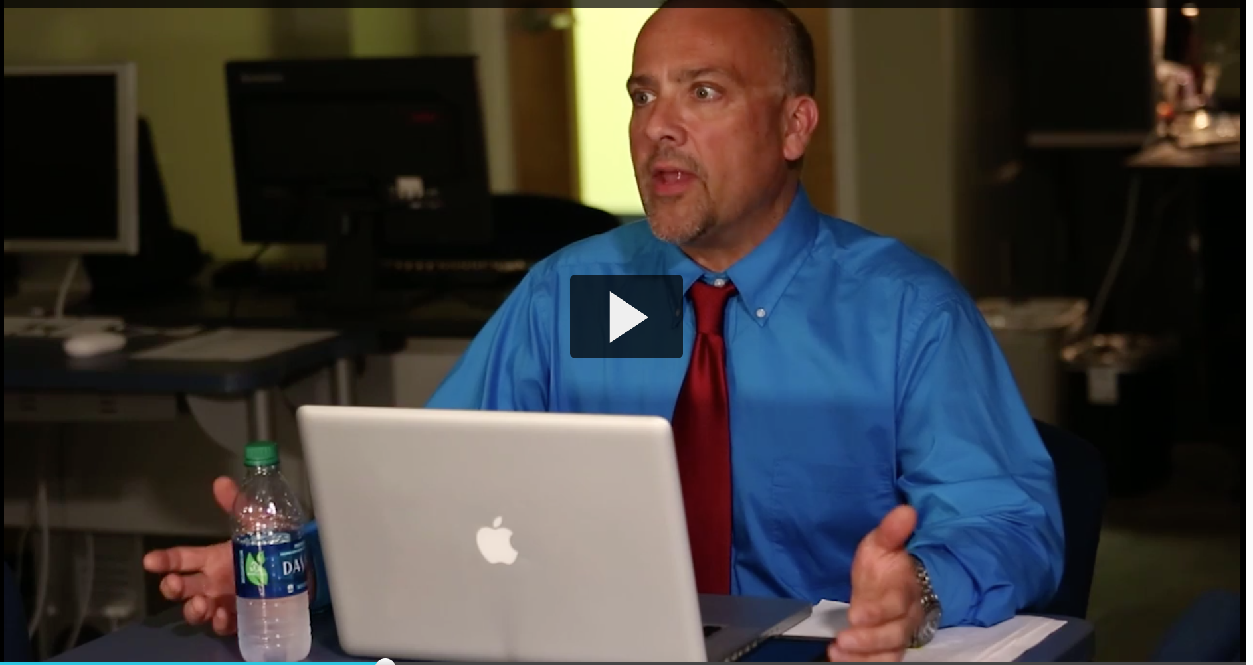
Professional Development for Online Faculty
Evidence Based Learning-Creating a Culture of Inclusiveness at Drexel - Faculty Development Day (TAGG Scenario 1)
Self-Paced “Core Design Element Checklist” Course
Online Faculty Training (Level I)
    Online self-paced
    F2F workshop
    Webinar
Workshops/Brown Bags
https://1513041.mediaspace.kaltura.com/media/TAGG+Scenario+1/1_ppwnw0gl

Slide 13
Benefits to Student, Faculty and Program
Overview of the Process
Request for Course Design Review
Self-Review
Peer-Review
Tools and materials
provided to the Instructor
Drexel University
Core Design Elements Checklist
Quality Matters Rubric
OLC Fellow(s) assigned
Drexel University
Core Design Elements Checklist:
self-paced online training course
Initial Meeting/Consultation
Between Fellow and Instructor
Review conducted by instructor
Fellow(s) conducts the review
Confidential feedback to instructor
Consultation with Fellows as needed
Follow-up, additional
consultation as needed
Notes:
Karyn 13-18

Slide 14

Course Reviews
Types of Reviews
Self-Review using DU Core Design Element Checklist course in Blackboard.
A Fellow Review using the DU Core Design Elements Checklist
A QM Review by three Fellows using the Quality Matters rubric

Slide 15

The Review Process
Confidential
Collegial
Voluntary
Focused on design, not instruction

Slide 16
THE DREXEL UNIVERSITY CORE DESIGN
ELEMENTS CHECKLIST (DUCDEC)
1. A course description is provided.
2.. This may include a statement that introduces the student to the purpose of the course and its components.
3. In the case of a hybrid course, there is a statement that clarifies the relationship between the ‘face-to-face’ and ‘online’ components.
4. The number of credit hours earned for successful completion is clearly posted.
5. The grading policy is clearly stated.
6. Specific/descriptive criteria are provided for the evaluation of student work and participation.
7. Instructions for completion and submission are provided.
8. Grading scales and weights are provided.
9. Course learning objectives describe outcomes that are measurable.
10. Assessment and evaluation are aligned with course learning objectives.
11. Assessment and evaluation tools are appropriate for measuring the stated learning outcomes.
12. Assessment and evaluation goals are clearly communicated.
13. Information about student feedback is provided.
14. Instructor contact and availability information is provided.
15. A list of textbooks, supplies, and other instructional materials needed for the course is provided.
16. Due dates and deadlines are provided.
17. A disclaimer that dates are subject to change should be included.
18. A code of conduct and information about academic integrity are provided.
19. Links to university policies should be provided.
20. Netiquette standards should be provided as needed.
21. Links, email addresses, and/or phone numbers to technical support are provided.
22. Content is sequenced and structured in a manner that enables learners to achieve the stated goals.
23. The course content is divided into learning Modules that are labeled and presented in a logical manner.
24. The course is easy to navigate.
25. The components and structure of the course are clear and understandable.
26. Instructions about how to get started and where to find various course components is provided.
27. Broken or outdated links are corrected or removed.
28. Required online resources are accessible.
29. Links to academic resources are provided.
30. Links to Drexel Express, library, tutoring centers, counseling services, Provost Office, DragonCard Office, and bookstore are provided.
31. The university statement regarding ADA compliance is provided.
32. Information about how to request special Services is provided.

Slide 17
Course Ownership
  When a course is submitted for review, the faculty member will be asked if he/she to agree to the following statement:
“Departments have different rules related to course ownership. We respect intellectual property rights and considerations related to course ownership. Before scheduling a course review, please confirm that you have the right to have the course design reviewed.”
I certify that I have the right to have this course design reviewed and make changes to the course.

Slide 18
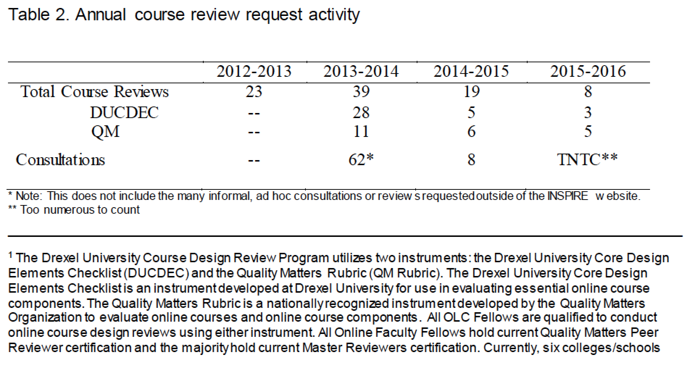
Annual Course Review Request Activity

Slide 19

Academic Policy
University Wide Provost Office (Centralized)
  Learning Management System
  Technology Support via OLT
  Accessibility
  INSPIRE Initiative*
College and School (Decentralized)
Quality Measures
  Quality Matters Rubric*
  Drexel University Core Design Element Checklist*

Slide 20

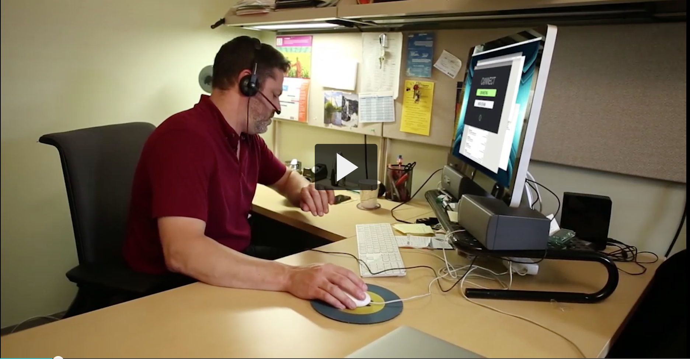
Academic Policy Road Map
TAGG Scenario 2
https://1513041.mediaspace.kaltura.com/media/TAGG+Scenario+2/1_07lcy778

Slide 21

Academic Structure
In 2010, Online Learning Council Lead by Associate Provost: 100 members from across University
  Quality
  Accessibility
  Scalability
  Retention
  Student Services
  Communication
Executive Director – Online Learning Council*
Online Learning Council Fellows*

Slide 22
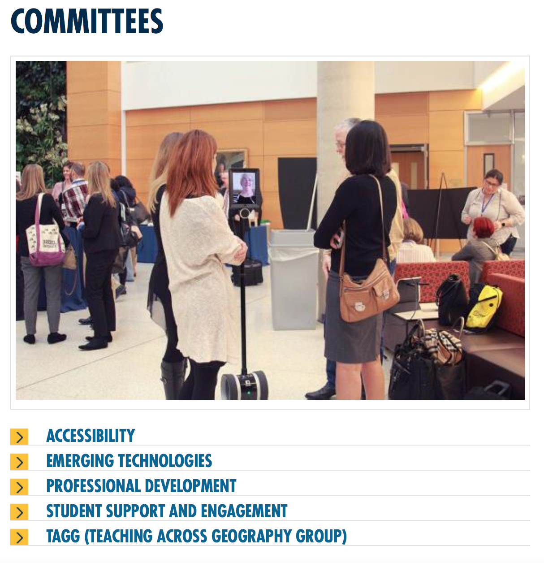
Academic Structure
2017, Online Learning Council Maintains 100 members from across University
Chair – Online Learning Council Fellows*
Online Learning Council Fellows*

Slide 23
Academic Structure

Slide 24

Academic Structure

Slide 25
Academic Culture
Pockets of Excellence Across the Academic Enterprises
Collaboration – Expanding Breadth and Depth*
Dissemination, Transparency and Collegiality
  Faculty Orientation to Online Teaching
  Faculty Development Days
  Repository of Resources
  Self-Review
  Peer Review
  Consultation
Quality Assurance

Slide 26
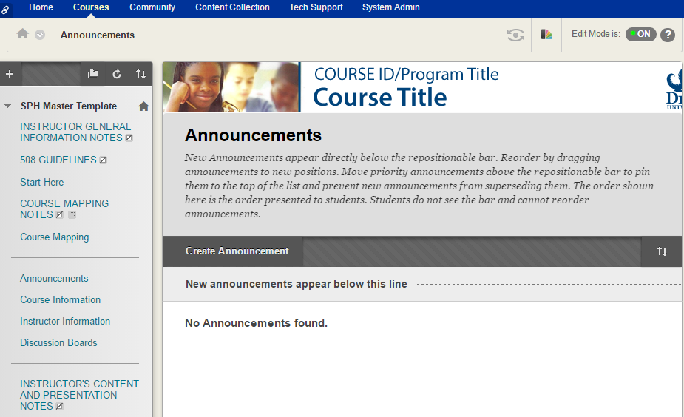
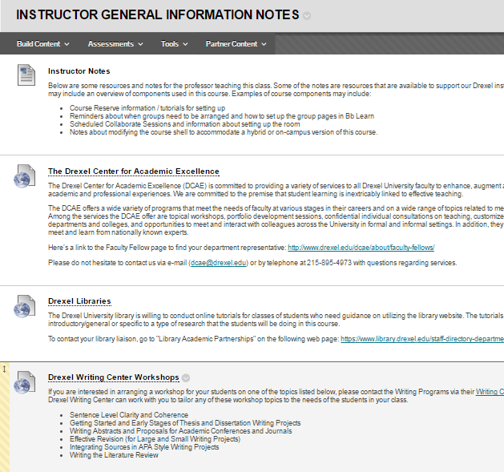
University Initiatives
Master Course Template
Notes:
Design a Master Course Template based on Quality Matters Standards that involved stakeholders such as faculty, instructional designers, staff from the Provost Office of Assessment, staff from the University’s Office of Accessibility.
Frame the Course Master Template as a Dashboard for One Stop Information.
General Instructor Information

Slide 27
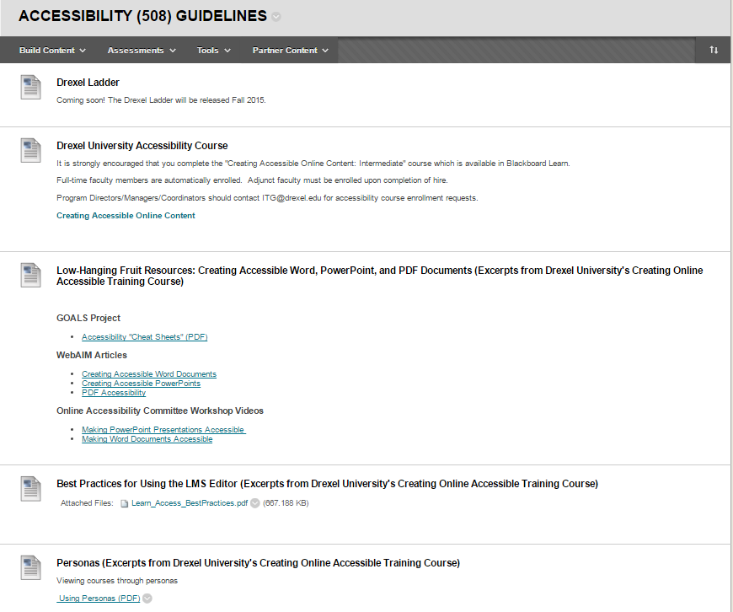
University Initiatives-Accessibility
Master Course Template
Notes:
Accessibility (508) Guidelines

Slide 28
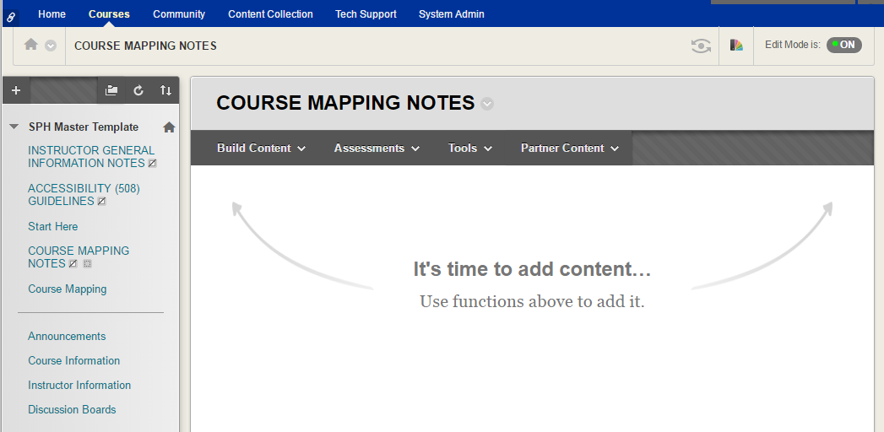
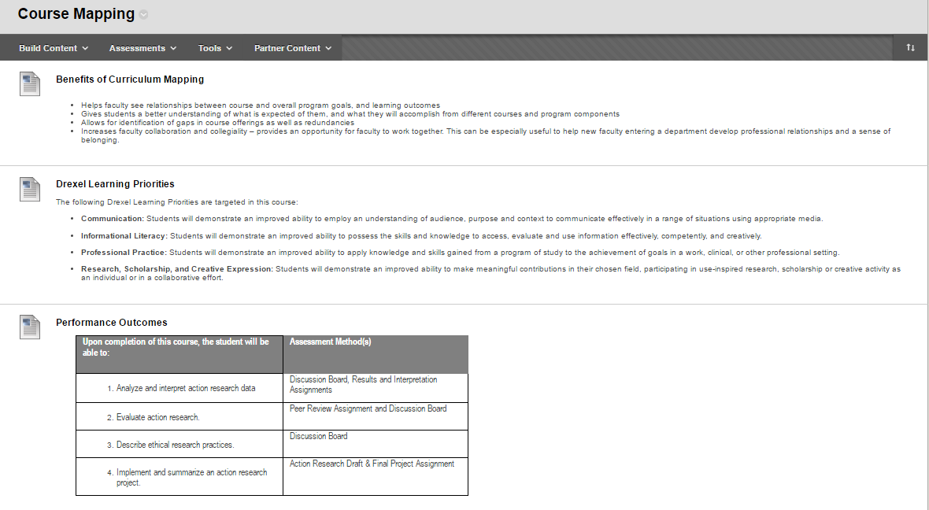
University Initiatives-Alignment
Master Course Template
Notes:
Course Mapping

Slide 29
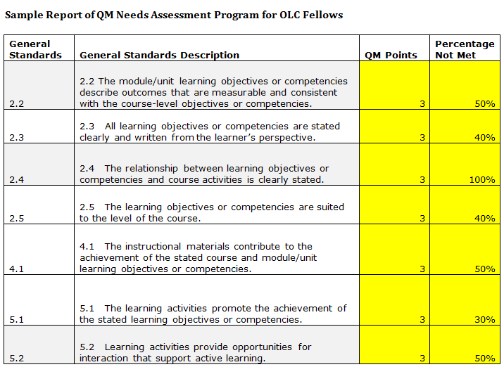
University Initiatives
Needs Assessment
Notes:
Perform a Quality Matter Needs Assessment on those courses that implemented the Master Course Template and roll up data at the Program Level rather than the course level.

Slide 30
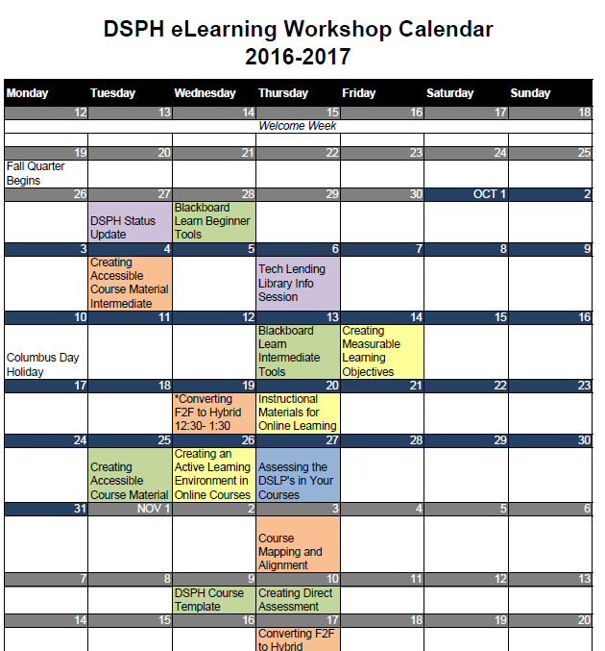
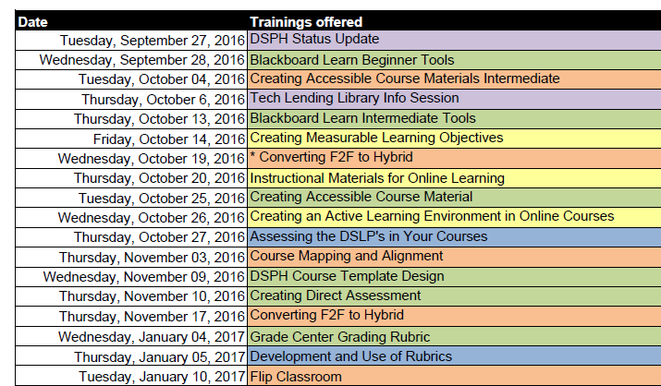
University Initiatives
Professional Development Workshops
Notes:
Identify key General Standards that do not meet a 80% threshold and provide trainings to address the deficiency.
Roll out a series of trainings that address the gaps found in the needs assessment.

Slide 31
University Initiatives
Workshop Evaluations
Notes:
We are evaluating the training workshops.

Slide 32
Centralization v Decentralization-
What is the “just right” Mix?

Slide 33
College and School Initiatives
College of Arts and Sciences
College of Computing and Informatics
The Dean of the College of Arts and Science created the COAS Committee on Technology-Enhanced Teaching (CCTET) that is chaired by an OLC Fellow and comprised of faculty representatives from each department in COAS. The work of CCTET has resulted in:
  - Conducted a limited survey of faculty who had undergone the online course design review process using the Drexel University Core Design Elements Checklist:
The Information Science Department at CCI developed initiatives for undergraduate and graduate courses.
  - All undergraduate courses are being developed and/or revised using a template following the Quality Matters Standards.
  - A group of PhD students were trained to conduct course reviews and reviewed 40 Masters courses using the DUCDEC. In Phase 2 of the project they are reviewing the courses in more depth using modified Quality Matters Standards.

Slide 34
College and School Initiatives
College of Engineering
Westphal College of Media Arts and Design
Established the QM Rubric as the basis for Online and Blended course design within the College of Engineering, Construction Management Program.
Looking towards planning for a Technology Enhanced Teaching Committee within College of Engineering
Roundtable developed to discuss online courses and online course development within the College.
Instructional Designer assisting with online course development.

Slide 35
College and School Initiatives
Dornsife School of Public Health
Kline School of Law
Master Course Template developed and implemented throughout the Dornsife School of Public Health (DSPH) for all online and hybrid courses (currently, four fully online and hybrid programs).
Currently all online and hybrid DSPH courses (~40 courses) are being reviewed via the DSPH QM Needs Assessment Program based on the QM General Standard Rubric within the school (represents ~ 30% of all course offerings).
After needed modifications, the courses will undergo Drexel Internal QM Review
15 new online courses were developed using the QM Rubric and all new online courses use the QM Rubric for course development.
Online Course Template developed and now in use throughout all online/hybrid courses at Kline.

Slide 36
College and School Initiatives
College of Nursing and Health Professions
All online courses located within the MSN Program (fully online) are reviewed before approval using the QM Course Design Rubric.
A Common Course Template, based on the QM Course Design Rubric is used for online and hybrid courses throughout CNHP, face-to-face, hybrid and online.
Online Tutorial “Online Teaching 101”is used for new faculty hires (adjunct, part time and fulltime before receiving an online course load with Department of Nursing.
New QM Peer Reviewers and faculty completing “Applying the QM Rubric” course are added to existing reviewers within the College.
“Raising the Bar” Quarterly Online Lecture Topic Series continues into fifth year.

Slide 37
College and School Initiatives
School of Education
Faculty in the SoE participated in six individualized training sessions around quality course design.
SoE Program Directors attended a workshop delivered by Ray Lum centered on direct assessments, and alignment among objectives, activities and course assessment. A number of faculty members in the SoE participated in the “Applying the QM Rubric” course.
Because of the high number of distance faculty, the SoE holds a large percentage of the TAGG committee roster.
The SoE has hired a fulltime instructional designer who has been tasked with insuring course creation and modification within the framework of QM standards.
In conjunction with CNHP, faculty and staff in the SoE are working to create two new online pedagogy courses slated for delivery in the fall.

Slide 38

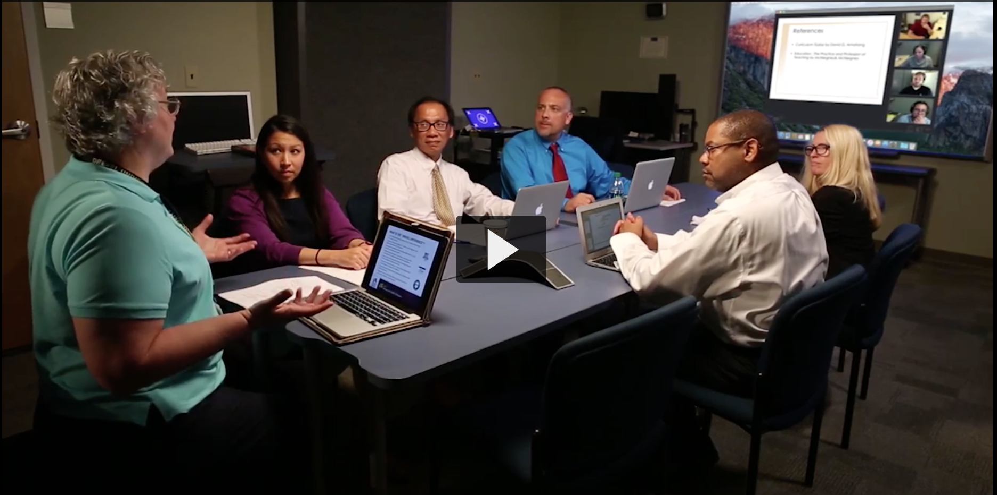
Thank you
Scenario 3

