Slide 1
Follow the Yellow Brick Road to Becoming A
K-12 Certified QM Peer Reviewer!
Insomnia Cured Here. "The Wizard of Oz (1939)". 6 December 2008. Online image. Flikr..https://flic.kr/p/5GTTPd

Slide 2
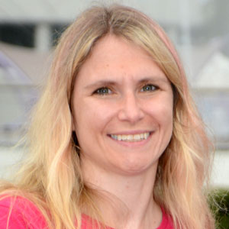
Meet Your Presenter
Suzie Scheffler
K-12 Program Manager
@smscheffler
sscheffler@qualitymatters.org

Slide 3
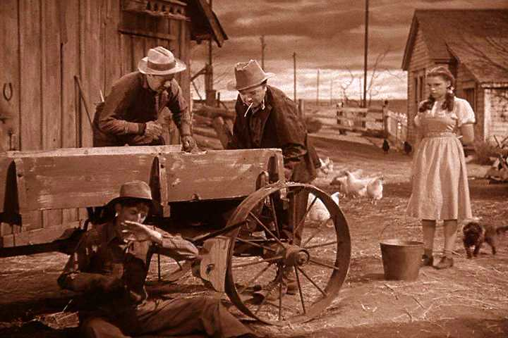
Poll 1
What’s your primary role?
Teacher/Professor
ID/Ed Tech
Content Specialist/SME
Administrator
Other

Slide 4
Early Online Learning
Insomnia Cured Here: "The Wizard of Oz (1939)". 6 December 2008. Online image. Flikr. https://flic.kr/p/5GLVuc

Slide 5
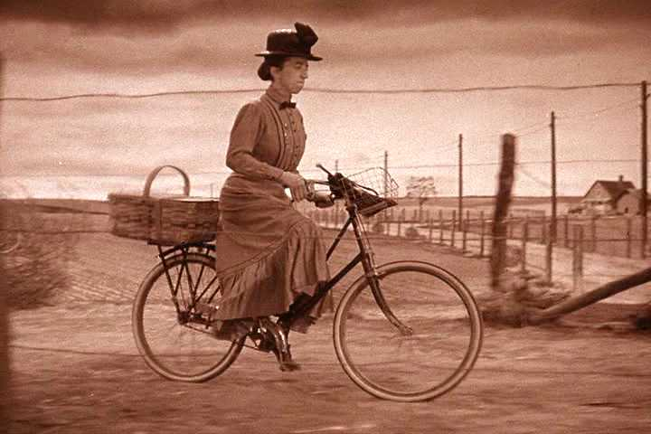
Poor Quality Courses
Insomnia Cured Here: "The Wizard of Oz (1939)". 6 December 2008. Online image. Flikr. https://flic.kr/p/5GRkvf
Insomnia Cured Here: "The Wizard of Oz (1939)". 6 December 2008. Online image. Flikr. https://flic.kr/p/5GRd5y

Slide 6
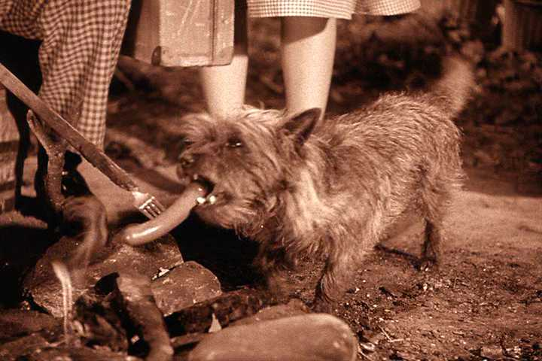
What about the students?
Insomnia Cured Here: "The Wizard of Oz (1939)". 6 December 2008. Online image. Flikr. https://flic.kr/p/5GRkyj

Slide 7
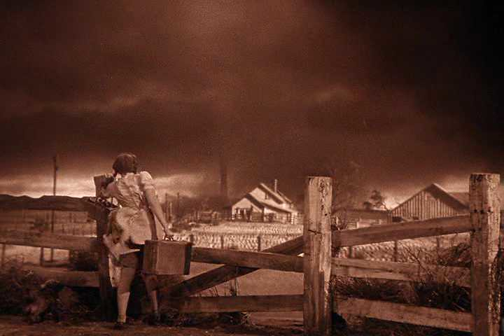
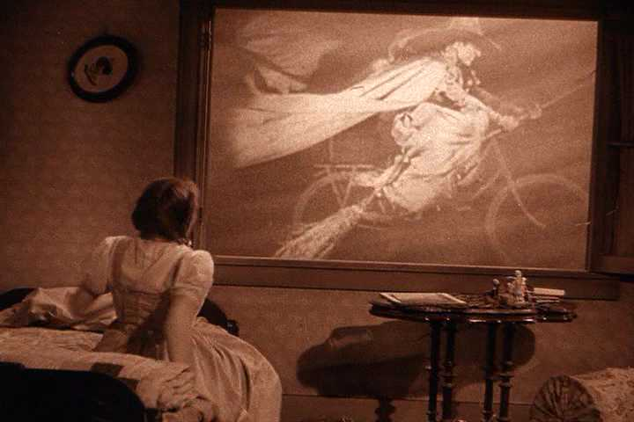
Tornado of New Courses
Insomnia Cured Here: "The Wizard of Oz (1939)". 6 December 2008. Online image. Flikr. https://flic.kr/p/5GRkB5
Insomnia Cured Here: "The Wizard of Oz (1939)". 6 December 2008. Online image. Flikr. https://flic.kr/p/5GMnWX

Slide 8
platinumblondex. "The Wizard of Oz (1939)". 7 August 2010. Online image. Flikr. https://flic.kr/p/8qcksu

Slide 9
Quality Matters K-12 Rubric
Fifth Edition, 2019
8 General Standards
43 Specific Standards
Elementary, Middle, and High School
Online and Blended Courses
Insomnia Cured Here: "The Wizard of Oz (1939)". 6 December 2008. Online image. Flikr. https://flic.kr/p/5GREGW

Slide 10
Quality Matters Reviewer
Peter K. Levy: "There's no place like home.". 4 April 2016. Online image. Flikr. https://flic.kr/p/FxJnzG

Slide 11
How to Become a QM K-12 Reviewer?
Peter K. Levypilsnerpills: "oz". 4 April 2016. Online image. Flikr. https://flic.kr/p/awCbxx

Slide 12
Professional Development
Applying the QM K-12 Rubric
K-12 Reviewer Course
Insomnia Cured Here: "The Wizard of Oz (1939)". 6 December 2008. Online image. Flikr. https://flic.kr/p/5GRXSG

Slide 13
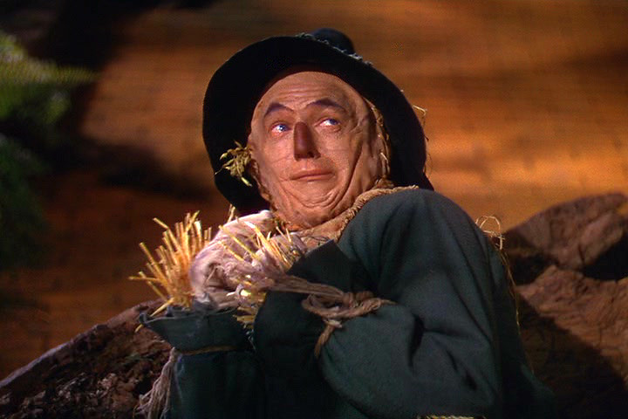
Applying the QM K-12 Rubric (K-12 APP)
Public sessions begin the first Tuesday of every month
3 weeks
5-7 hours per week
Graduate credit is available
Insomnia Cured Here: "The Wizard of Oz (1939)". 6 December 2008. Online image. Flikr. https://flic.kr/p/5GPtoD

Slide 14
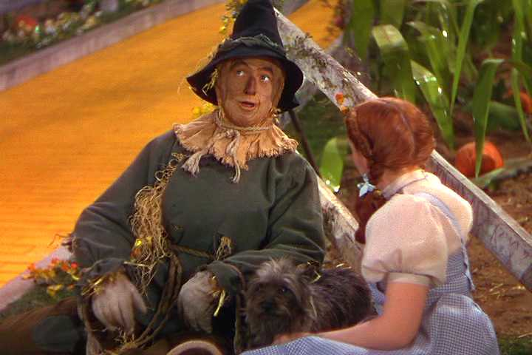
K-12 Reviewer Course
Public sessions begin the first Wednesday of every month
3 weeks
8-10 hours per week
Graduate credit is available
Always keeping the students in mind!
Insomnia Cured Here: "The Wizard of Oz (1939)". 6 December 2008. Online image. Flikr. https://flic.kr/p/5GMFfr

Slide 15
Heart for Online Learning!

Slide 16
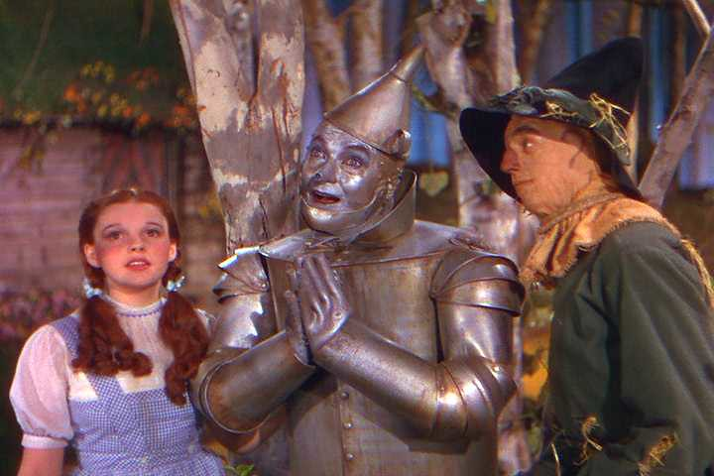
The Heart
Please take a moment to share the skills that you process that you think will make you strong course reviewer.
Insomnia Cured Here: "The Wizard of Oz (1939)". 6 December 2008. Online image. Flikr. https://flic.kr/p/5GTL7y

Slide 17
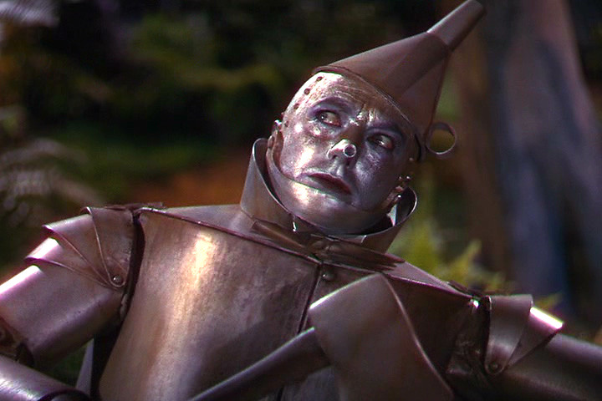
For Love or Money? Why not both?
What do you mean teachers don’t do it for the money?
Insomnia Cured Here: "The Wizard of Oz (1939)". 6 December 2008. Online image. Flikr. https://flic.kr/p/5GTL7y

Slide 18
Courage
Insomnia Cured Here: "The Wizard of Oz (1939)". 6 December 2008. Online image. Flikr. https://flic.kr/p/5GTL37

Slide 19
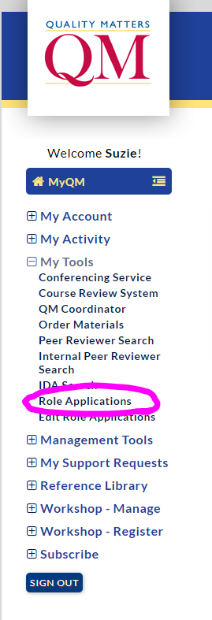
My QM
Insomnia Cured Here: "The Wizard of Oz (1939)". 6 December 2008. Online image. Flikr https://flic.kr/p/5GPtyn

Slide 20
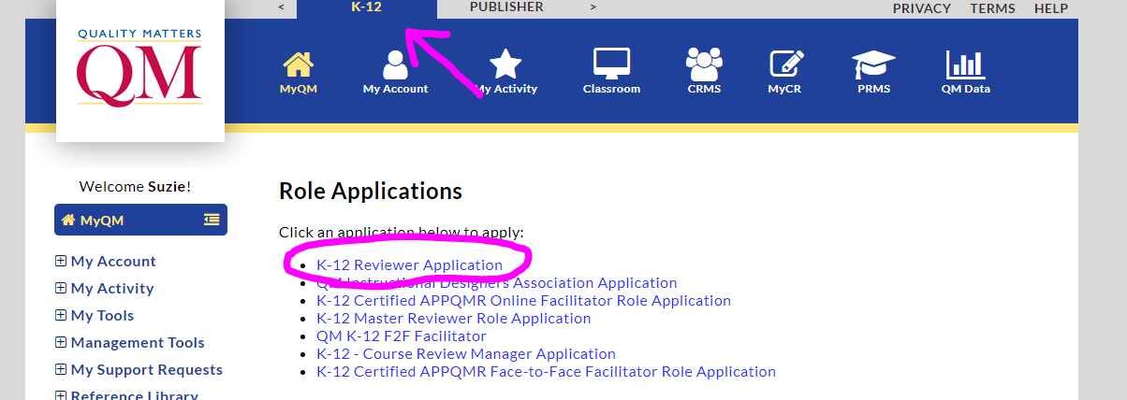
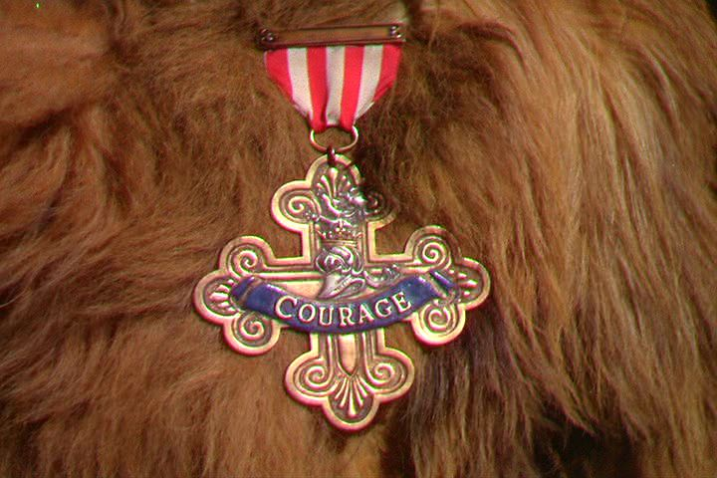
Pay Attention to the Tabs
Insomnia Cured Here: "The Wizard of Oz (1939)". 6 December 2008. Online image. Flikr. https://flic.kr/p/5GWEHY

Slide 21
The End of the Yellow Brick Road
Insomnia Cured Here: "The Wizard of Oz (1939)". 6 December 2008. Online image. Flikr. https://flic.kr/p/5GRY3E

Slide 22
Take the
K-12 APP and
K-12 RC.
2. Incorporate your love of online learning and previous experience to what you’ve learned.
3. Fill out the K-12 Reviewer and K-12 Publisher Reviewer Applications
Insomnia Cured Here: "The Wizard of Oz (1939)". 6 December 2008. Online image. Flikr. https://flic.kr/p/5GRY2U

Slide 23
The Master Reviewer
Insomnia Cured Here: "The Wizard of Oz (1939)". 6 December 2008. Online image. Flikr. https://flic.kr/p/5GQGS4

Slide 24
Steps to Becoming a K-12 Master Reviewer
Complete a minimum of 2 reviews
Take the K-12 Master Reviewer Course
Complete the Applications:
K-12 Master Reviewer
K-12 Publisher Master Reviewer
Insomnia Cured Here: "The Wizard of Oz (1939)". 6 December 2008. Online image. Flikr. https://flic.kr/p/5GSnAz

Slide 25
Insomnia Cured Here: "The Wizard of Oz (1939)". 6 December 2008. Online image. Flikr. https://flic.kr/p/5GMF8D

Slide 26
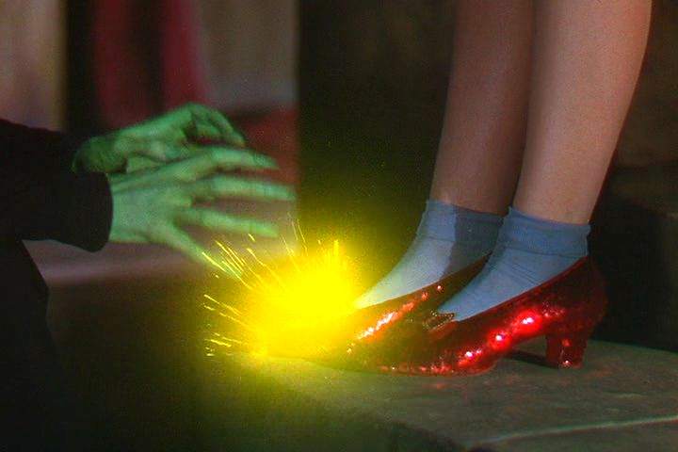
Poor Quality is No Match for You!!
Insomnia Cured Here: "The Wizard of Oz (1939)". 6 December 2008. Online image. Flikr. https://flic.kr/p/5GRVJ6

Slide 27
Coupon Code: “Yellow Brick Road”
You have one week, my pretty! Coupon expires on Monday, Nov 2nd.
20% off the K-12 Applying the QM Rubric and Reviewer Course
Register for them both at the same time
Input Code: “Yellow Brick Road”
Insomnia Cured Here: "The Wizard of Oz (1939)". 6 December 2008. Online image. Flikr. https://flic.kr/p/5GWdRw

Slide 28
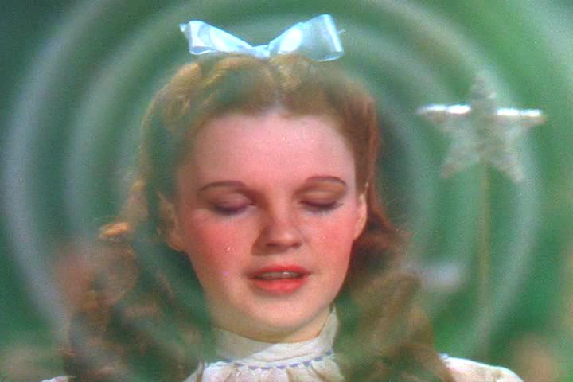
What are your plans?
I will be signing up to become a certified reviewer this week.
I will be signing up to become a certified reviewer, but not this week.
My goal is to become a Master Reviewer
I’m not sure.
Insomnia Cured Here: "The Wizard of Oz (1939)". 6 December 2008. Online image. Flikr. https://flic.kr/p/5GSBaB

Slide 29
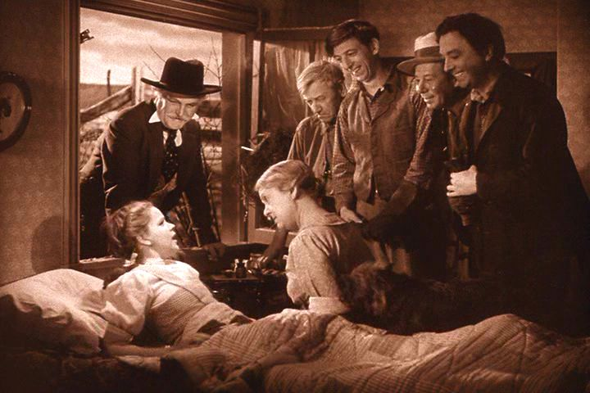
Questions?
sscheffler@qualitymatters.org
Insomnia Cured Here. "The Wizard of Oz (1939)". 6 December 2008. Online image. Flikr. https://flic.kr/p/5GWZKQ

Slide 30
Thank you!!!!
Insomnia Cured Here: "The Wizard of Oz (1939)". 6 December 2008. Online image. Flikr. https://flic.kr/p/5GSGAT

