Slide 1
According to the Numbers, Templates are Good For You
Dr. Ben Hollis Executive Director, Kent State Online

Slide 2
Templates are good for you
Data for informing & promoting change
Overview
Communication strategies
Establishing success & navigating change

Slide 3
Templates are good for you
Data for informing & promoting change
Overview
Communication strategies
Establishing success & navigating change

Slide 4
Templates are good for you
Data for informing & promoting change
Overview
Communication strategies
Establishing success & navigating change

Slide 5
Templates are good for you
Data for informing & promoting change
Overview
Communication strategies
Establishing success & navigating change

Slide 6
Templates are good for you
Data for informing & promoting change
Overview
Communication strategies
Establishing success & navigating change

Slide 7
Not prescriptive
Saves time
Templates are good for you
Consistent
Foundational with QM in mind

Slide 8
Not prescriptive
Saves time
Templates are good for you
Consistent
Foundational with QM in mind

Slide 9
Not prescriptive
Saves time
Templates are good for you
Consistent
Foundational with QM in mind

Slide 10
Not prescriptive
Saves time
Templates are good for you
Consistent
Foundational with QM in mind

Slide 11
Not prescriptive
Saves time
Templates are good for you
Consistent
Foundational with QM in mind

Slide 12
Party like it's 2017
Help Desk analysis of Blackboard tickets in first 3 months of the semester
According to the numbers ...
66.7% of tickets could be negated with better training and/or course standardization

Slide 13
Party like it's 2017
Help Desk analysis of Blackboard tickets in first 3 months of the semester
According to the numbers ...
66.7% of tickets could be negated with better training and/or course standardization

Slide 14
Party like it's 2017
Help Desk analysis of Blackboard tickets in first 3 months of the semester
According to the numbers ...
66.7% of tickets could be negated with better training and/or course standardization

Slide 15
Party like it's 2017
Help Desk analysis of Blackboard tickets in first 3 months of the semester
According to the numbers ...
66.7% of tickets could be negated with better training and/or course standardization

Slide 16
Communication Ecosystems
Listservs / Faculty Meetings / Email
How do you get everyone to know something?
Pop-Up Messages
Training / Workshops

Slide 17
Communication Ecosystems
Listservs / Faculty Meetings / Email
How do you get everyone to know something?
Pop-Up Messages
Training / Workshops

Slide 18
Communication Ecosystems
Listservs / Faculty Meetings / Email
How do you get everyone to know something?
Pop-Up Messages
Training / Workshops

Slide 19
Communication Ecosystems
Listservs / Faculty Meetings / Email
How do you get everyone to know something?
Pop-Up Messages
Training / Workshops

Slide 20
Communication Ecosystems
Listservs / Faculty Meetings / Email
How do you get everyone to know something?
Pop-Up Messages
Training / Workshops

Slide 21
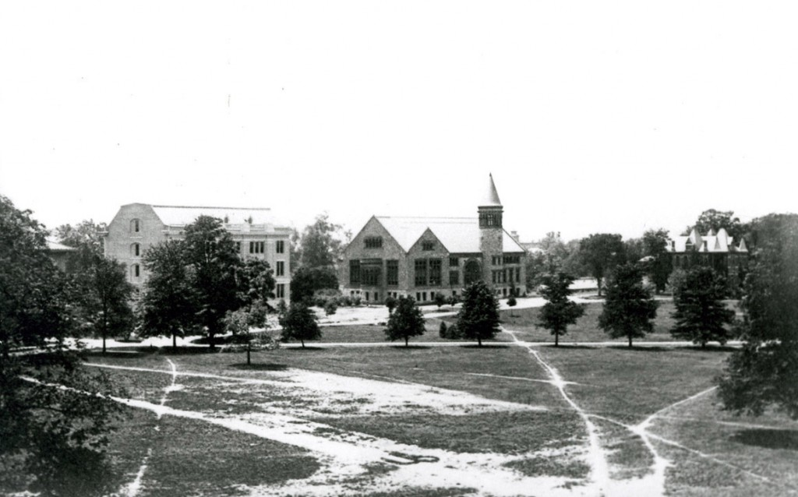
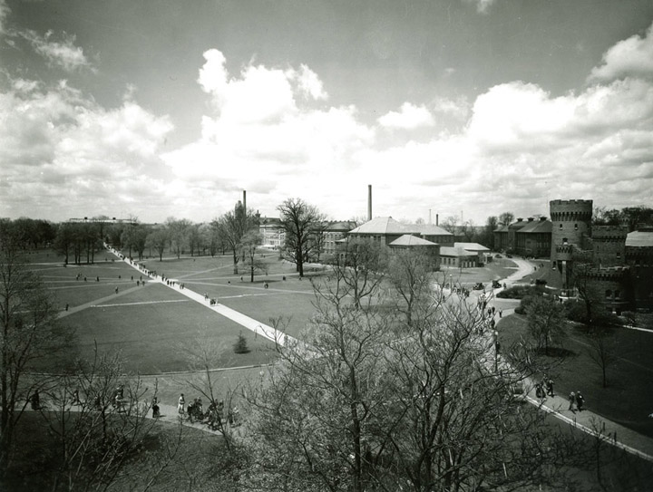
Faculty pathways & wayfinding
Source: The Oval’s Long Walk has paved way for students for a century

Slide 22
Bb Learn Building Block

Slide 23
203 faculty members
template added to 278 sections of 235 courses
One semester later ...
52% of tickets could be negated with better training and/or course standardization

Slide 24
203 faculty members
template added to 278 sections of 235 courses
One semester later ...
52% of tickets could be negated with better training and/or course standardization

Slide 25
203 faculty members
template added to 278 sections of 235 courses
One semester later ...
52% of tickets could be negated with better training and/or course standardization

Slide 26
203 faculty members
template added to 278 sections of 235 courses
One semester later ...
52% of tickets could be negated with better training and/or course standardization

Slide 27
Building Block vs Commons
Course Migration / Carpe Diem! Seize the Design!!
Training / Start with the Template
Making the switch from Blackboard to Canvas
Provost Leadership Academy Do you think a university-wide template would make online classes easier for students? 88% Yes (n = 77)

Slide 28
Building Block vs Commons
Course Migration / Carpe Diem! Seize the Design!!
Training / Start with the Template
Making the switch from Blackboard to Canvas
Provost Leadership Academy Do you think a university-wide template would make online classes easier for students? 88% Yes (n = 77)

Slide 29
Building Block vs Commons
Course Migration / Carpe Diem! Seize the Design!!
Training / Start with the Template
Making the switch from Blackboard to Canvas
Provost Leadership Academy Do you think a university-wide template would make online classes easier for students? 88% Yes (n = 77)

Slide 30
Building Block vs Commons
Course Migration / Carpe Diem! Seize the Design!!
Training / Start with the Template
Making the switch from Blackboard to Canvas
Provost Leadership Academy Do you think a university-wide template would make online classes easier for students? 88% Yes (n = 77)

Slide 31
Building Block vs Commons
Course Migration / Carpe Diem! Seize the Design!!
Training / Start with the Template
Making the switch from Blackboard to Canvas
Provost Leadership Academy Do you think a university-wide template would make online classes easier for students? 88% Yes (n = 77)

Slide 32
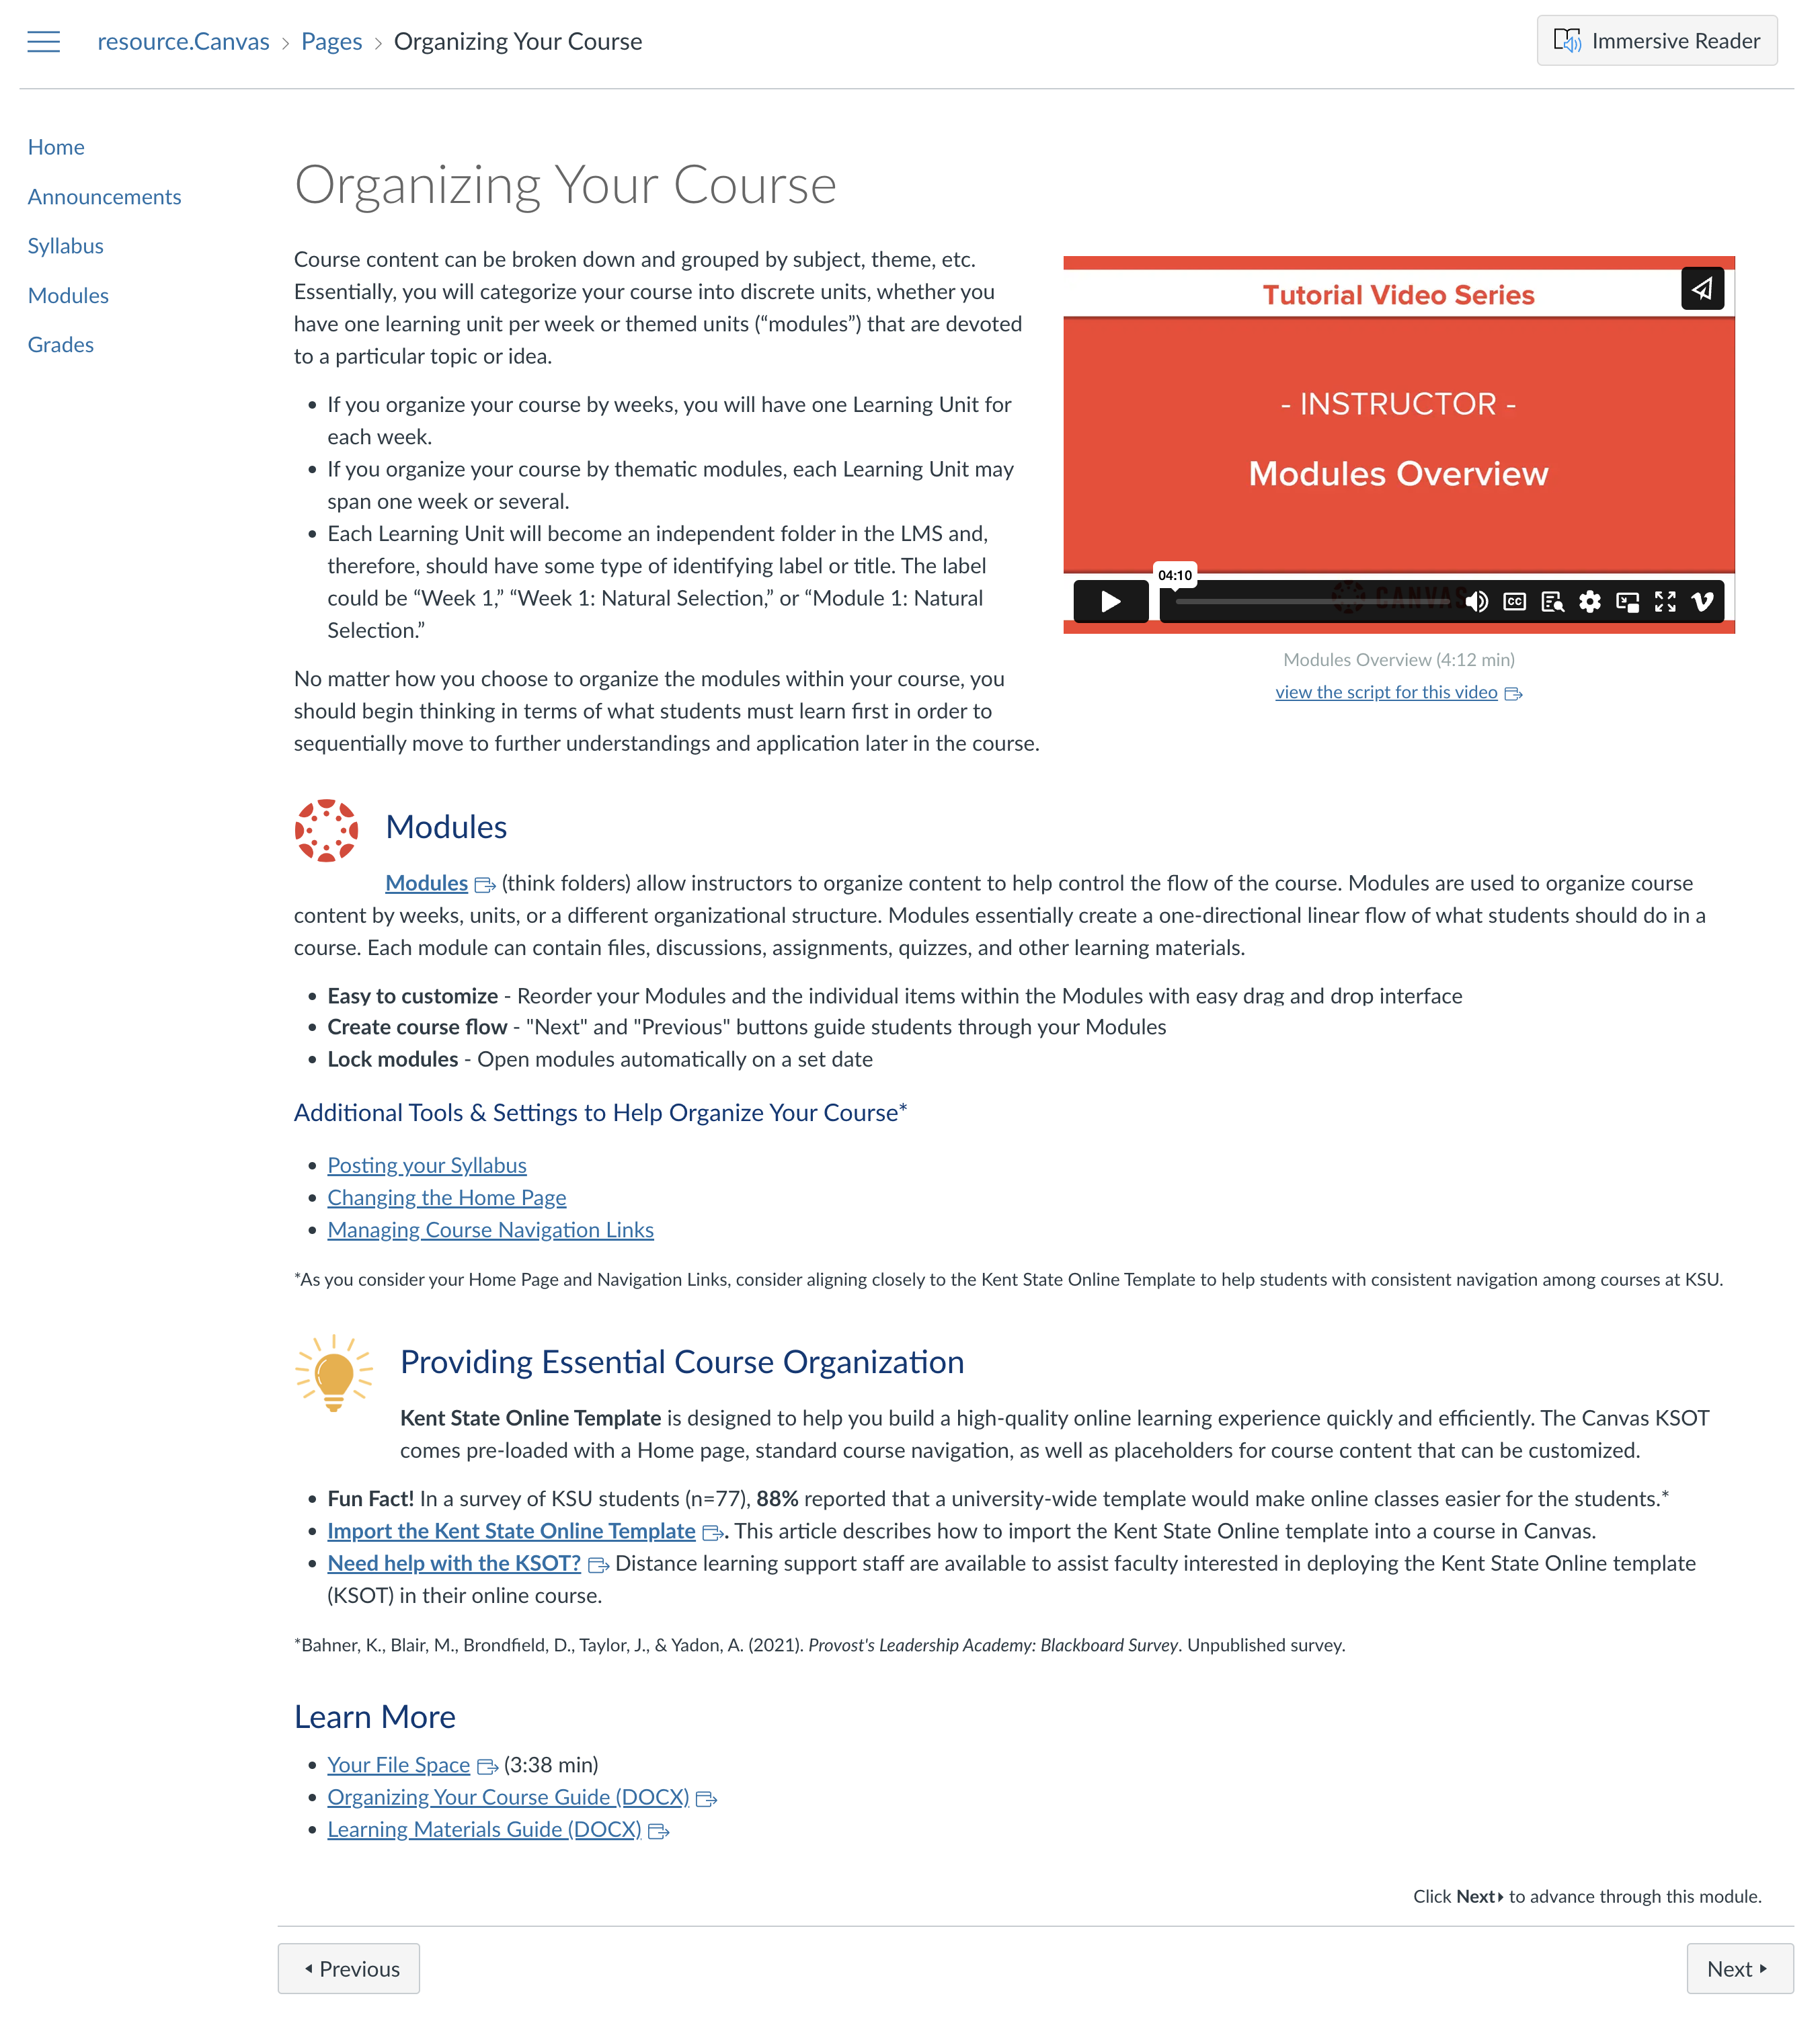
Canvas in a Flash

Slide 33
Party like it's 2023
4,900 imports & counting ...
Template today
Need a consistent student experience

Slide 34
Party like it's 2023
4,900 imports & counting ...
Template today
Need a consistent student experience

Slide 35
Party like it's 2023
4,900 imports & counting ...
Template today
Need a consistent student experience

Slide 36
Party like it's 2023
4,900 imports & counting ...
Template today
Need a consistent student experience

Slide 37
Questions?
Dr. Ben Hollis Executive Director, Kent State Online

