Slide 1


Department of Assessment and Academic Quality
Effective Systems of Evidence-Led Improvement: How to Make Your Colleagues Love the Data?

Slide 2
Presentation Overview
  Discoveries on evidence-led improvement from the HLC Retention & Completion Academy (2014-2018)
  Philip McCready, PhD
  University of the Rockies
  Literacy Taskforce initiatives and infographics
  Debora Scheffel, PhD
  University of the Rockies/Colorado Christian University
  HLC Retention & Completion Academy Team: Dr. Gina Hernez-Broome, Dr. Kristin Ballard, Joseph Beane, MA, Michael Hebert, MSME, and Dr. Philip McCready

Slide 3
Approach to improvement
  Know Thy Student
Project Goal: to build a strategic marriage of learner data and organizational systems improvement to make data actionable.
Defining evidence-led – Denoting disciplines of education that proceed empirically with regard to the student and reject more traditional protocols.

Slide 4
Making data meaningful for educators?
Schools collect a lot of data, yet much of it is not meaningful. Data is only meaningful if people understand what it tells them about their activities, and they can use it to improve.
We require meaningful data in two key areas:
For administrators to manage institutional effectiveness and accreditation vis-à-vis the university mission.
For deans and faculty to manage student learning and educational outcomes for each program and in each school.
While these are interrelated, each has distinct requirements.

Slide 5
University of the Rockies context
The approach to graduate success at University of the Rockies is rooted in its learning context:
Rockies mission and core values
Serving a fully online graduate population
Focus on the behavioral sciences
Primacy non-traditional adult learners aged 30-years or older from diverse backgrounds
Open enrollment philosophy
Notes:
Carol – crop done

Slide 6

University of the Rockies provides high-quality, accessible learning opportunities globally for diverse groups of individuals seeking preparation
for life goals, professional practice, service,
and distinguished leadership.
Integrity, Service, Excellence, and Diversity

Slide 7
Origins of meaningful data in education
“Constructive Alignment” (Briggs, 1996)
Focus on the alignment between the objectives of a course & the targets for assessing student performance
Focus on the learner's activities to create meaningful courses and programs with purpose
Constructivist learning practice
Instructional design alignment

Slide 8
Making program learning goals meaningful?
Constructive alignment to validate program learning outcomes
The goals and challenges of your learner population | The competences & competencies needed in each program and market segment
How do they plan to use their degree? | Is the degree aligned to the career pathways?
What benefits from the program or school matter most to the students? | Are the knowledge, understanding, skills and abilities right for the student and the market?
What challenges or concerns do students have to learn successfully? | Where are new students at for academic skills, study skills and any challenge issues?
What expectations do students have vis-à-vis university support? | What should the school do for the student and what should it expect of the student?
Are students in the right degree program for their career/life goals? | Do learning outcomes align with the mission of the school and with market needs?

Slide 9
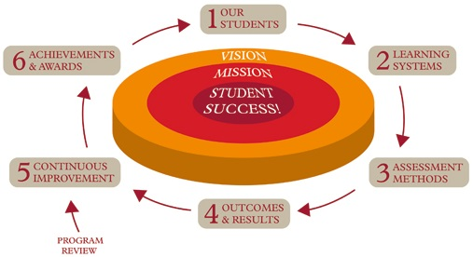


Quality improvement model
Student insight
systems
External
validation
▪ External
scanning
Internal review
committee
360°
Assessment
reporting

Slide 10
Evidence-based assessment systems
Establishing institutional systems for tracking student learning, retention and satisfaction outcomes
Notes:
Carol – crop done

Slide 11
Alignment of outcomes model
Assessment methodology: measures student learning at all levels and align with the University mission and program outcomes.
The process aims to align institutional outcomes with program and course learning outcomes.
Alignment must be accurate and meaningful to generate meaningful student learning outcomes
Notes:
We embed Waypoint in select courses and assignments to measure CLOs PLOs, and ILOs.

Slide 12
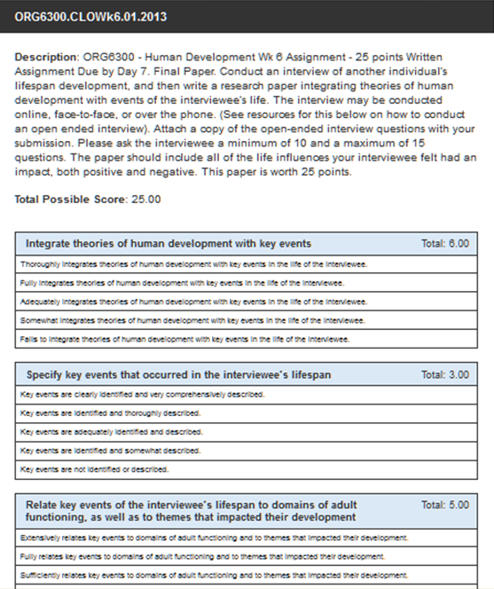
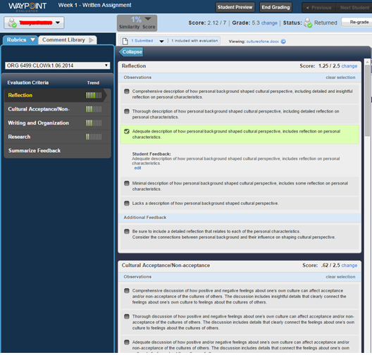
Learning assessment via course-level rubrics
Instructors grade work using Waypoint Outcomes – an integrated, holistic rubrics aligned to Institutional Learning Outcomes (ILOs) and Course Learning Outcomes (CLOs) embedded in selected courses.
The approach allows data to be aggregated and sliced for better reporting.
Notes:
WP not only serves to give students clear expectations, a tool for faculty for uniform grading and effective feedback, but also captures outcome data.

Slide 13
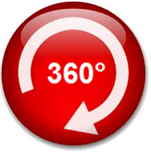
360°Assessment Report &
Student Success Dashboard
The student success 360° dashboard shows how each degree program, master’s and doctoral schools are performing on assignment scores, course completion and satisfaction rates.
Learning tracked over 3-years can be compared program by program, and course by course.
The data model is drillable down to the course or assignment level.
Notes:
Data collected through WP is collected, analyzed and reported.

Slide 14
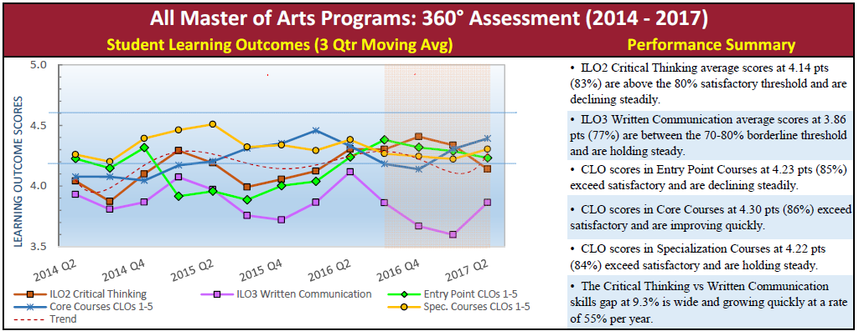
Tracking broad trends in & across degree programs
Student learning outcomes – 3-year moving quarterly averages
Critical Thinking and Written Communication outcome KPIs
Entry Point, Core, and Specialization course learning outcome KPIs
Performance target: 4 points or 80%
Notes:
Add notes – Phil, talk about what we measure..

Slide 15
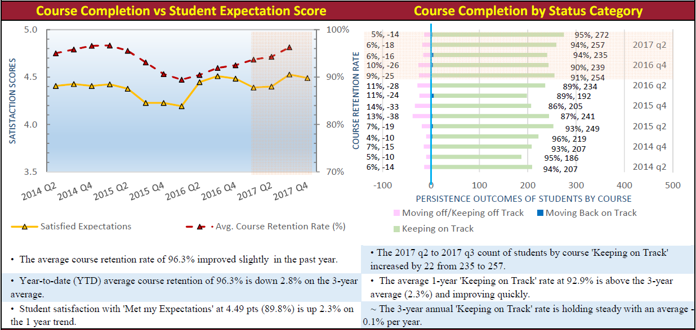
Tracking course-completion rates
Negative sentiment can be tracked as a potential retention issue and explored further, e.g. by low scoring course.
Notes:
Add notes – Phil, talk about what we measure..

Slide 16
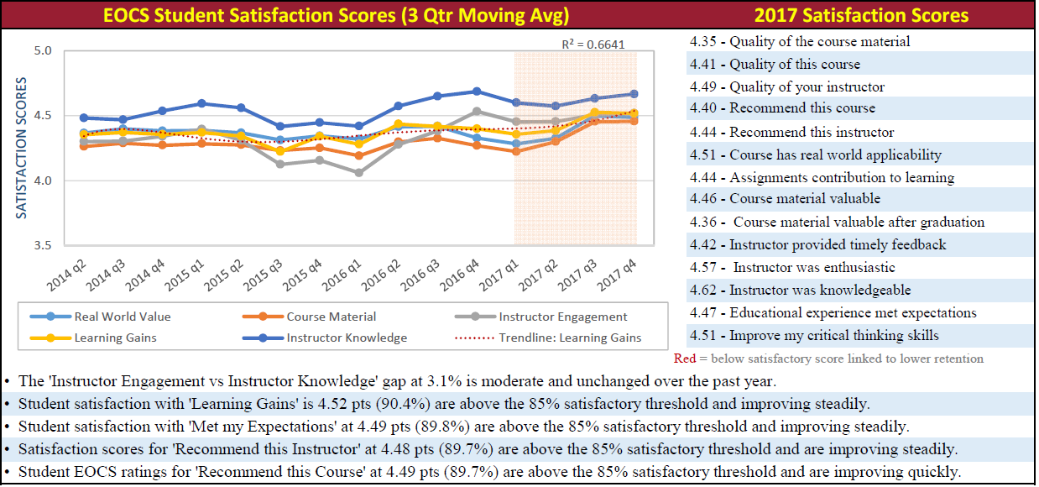
Making student satisfaction data actionable
We track five student satisfaction KPIs based on fourteen ratings.
We have linked some indicators with reduced course completion.
Notes:
Add notes – Phil, talk about what we measure..

Slide 17
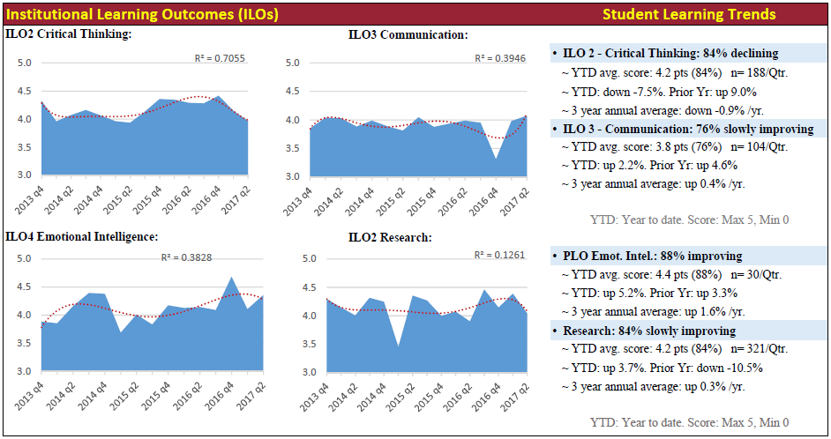
Assessing institutional learning outcomes
Standardized performance metrics creates a common language to discuss academic quality.
Notes:
Add notes – Phil, talk about what we measure..

Slide 18
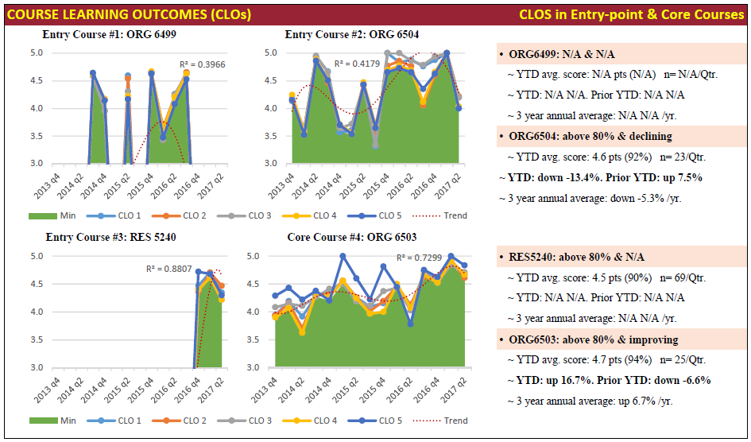
Assessing course learning outcomes
Quarterly reporting creates discovery opportunities.
Notes:
Add notes – Phil, talk about what we measure..

Slide 19
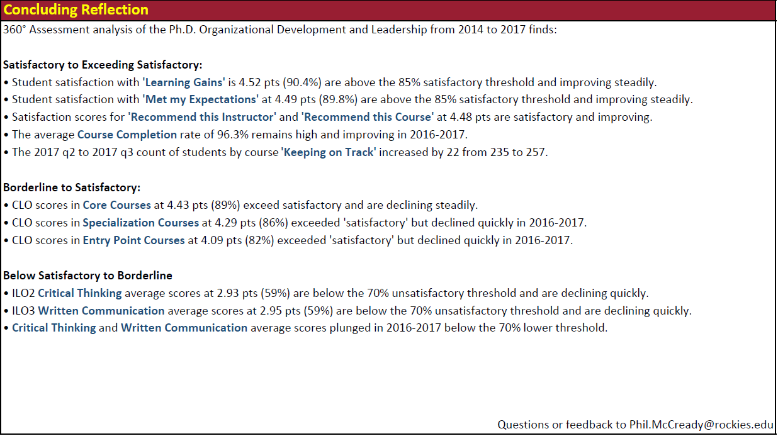
Assessing performance acceptability
Standard performance statements and benchmarks help to create a more universal assessment of sufficiency.
Notes:
Add notes – Phil, talk about what we measure..

Slide 20
Infographics to make data meaningful
  Debora Scheffel, PhD
  University of the Rockies/Colorado Christian University
Notes:
Our CIM has other triggers
Program Review
Strategic, regulatory, curricular, or process improvement.
One of the mechanisms that facilitates inquiry and makes recommendations for mprovement is the A-Team

Slide 21
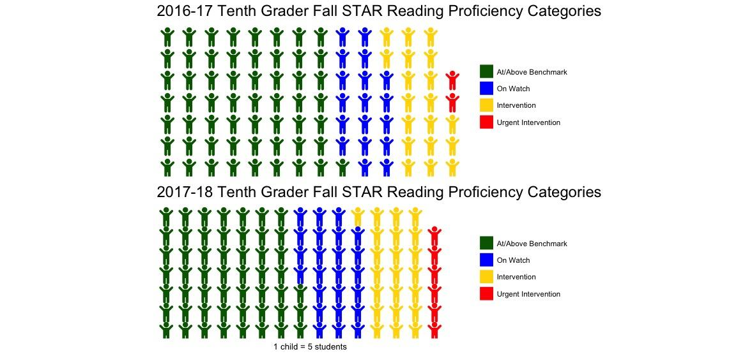
Visualizing teaching intervention results
Change in student proficiency categories by year
Notes:
This kind of deeper dives have produce baseline data for our review of entry point courses – strategic goal
Entry Point Review Initiative
Incorporation and use of existing Writing Center and Library resources
Literacy Plan – Philosophy, scaffolding, rubrics, training faculty, measuring improvement
Collaborations with other departments – personas, retention data, early alert form (a form that consolidates and structures issues so that they can be sent to appropriate parties on one hand, and classified, tracked and analyzed to make improvements)

Slide 22
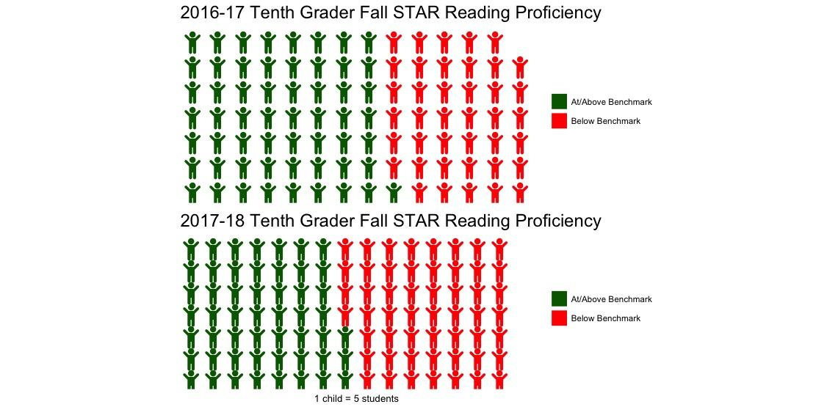
Making student proficiency data meaningful
Change in student reading proficiency by year
Notes:
This kind of deeper dives have produce baseline data for our review of entry point courses – strategic goal
Entry Point Review Initiative
Incorporation and use of existing Writing Center and Library resources
Literacy Plan – Philosophy, scaffolding, rubrics, training faculty, measuring improvement
Collaborations with other departments – personas, retention data, early alert form (a form that consolidates and structures issues so that they can be sent to appropriate parties on one hand, and classified, tracked and analyzed to make improvements)

Slide 23
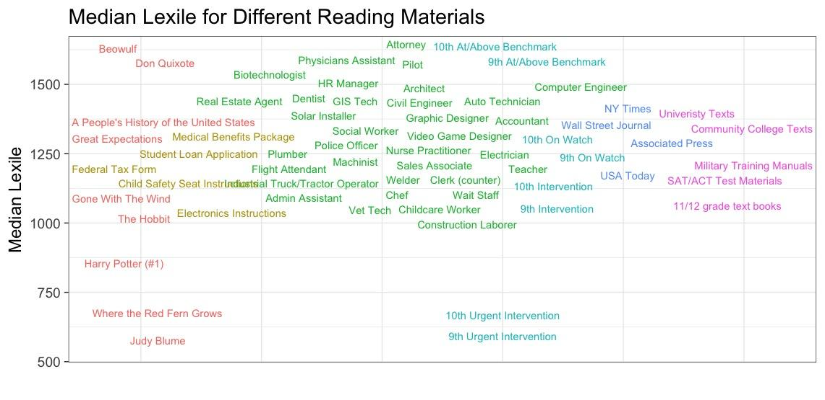
Visualizing the impact of reading proficiency

Slide 24
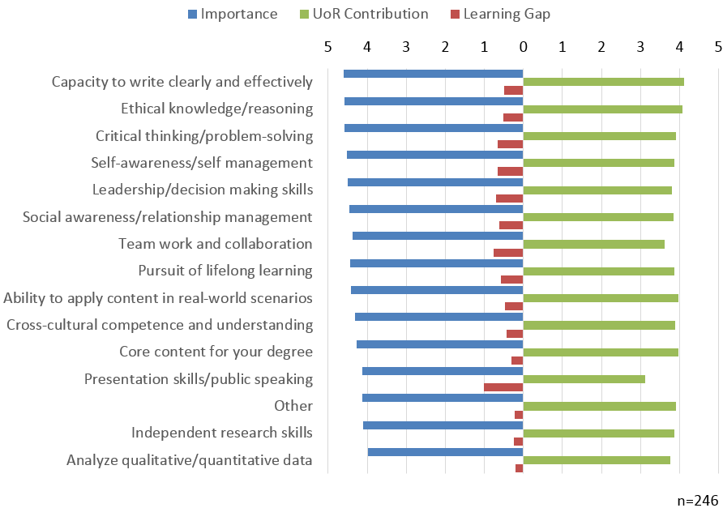
Alumni opinion on learning priorities
Five learning priority gaps highlighted:
  Presentation skills/public speaking
  Teamwork and collaboration
  Leadership/decision-making skills
  Critical thinking/problem solving
  Self-awareness/self-management

Slide 25



Knowing thy student
Establishing institutional systems for fostering productive relationships that foster student learning, retention and satisfaction success
Notes:
Carol – crop done

Slide 26
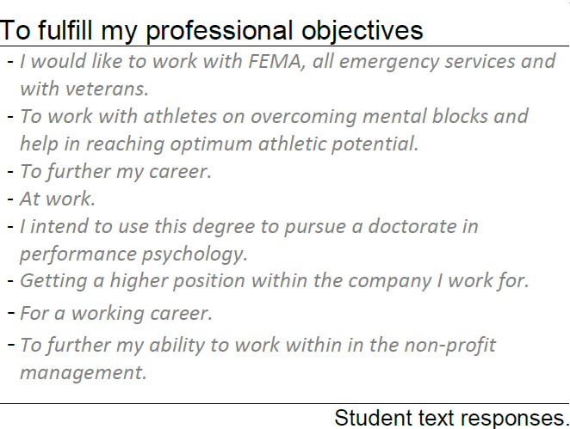
Instructor-student connection
Student Information Form: drawing on research literature of persistence and completion, this instrument creates a new, deeper understanding of new intake students.
Promoting student connection: in week one, faculty are encouraged to connect using the rich student biographies of each student.
Promoting student connection: in week one, faculty are encouraged to connect using the rich student biographies of each student.
Notes:
Carol – crop done

Slide 27
Tracking the student experience
Dashboards to visualize feedback
Weekly Check-in formative assessment survey and email to alert instructors to student change requests.
What is helping you to do well in the course this week?
What changes could help you do better in the course?
Notes:
Carol – crop done

Slide 28

Discovering issues early
Early Alert: Using a common reporting platform to flag at-risk students early enough to make a difference
Specialist advisors
respond to an Early Alert student in 24-48 hours
Data is collected systematically to generate insight on common risk
factors
Notes:
Carol – crop done

Slide 29
Institutional ecosystem
Building institutional capacity to make data actionable
Notes:
Carol – crop done

Slide 30
Systems to improve academic support
Empowering new faculty
leadership teams with data
Lead Faculty: Senior faculty were established to lead quality improvement via Peer Review, Circles of Practice and Program Review.
Circles of Practice: Communities of affiliation of experienced and respected faculty members created to support faculty development through regular communication, sharing of best practices etc.
Entrypoint Super Team : A select group of faculty, empowered with new data tools to provide new students with an intentional experience to foster persistence in Entry Point courses.
Notes:
Carol – crop done

Slide 31
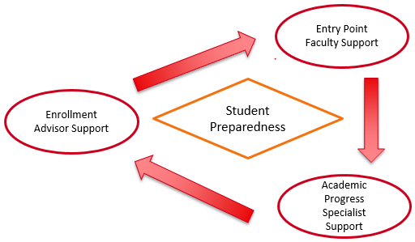
Data to aid learning in student services
New cross-team collaboration to find new ways to improve student support
Student Preparedness Focus: Putting
student preparedness as a central
goal, this initiative focuses on
inter-team collaboration and
sharing of best practice and data to improve the quality of enrollment advising support as well as academic
progress specialist support.
Notes:
Carol – crop done

Slide 32
Systems to drive learning: External review
Goal: Add to the existing QM certification
Program Design
Recognizes online programs that are designed around measurable learning objectives or competencies.
Learner Success
Recognizes online programs that demonstrate a mission-driven definition of success for their learners.

Slide 33
… Thank you.
Questions?
Phil.McCready@rockies.edu

