Slide 1
Pathways to Excellence: Assessing Student Success in Writing
Dr. Susan Simkowski
Associate Professor of Communication
Member - Assessment of Learning
Outcomes (CALO)
Member – Technology Systems for
Instruction (TSI)
Dr. Terri Wells
Assistant Professor of English
Faculty Co-Chair-Committee for
Assessment of Learning Outcomes (CALO)
Dr. Becky Timmons
Director of Academic Assessment and Accountability
Co-Chair-Committee for Assessment of Learning Outcomes

Slide 2
A Regional, Public University
The 5th largest Arkansas university located in the 2nd largest city in Arkansas 1 Master’s degree, 33 bachelor’s degrees,
14 associates, and 27 certificates
Enrollment: 6,637

Slide 3
KAHOOT
What is your role?
Administrator
Higher Education Faculty
K-12 Educator
Instructional Designer

Slide 4
Overview
Today’s Learning Outcomes
Quality Matters - Standard 3

Slide 5
KAHOOT
Which of the following have you used for assessment?
NSSE
LiveText
Blackboard

Slide 6
Assessment Process Evaluation of Written Communication
on our Campus

Slide 7
Assessment Process – Evaluation of Written Communication on our Campus
2016-2017 More intense process of looking at written communication
Tools used for assessment purposes
NSSE
LiveText
Blackboard
What we learned

Slide 10
NSSE
How we used NSSE
What results we received
Advantages and Disadvantages

Slide 12
LiveText
How we used LiveText
What results we received
Advantages and Disadvantages

Slide 13
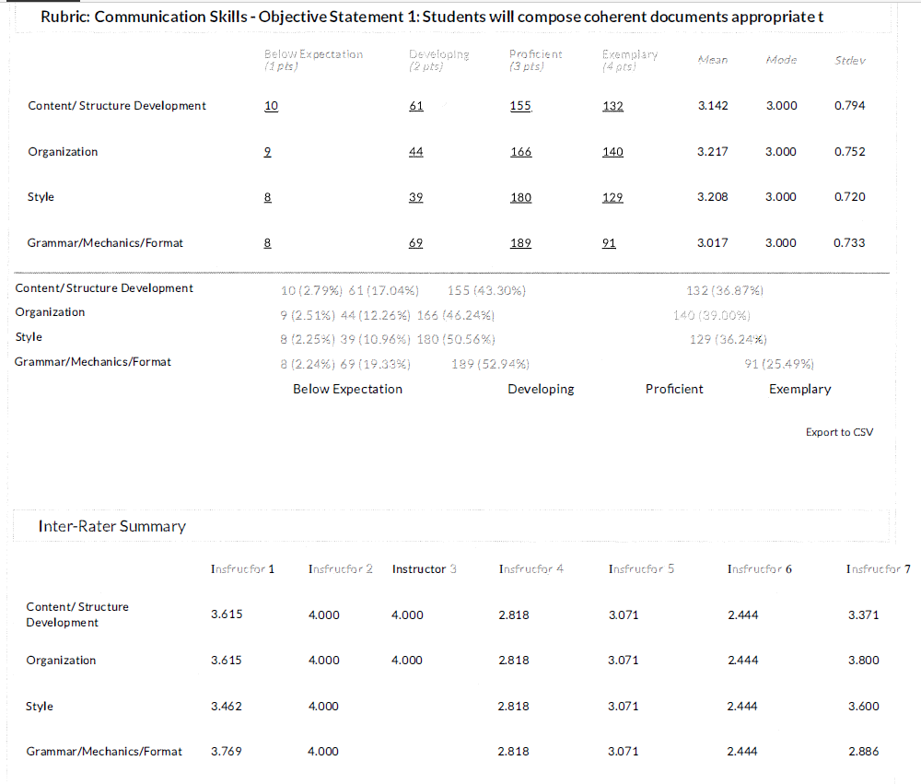

Slide 14
Blackboard
How we used Blackboard
What results we received
Advantages and Disadvantages

Slide 16
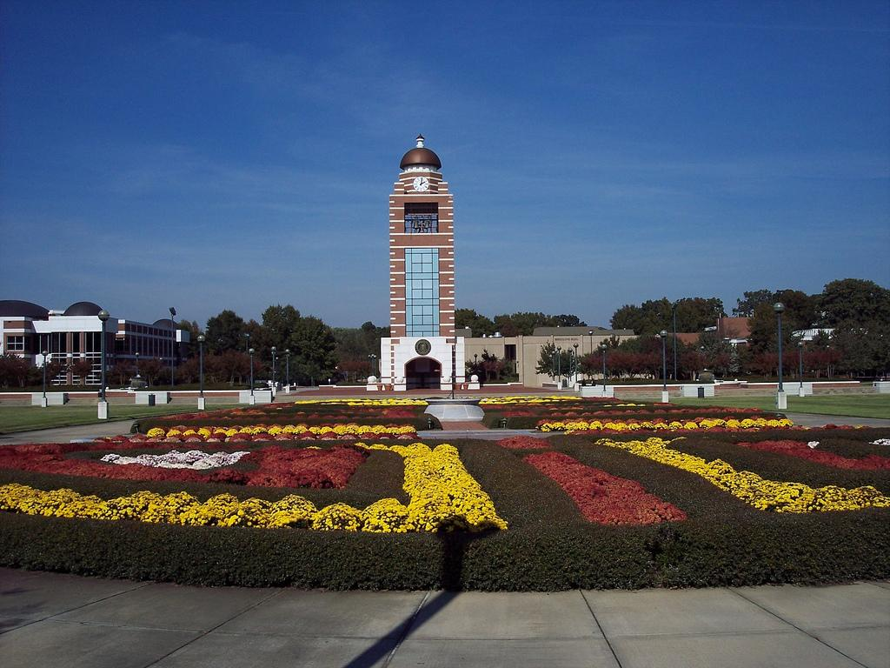
Takeaways
Process
Rubric
Norming
Tools
Culture

Slide 17
Future
University Learning Outcomes/General Education (ULOs)
Rubrics
Faculty Engagement
Connections to Quality Matters

Slide 18
Dr. Susan Simkowski
Susan.Simkowski@uafs.edu
Dr. Terri Wells
Terri.Wells@uafs.edu
Dr. Becky Timmons
Becky.Timmons@uafs.edu

