Slide 1
Preparing Teachers for Virtual Learning: How to Accomplish the Task with Badges and Certificates
Deborah Banker, Ed. D.
Tarleton State University

Slide 2
Purpose of the Study
Different Skill Set
Successfully teaching and designing online lessons and courses takes a different set of skills than teaching face to face (Boudreau, 2020)
We’ve got a generation of young teachers who were taught how to use PowerPoint, DreamBox, or a learning management system, but who weren’t taught how to use any of those things to actually teach.” (Barbour as in Herold, 2021)
Does engaging with professional development affect preservice teachers’ beliefs about their skills for online teaching and online course design?

Slide 3
Important to note:
Training is required by the Texas Administrative Code Chapter 19, §228.30 (c)(8).
(c) The following subject matter shall be included in the curriculum for candidates seeking initial certification in any certification class:
(8) instruction in digital learning, virtual instruction, and virtual learning, as defined in TEC, §21.001, including a digital literacy evaluation followed by a prescribed digital learning curriculum.

Slide 4
Background

Slide 5
Enrollment in virtual schools has been increasing faster than enrollment in public schools even before the Pandemic
Very few teacher preparation programs, even those offered online, have included instruction for teacher candidates to teach or design courses or lessons for K-12 online schooling (Koenig, 2020)
Children are enrolled by their parents in virtual charter schools because of safety issues, bullying, and child chronic health issues that local public schools are ill-equipped to handle. (Hobbs, 2022).
Even before the COVID-19 Pandemic , a study found that only 42.3 % of responding teacher education preparation programs acknowledge the need for including field experience in an online setting as a “future of teaching/reality of teaching change.” (Michigan Virutal Learning Research Institute , 2016)

Slide 6
Larson & Archambault (2019): “…there continues to be gaps in the literature examining the etent to which teachers are being educated, trained, and otherwise prepared to function in online settings.”extent
Graziano & Bryas-Bongey (2018): “[Survey] participants recognized the need for online teaching, but reported there are too many state requirements from their traditional teacher preparation program, leaving limited or no room to incorporate new curriculum on online and blended teaching methods.”
“Effective online teaching techniques must be defined, empirically proven, and then efficiently implemented by both future and current K-12 online teachers to ensure quality online educational experiences and outcomes for students.”
“While undergraduate teacher preparation programs have limited or no room for other courses or initiatives, deans of graduate programs were generally more likely to support the inclusion of graduate degrees, optional courses, and/or certificates.”

Slide 7
Participants
30 junior level teacher preparation students
Have been accepted into the teacher education program
EC-6 and 4-8 focus of education
Ages between 18 to 30 years old
Number of students was limited due to the cost restraints of the Quality Matters training for the students

Slide 8
Methodology
Study took place over one long academic semester
N=21 (completers)
The research design used was pretest/posttest using a survey wouthout a control group and randomization was not possible (Shuttleworth, 2009).
Survey was researcher developed
Survey contained both Likert scale questions and free response questions
IRB was approved and IRB protocols were followed
Pretest Survey administered
Professional development started with QM for Students delivered by Quality Matters, Inc. (QM certificate earned, university badge earned)
Participants then given virtual assignment of developing a course map using material from Dr. Brian Beatty’s Hyflex Design Worksheet (badge earned)
Next participants were to obtain a free Canvas course shell for teachers
Finally, participants created an online lesson using the knowledge from the QM for Students, the available k-12 QM Rubric without annotations, and the course map they developed to create an online lesson in Canvas (badge earned)
Students earned badges and certificates for each task completed and a certificate at the end provided by the university.
Posttest Survey administered.

Slide 9
RESULTS

Slide 10
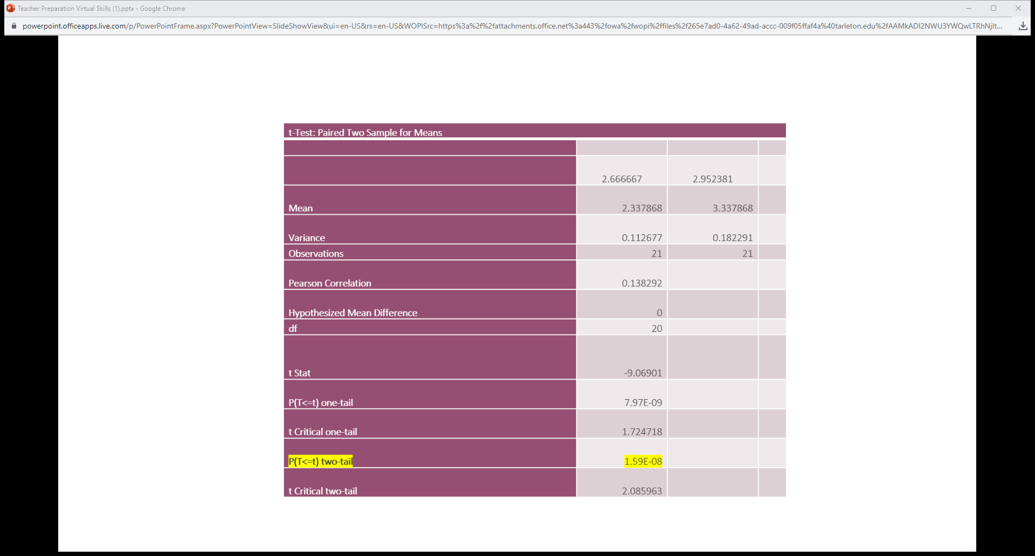

Slide 11
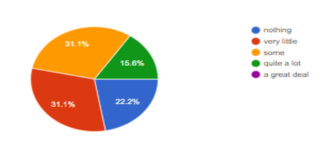
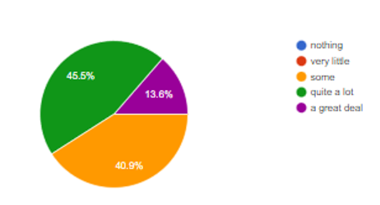
Create K-12 online lessons
Pretest
Posttest

Slide 12
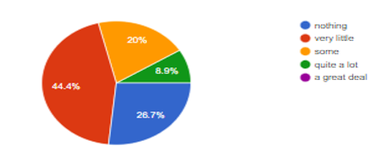
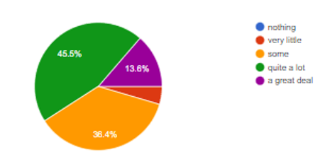
Create K-12 online instructional units or courses
Pretest
Posttest

Slide 13
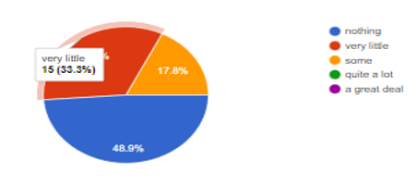
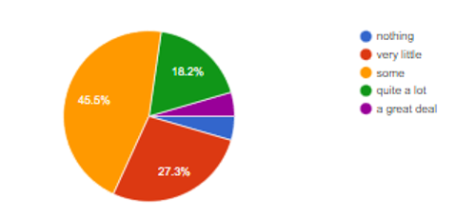
Possesses a general working knowledge of the Texas Virtual School System
Pretest
Posttest

Slide 14
What they had to say after the training experience
I feel good enough to create an online course, but I don't fully feel confident in them.
On a scale of 1-10. I feel about a 6. I think I would need a great deal of planning and preparation time to create a true online course.
I feel somewhat confident. Need more practice. It also depends on the platform. So far, I have learned how to create online courses in Google Classroom and Canvas.
I feel prepared to create lessons online, but still think that I could benefit from more instruction.

Slide 15
Conclusions
Current Results Show:
Future Research Considerations
Future K-12 teachers are not as technologically prepared to teach the next generation via online formats
Current K-12 preservice teachers appear receptive to professional development training (mastery learning) to hone their virtual skills
The state recognized the need to have future teachers trained for competency in all things digital
Impact of delivering the virtual training via asynchronous methods
Longitudinal analysis of virtual skill retention
How many certified traditional K-12 educators gravitate toward a career in the virtual public school

Slide 16
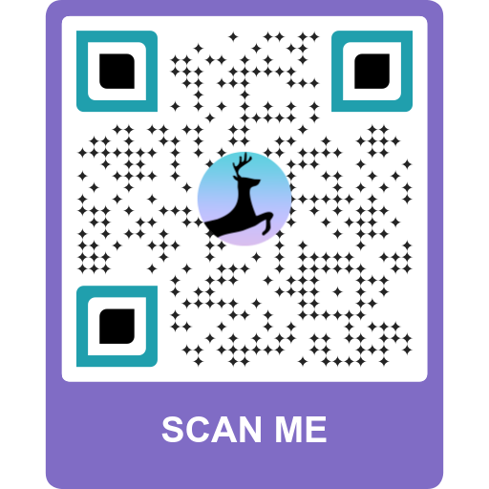
Now, how can this work for you?
Professional Development Flow Chart for Badges and Certificates
What skill or competency (standard) can you just not fit into your curriculum?
OR
What skill or competency (standard) can you take out of your curriculum and have students learn it by badges and certificates to make room for something to take its place in your curriculum?
Break the skill or competency down into its component parts, i.e., perform a task analysis on that skill or competency
Each task can allow the learner to earn a badge
Once all the badges are earned, have a certificate generated by the LMS
This is really Mastery Learning ☺

Slide 17
Photo Collage
Are
there
any
questions?

