Slide 1
Leadership Strategies
Presenters: Jeremy Anderson, Eddie Andreo, Lisa Clark, Patrick Dempsey, Veena Radhakrishnan, and Sasha Thackaberry

Slide 2
Agenda
Panelists share leadership strategies applied to a challenge or project
Participants brainstorm a leadership strategy for addressing a challenge or project at their institution
Participants will share ideas
Question & Response

Slide 3
Beckhard & Harris Change Model
D X V X F > R
Dissatisfaction X Vision X First Steps > Resistance
Thank you to Beth Rubin & Kim Siegenthaler, who shared this at UPCEA 2019

Slide 4
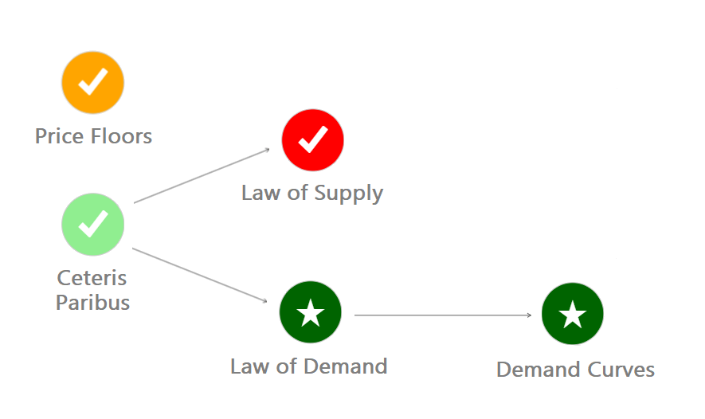
Jeremy: Scaling adaptive learning
Scale adaptive learning
Learning Map Details Analytics
Notes:
Define adaptive learning

Slide 5
Jeremy: Scaling adaptive learning
Scale adaptive learning
Program directors
SMEs & faculty
IDs
Advisors & support
Enrollment
Notes:
Change for variety of roles

Slide 6
Jeremy: Scaling adaptive learning
D X V X F > R
Notes:
Dissatisfaction
Vision
First Steps
Resistance

Slide 7
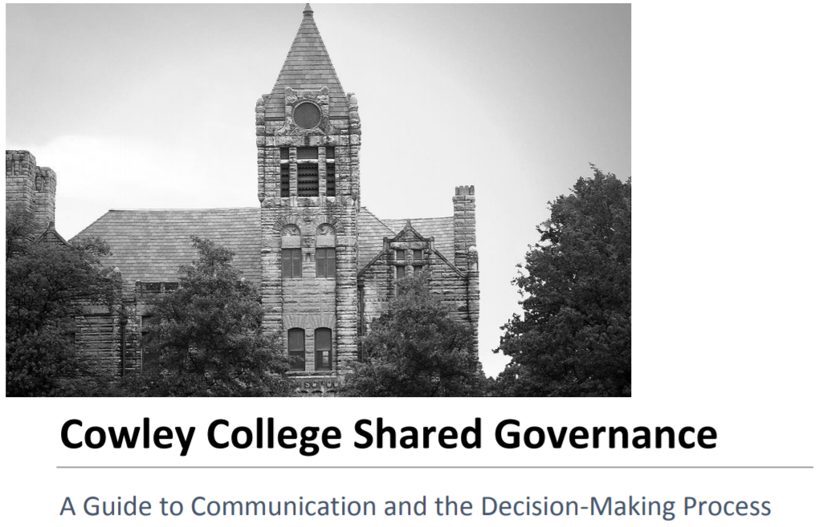
Eddie
Building bridges through a Shared Governance Decision-Making Process

Slide 8
Four Major Initiatives
Major LMS migration with across campus training in Quality Matters
Course template and syllabus template development based on the QM Rubric (meeting 20+ Standards)
Move from Managed Hosted to SaaS
Programing, development, and implementation of our new SALSA (Styled & Accessible Learning Services Agreement) syllabus

Slide 9
Strategies
Ask for a seat at the “table”
Build bridges with Department Chairs/Deans
Present your idea
Build your committee
Building your committee
You!
Department Chair/Dean representative
Instructional Technologist/QM expert
Full and part-time faculty
Others?
Student representative
Registrar’s
Advisor

Slide 10
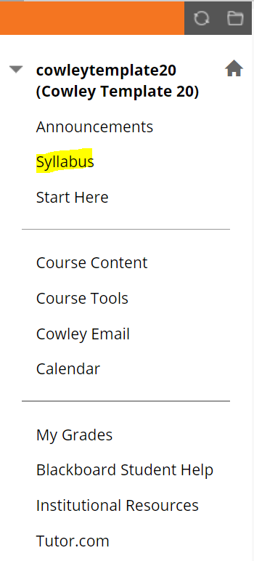
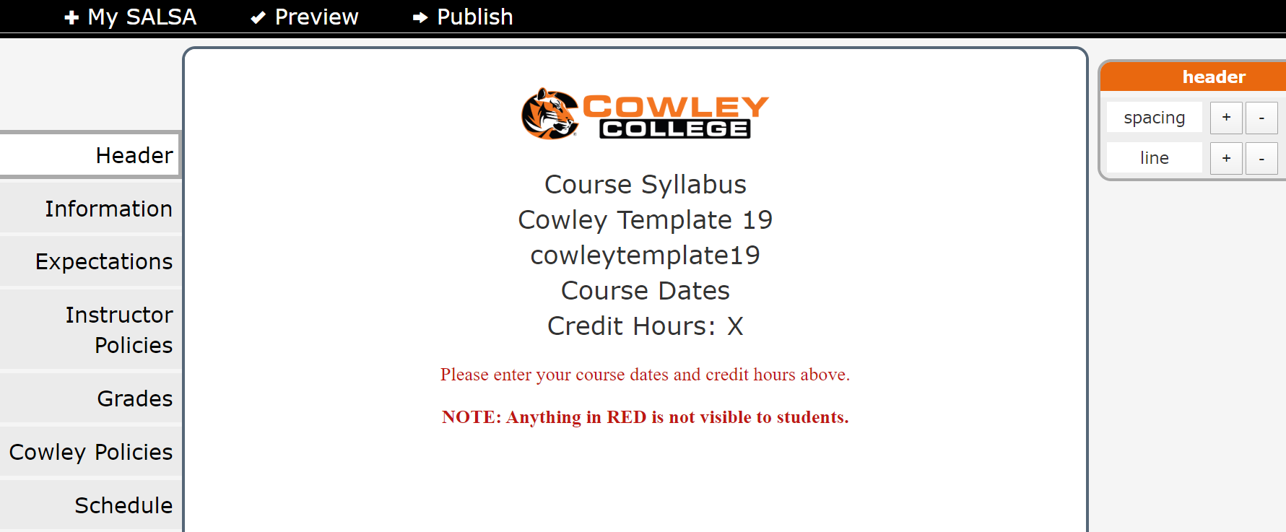
SALSA

Slide 11
Outcomes/Benefits
Consistency across all courses
Fully Accessible
All courses (online, hybrid, f2f) use it
Reporting features for accreditation and the registrar’s office
Template was decided by the committee
First Bb Institution to develop and implement it (Just ask!)
Reduces printing costs/PDF option
Dedicated link in all course menus

Slide 12
Lisa: Leveraging Position to Address Institutional Challenges
Coordinator
Director
Dean
LMS Administrator
Senior Instructional Designer
The list goes on…..
Committee assignments
Meeting invitations
Participant in conversations
Increased relevancy

Slide 13
Lisa: Leveraging Position to Address Institutional Challenges
D X V X F > R
Feelings of
exclusion or irrelevancy
Valued and essential
Identify institutional challenges that you can address
Determine the person(s) you need to connect with
Territorialism
Perceived intrusion
Change

Slide 14
Lisa: Leveraging Position to Address Institutional Challenges
LMS
Plagiarism
Feedback
Consistency
Assessment
Proctoring Technology
Academic integrity
Class time & space
QM Professional Development
Applicable to all teaching modalities
Accreditation

Slide 15
Patrick
moving from a no-ID model for course design to a required faculty-ID-pairing model
Dissatisfaction X | Vision X | First Steps > | Resistance
Peers Encourage and instigate envy Potential Show a better way (and how to get there) People Start creating a culture around teaching excellence, a critical mass can be a tiny minority | Mission Distributing expertise. Scaling quality. Vision Create convincing learning experiences that enable success for all students Strategy Support Deliver what people want, even if it is not what we do Share Constant communication: mixed methods, stats and stories Sell WIFM | Focus on strategy Create partnership Sell the vision Show how this will make the life of the instructor easier, the product of the school better Create the model Collaboratively create a model for that program | Cynical Attitude: No matter what, they will object, usually with little knowledge or specifics Response: Ignore Critical Attitude: People who have had experience or have other ideas based on some level of knowledge Response: Investigate Cautious Attitude: Get it, but they are already burdened and they’ve trying lots of things, not sure they are ready to commit Response: Inspire Curious Attitude: Genuinely interested Response: Initiate

Slide 16
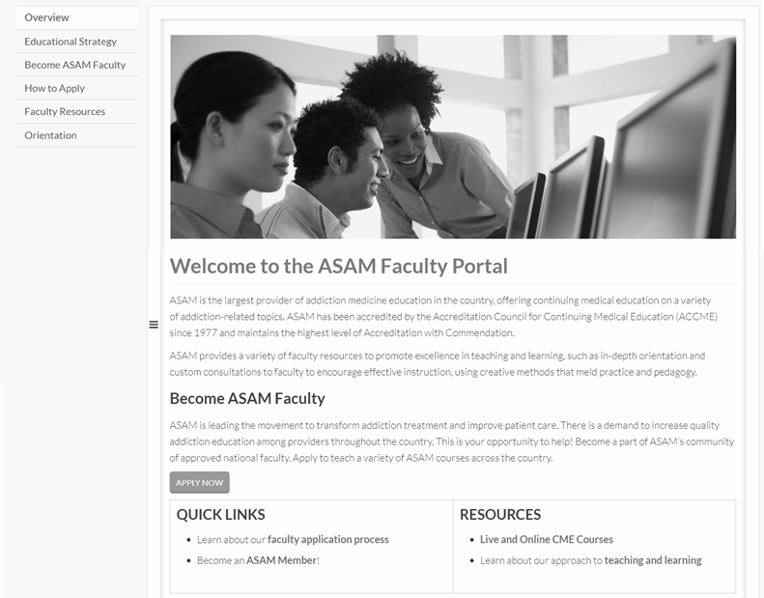
Veena
Faculty Management & Development Process
SHIFT FROM A DECENTRALIZED MODEL TO A CENTRALIZED PROCESS

Slide 17
Faculty Management & Development Process
DISSATISFACTION
VISION
FIRST STEPS
RESISTANCE
Lack of process consistency
Manual systems and processes
Outdated technology
Centralize faculty recruitment, onboarding, and development efforts to improve the faculty management process
Understand existing processes
Develop a faculty management system
Utilize a “train the trainer” model
Resistance to change in processes and implementation of a new system
Strategies
Communication
Inclusion
Engagement
x
x
>

Slide 18
Sasha: New UI & Course Template
D X V X F > R
Lack of accessibility
Not responsively designed
Behind as an institution in ID
Build a proof of concept course
Share how quality can look & feel
Reinforce three parts of mission
Showed screenshots of new UI
Built first courses
Provided support for a switch

Slide 19
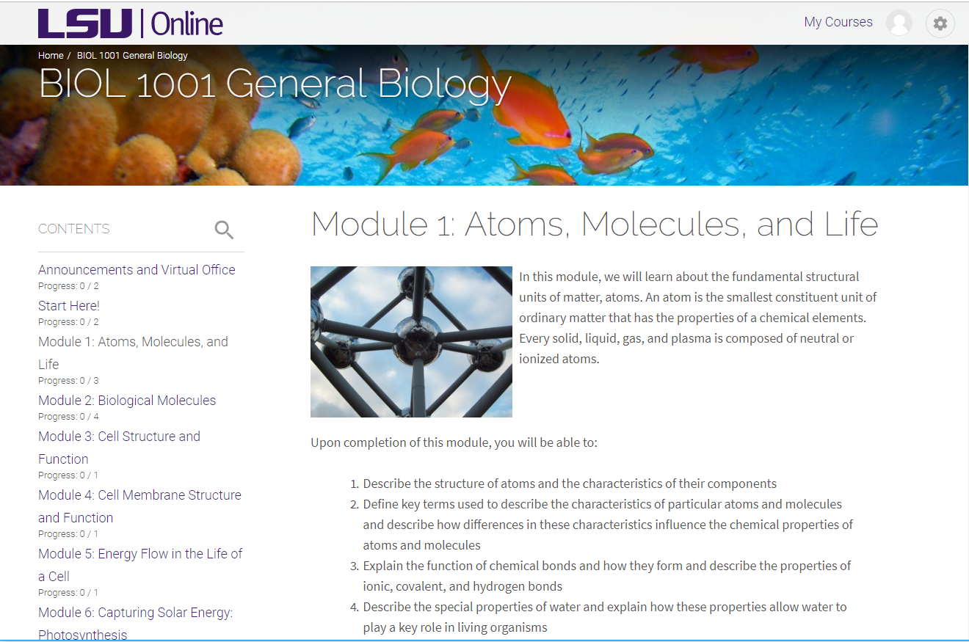
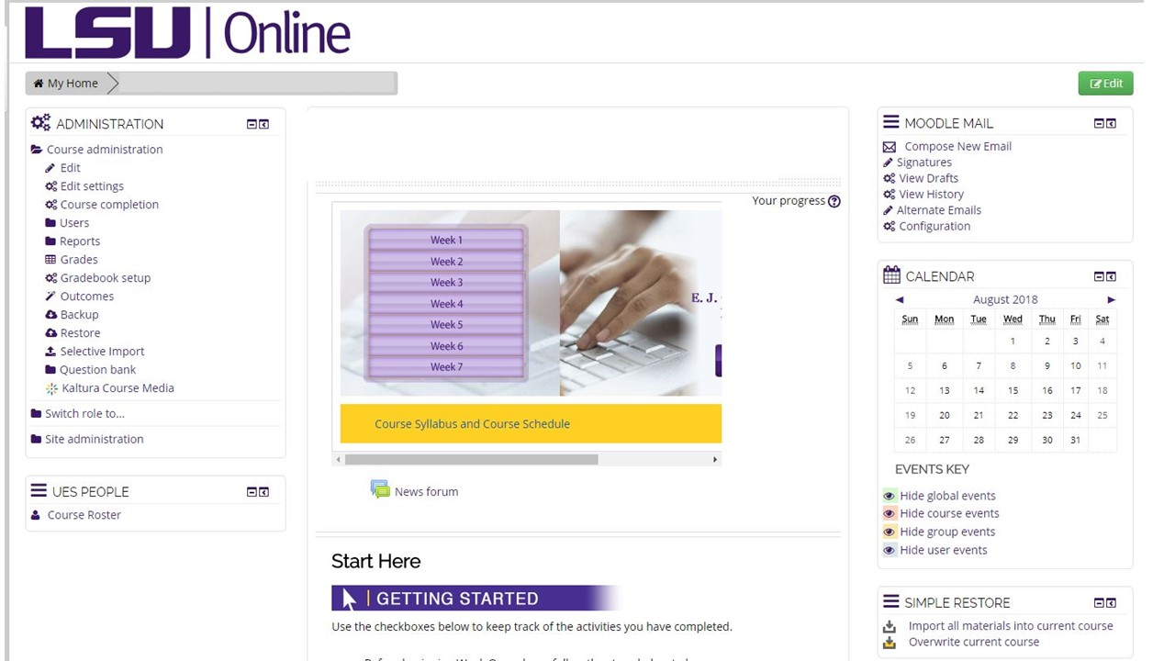
Sasha: New UI & Course Template

Slide 20
Handout info- directions for participants
tinyurl.com/QMchangemodel

Slide 21
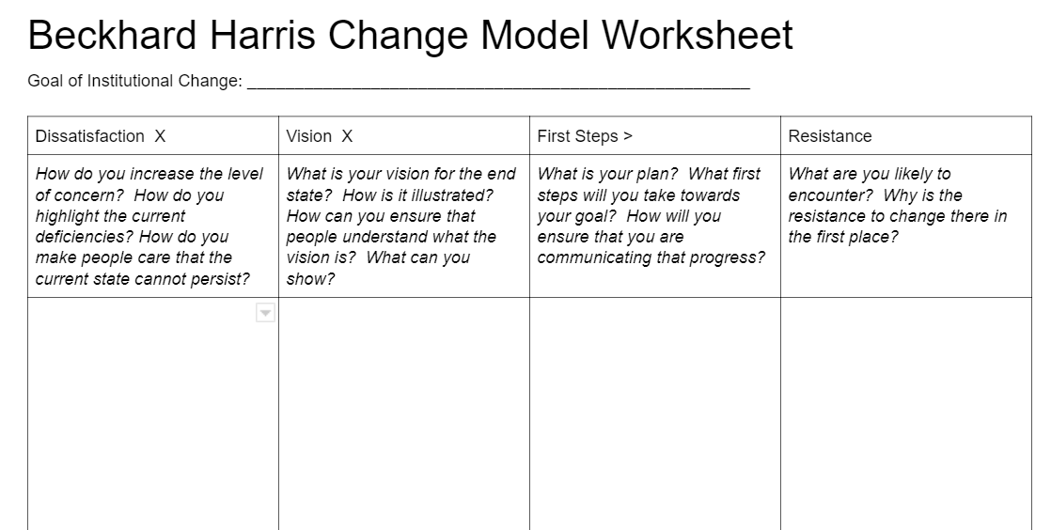
Sharing

Slide 22
Questions

