Slide 1

Stewards of another place: Implementing Online Strategies for Community Engagement
Andria F. Schwegler & Barbara W. Altman
Texas A&M University – Central Texas

Slide 2



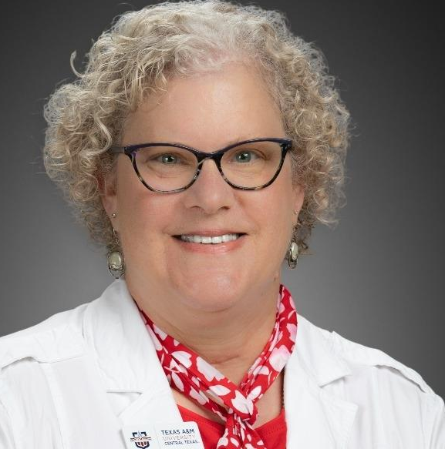
Welcome to the session
Dr. Andria F. Schwegler
Dr. Barb Altman
Associate Professor of Psychology
College of Education & Human Development
Associate Professor of Management
College of Business Administration

Slide 3
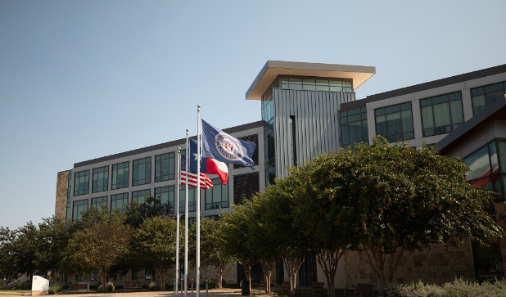
Our RCU
Texas A&M University – Central Texas
Upper-level Only
100% Transfer
Minority Serving
Hispanic Serving
Military Affiliated

Slide 4
agenda
A Look at How Far We Have Come
  Stepping Forward as Stewards of Place (AASCU, 2002)
  Recommitting to Stewardship of Place (AASCU & ARRC, 2022)
A Look at Where We Need to Go: Online Strategies for Engagement
  COBA Service Learning for Online Students
  Course Scheduling
  Student Research
  Community Service
  Community Engagement
Stewards of Place as Engaging Students Regardless of Place

Slide 5
Learning outcomes
Identify principles and recommendations for universities serving as stewards of place, which can be generalized to community engagement at other institutions
Discuss examples from multiple academic programs of community engagement using online learning delivery modes and/or strategies, including business, counseling, and psychology
Apply online strategies at home institutions to facilitate community engagement and transfer of student learning to contexts outside the classroom.

Slide 6

A Look at How far we have come
20 YEARS AS STEWARDS OF PLACE

Slide 7

AASCU (2002)
Stepping Forward as Stewards of Place
  “In the main [public engagement] is piecemeal, not systemic, and reflects individual interest rather than institutional commitment.”
  “AASCU institutions must find, create, and seize opportunities to make public engagement a more deeply embedded core value that authentically defines them.”

Slide 8
AASCU (2002)
Stepping Forward as Stewards of Place
Definition of Public Engagement
  Place-related
    Institutions are “inextricably linked with the communities and regions in which they are located”
  Interactive
    “spirit of give and take by the university and its partners”
  Mutually beneficial
    “institution is to be responsive to public needs in ways that are appropriate to the institution’s mission and academic strengths”
  Integrated
    “engagement must permeate all levels of the institution, and be integrated into its policies, incentive structures, and priorities”

Slide 9
AASCU (2002)
Stepping Forward as Stewards of Place
Characteristics of the Fully Engaged Institution
  “Mission statements that identify the region to be served... This more restricted area is from where their students come, to where their graduates return, and where the greatest partnership opportunities lie.”
  “Globalization is pursued as an extension of local need.”

Slide 10

AASCU & ARRC (2022)
Recommitting to Stewardship of Place
Three broad themes
Equity and upward mobility
Resources and resilience
Regional prosperity and civic health

Slide 11
AASCU & ARRC (2022)
Recommitting to Stewardship of Place
Principles of Stewardship
  Connection to Place - Geographic and cultural sites
  Reciprocity – Decenter university and share power
  Symbiosis and Synergy – Two-way relationships for mutual benefit
  Adaptability – Responding to change and embracing new processes
  Diversity of Approaches – Variety in institution and community fit
  Civic Engagement – Efforts to support involvement in local context
  Upward Mobility and Opportunity – Economic and employment support
  Institutional Intentionality – Commitment to stewardship

Slide 12
AASCU & ARRC (2022)
Recommitting to Stewardship of Place
“Some observers assume that every person has a college or university in their community, but analyses have demonstrated the existence of places where there are few, if any, accessible college options within a reasonable commuting distance.
What this means is that postsecondary opportunity is geographically contingent…
Many AASCU institutions play an important role in serving communities where postsecondary options may be scarce and people are unable to travel long distances for college.”

Slide 13
A LOOK AT WHERE WE NEED TO GO
ONLINE STRATEGIES FOR ENGAGEMENT

Slide 14
Tamu-CT Strategic plan
Imperative 3: Community Engagement
  Strategic Goal 3.1:
    “Prepare educated and engaged citizens that contribute to their communities and enhance the vitality of the region.”

Slide 15

COBA Implementation
Service learning is a required component of all undergraduate business majors via our Business Ethics course
LOs within the course:
  Civic action and reflection: Students will demonstrate independent experience and show initiative in a context of complex or multiple civic engagement activities, accompanied by reflective insights or analysis about the aims and accomplishments of one’s actions.
  Civic contexts/structures: Students will demonstrate ability and commitment to collaboratively work across and within community contexts and structures to achieve a civic aim.

Slide 16
Implementation in online classes
Students are charged with finding reputable non-profit organizations (NPO) within their own communities in which to complete their hours
Agreement must be signed by NPO and submitted directly to professor
Part of agreement:
  These activities should be meaningful client-serving and/or stakeholder engagement activities where students can understand how the Mission of the organization is accomplished and how it represents civic engagement and social responsibility
Hours served documentation also submitted directly to professor

Slide 17
Sample NPO Placements
Students find organizations they feel passionate about and sometimes continue to work with after the class ends
Ronald McDonald Houses
Special Olympics
Community Food banks
Community mental health clinics
Army support organizations
Local museum educational programs for youth
Community beautification initiatives

Slide 18
Implementation in online classes
Prompts for required Reflection assignment 1 (following first set of service hours):
    1. What surprised you in working at (insert name of the nonprofit)? How was the experience different than what you expected prior to the experience?
    2. What need in the community does this agency address? Do you see this as a low, medium or high priority need? Explain Why. How does that assessment influence your perception of your work at the agency?
    3. What readings in your text do you associate with the service hours you just performed? Present and apply at least 2 frameworks or concepts in this analysis.
    4. If you were doing this project as part of a corporate volunteer initiative, would you feel the same or different about the experience? Why or why not?

Slide 19
Implementation in online classes
Prompts for required Reflection assignment 2 (following second set of service hours):
    Whether your view of a business' role in the community has changed based upon your SL experiences?
    Did your 2nd SL experience reveal any of your values, attitudes or biases? How did it challenge or reenforce your personal values, attitudes or biases? Explain.
    What suggestions do you have for your each of the SL non-profit organizations you performed you SL with? How could they improve? What could they do to be more engaging and impactful in our society?
Anecdotal data from course evaluations:
  Students find their service learning one of the best experiences of the whole class

Slide 20
Cpsy implementation
Department-Wide Student Success Initiative
Faculty Student Success Coordinator
Access to Courses through Online Delivery Modes
Required Coursework with Embedded High Impact Practices
Undergraduate Research in Local Communities
Student-Identified Community Engagement Projects
Telemedicine Mental Health Support
IRB Reviewed Research on Assessment of Efficacy

Slide 21
Cpsy implementation
Department Student Success Coordinator
Student Support
Teaching (PSYC 3100 Psychology Major Seminar)
Curriculum Support (resources to build growth mindset, academic self-efficacy)
Peer Mentoring (supervising meeting space and coordinating across programs)
Advising Coordination
Assessment
Institutional Data
Custom Surveys
Resource Matching and Building
Faculty Support
Information Sharing

Slide 22
Online first scheduling
Semester Schedules Include Online Access
BAAS and BS Psychology Programs
Course |  |  |  | Enrollment | Mode
PSYC | 3311 | 125 | Behavior Management | 14 | K | 8 | F2F Web Enhanced
PSYC | 3311 | 115 | Behavior Management | 29 | O | 2 | Online Asynchronous
PSYC | 3430 | 110 | Behavioral Science Statistics | 7 | O | 6 | Online Synchronous
PSYC | 3430 | 120 | Behavioral Science Statistics | 6 | K | 8 | F2F Web Enhanced
PSYC | 3430 | 150 | Behavioral Science Statistics | 5 | O | 2 | Online Asynchronous
PSYC | 4435 | 110 | Behavioral Science Research | 4 | K | 8 | F2F Web Enhanced
PSYC | 4435 | 130 | Behavioral Science Research | 11 | O | 2 | Online Asynchronous
PSYC | 4435 | 120 | Behavioral Science Research | 11 | O | 6 | Online Synchronous
PSYC | 4435 | 120 | Behavioral Science Research | 9 | O | 2 | Online Asynchronous

Slide 23


ONLINE UNDERGRADUATE RESEARCH
High-Impact Practice in Required Curriculum
PSYC 4435 Principles of Research for the Behavioral Sciences
Online Asynchronous Course
IRB Reviewed Research Projects

Slide 24
ONLINE community engagement
Student-Selected Projects to Meet Community Needs
PSYC 5302 Social Psychological Processes (Online Asynchronous Course)
Persuasive Appeals for Military Members to Seek Mental Health Support
Mentor Pen Pal Program for Elementary Students and Local Nursing Home Residents
Increasing Access to Community Recycling Programs
Mentor Program to Promote and Support Foster Care
Therapeutic Horticulture in a Local Nursing Home
Educational Program to Reduce Wildfires in the Mojave Desert
Increasing Participation in Highway Clean Up Program

Slide 25
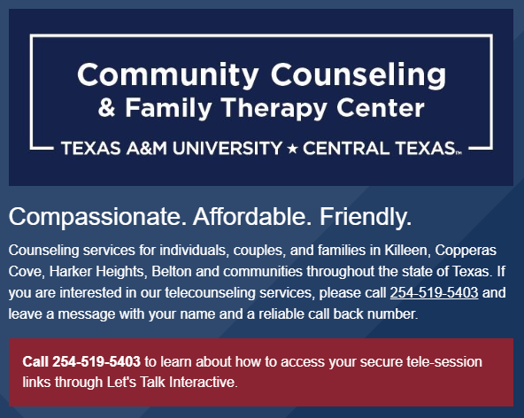
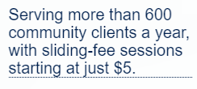
Online community engagement
Telehealth Support to Clients Across Texas
MS Clinical Mental Health Counseling & MS Marriage and Family Therapy Programs

Slide 26

Stewards of place - regardless of place
Application in real-world contexts is a hallmark of academic rigor (Schwegler, 2019).
Real-world application provides opportunities to discover relevance of learning (Kuh et al., 2013).
Online learners do not need to miss out on these opportunities.

Slide 27

NOW, TO YOUR PLACE…
WHAT ASSUMPTIONS AT YOUR INSTITUTION LIMIT STUDENTS' PARTICIPATION IN THEIR COMMUNITIES OR ON CAMPUS WHEN THEY ARE NOT CLOSE TO CAMPUS?
HOW WILL YOU INCLUDE ONLINE LEARNERS IN THEIR COMMUNITIES REGARDLESS OF WHERE THEY ARE?

Slide 28



THANK YOU FOR ATTENDING!
ANDRIA SCHWEGLER
schwegler@tamuct.edu
BARB ALTMAN
altman@tamuct.edu
Questions? Comments?

