Slide 1
Carol Parenteau
Department of Assessment & Academic Quality
September, 2017

Slide 2
The Hidden Powers of Alignment

Slide 4
Alignment
Critical course elements working together to ensure that students achieve the desired learning outcomes.
-QM Higher Education Rubric Workbook

Slide 5
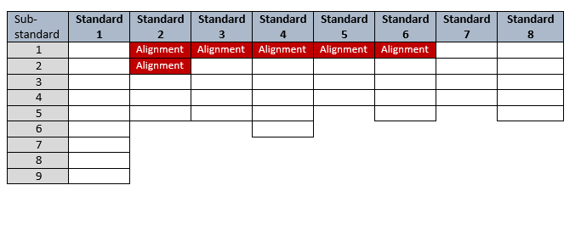
Alignment Requirements in the Rubric

Slide 6
ALIGNMENT

Slide 7
ORDER

Slide 8
COORDINATION

Slide 9
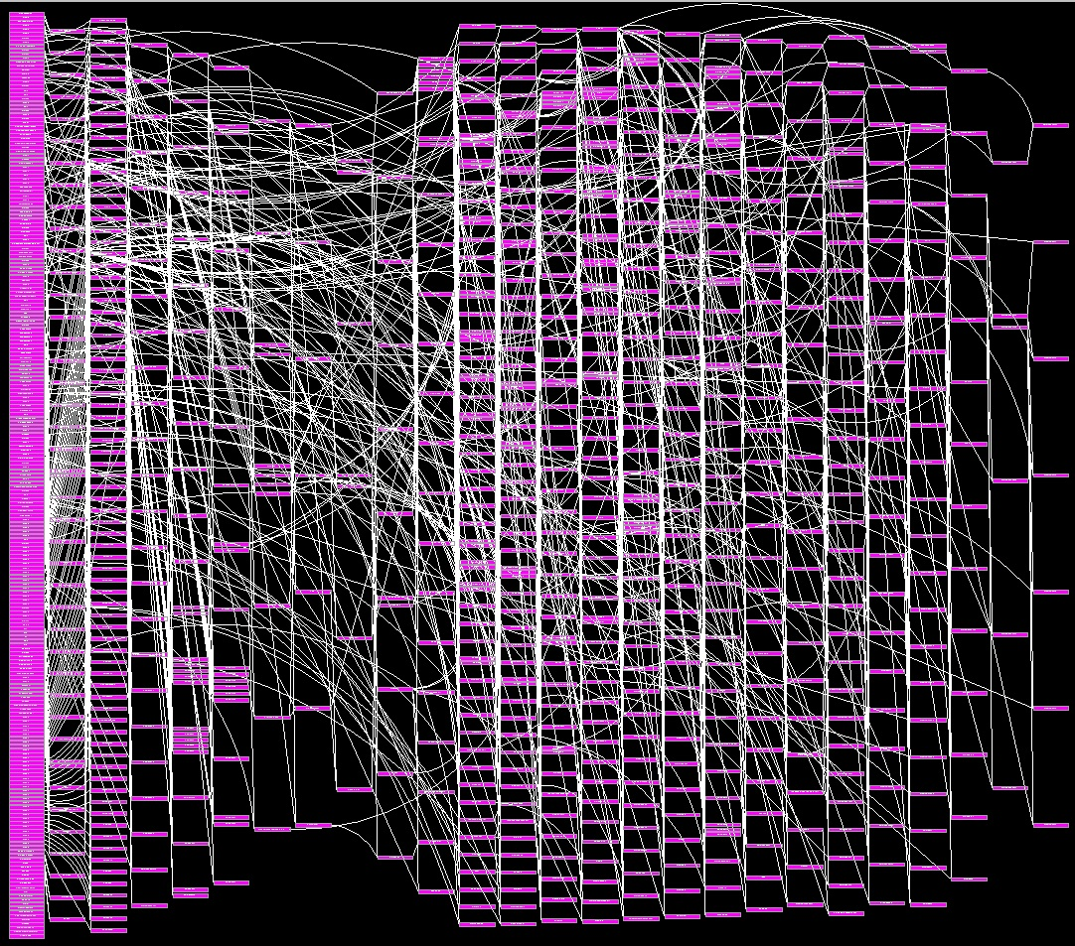
COMPLEXITY

Slide 10
ORGANIZATIOAL LEADERSHIP

Slide 11
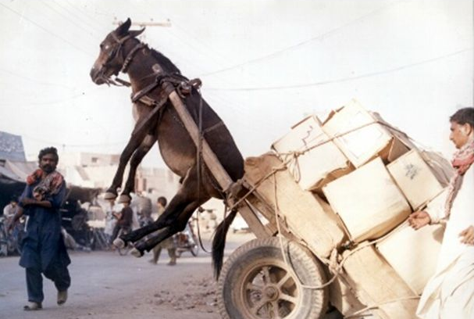

Slide 12
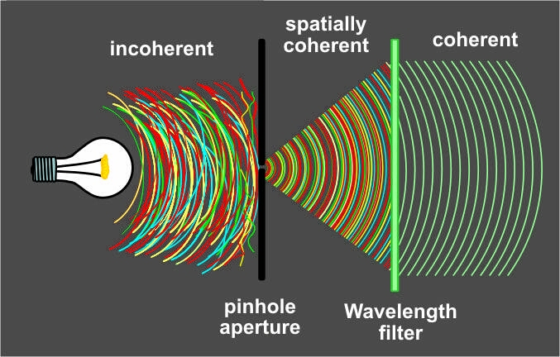
COHERENCE

Slide 13
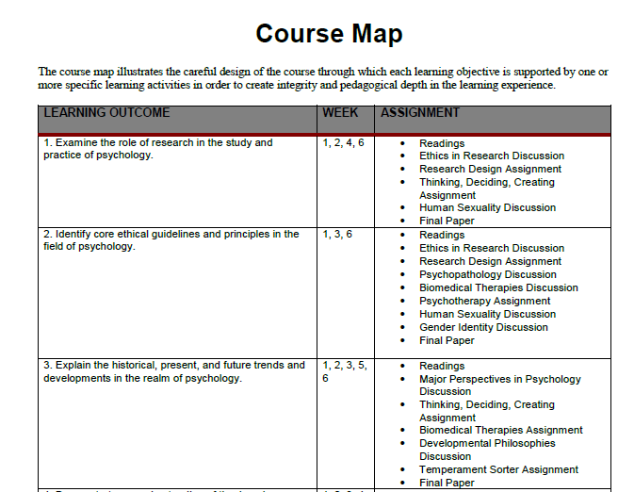
Weekly Outcomes
Assignments
CLOs aligned to WLOs and to activities

Slide 14
Activities aligned with CLOs and WLOs

Slide 15
Rubrics aligned with WLOs

Slide 16
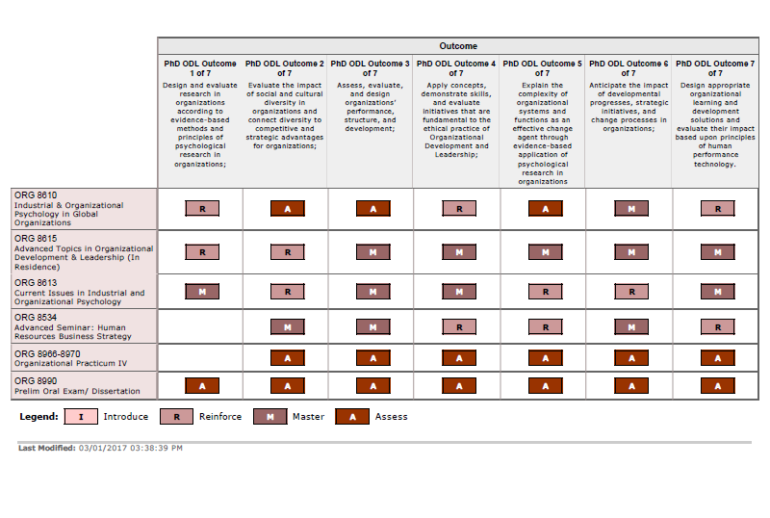
Program Learning Outcomes
Courses
PLOs aligned to Courses

Slide 17
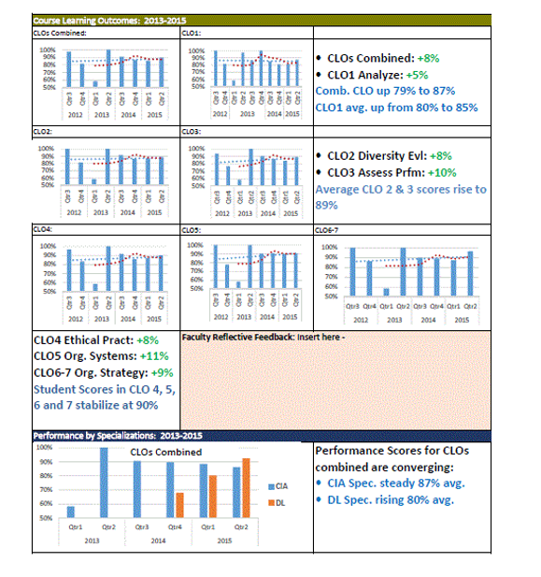
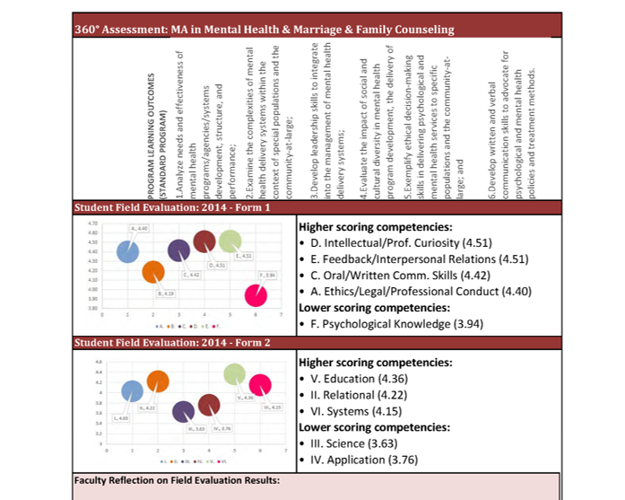
Course LOs by Course by year trends
Course and Institutional Outcome sby Program by year - trends
Performance trends by Competency
Coherent assessment results

Slide 18
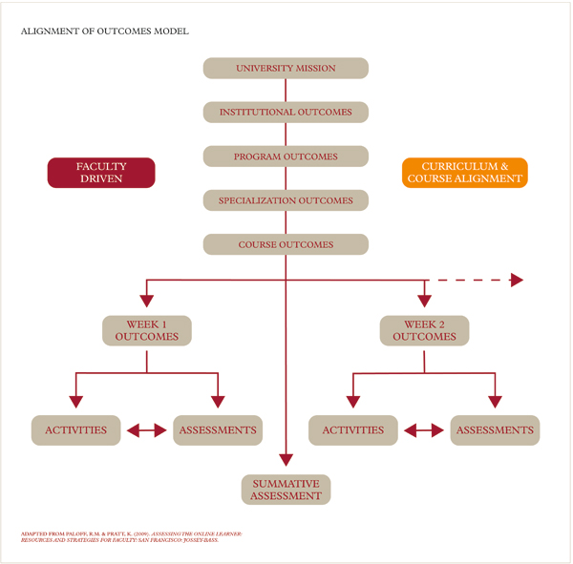
Alignment model

Slide 19
Critical elements working together

Slide 20
Thank you

