Slide 1
Understanding and Implementing Accessibility: Down the Rabbit Hole
Presented by: Linda Ayres

Slide 2
01
Learning Objectives
02
03
Deconstruct how accessibility standards (QM and WCAG) work within your institution
Identify specific strategies and tools for integrating accessibility principles into your course design
Discuss ways you can integrate accessibility principles into your course design

Slide 3
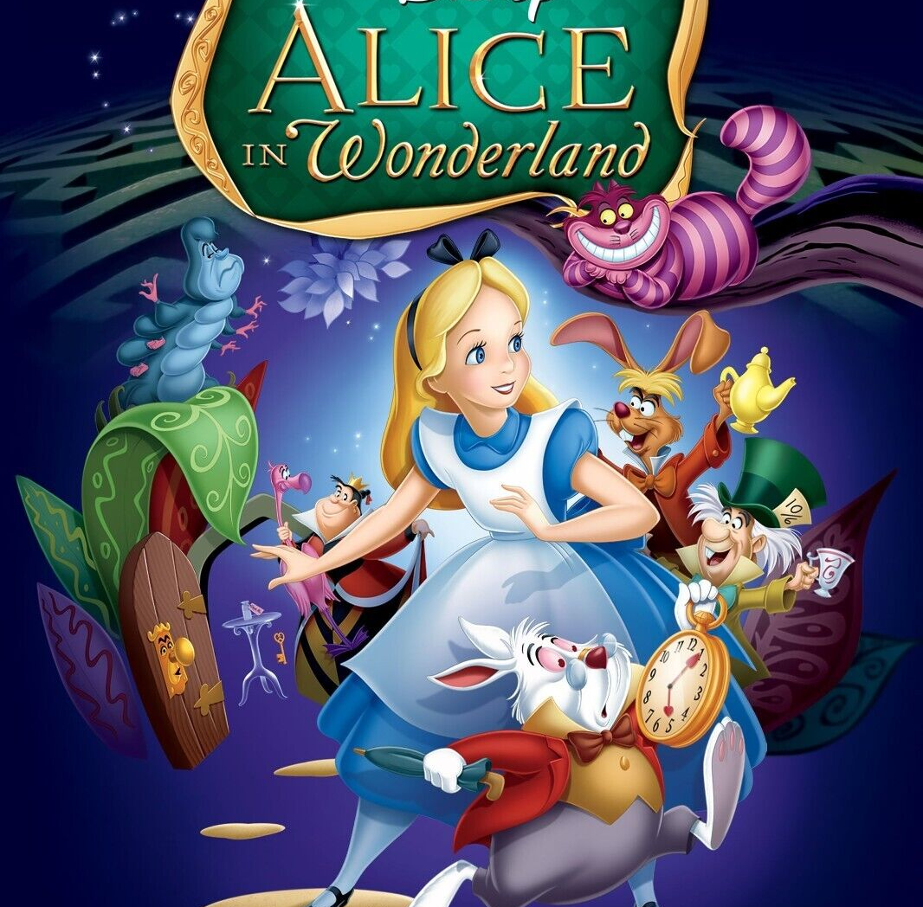
Introduction
Imagine accessibility as Alice's journey through Wonderland. Just like Alice tumbles down the rabbit hole into a world that’s bewildering and full of unexpected challenges, navigating accessibility can seem equally daunting. The standards and guidelines are like the eccentric characters she meets: puzzling, but crucial to understanding the landscape. Through trial and error, just as Alice learns to maneuver through Wonderland, we learn to integrate accessibility principles seamlessly into our course design, discovering along the way which strategies and tools truly work for our institution. Together, we’re finding our way through the maze, ensuring everyone can access the best parts of the experience.

Slide 4
Opening Question: Why is accessibility in a virtual program so important?
“Who’s to say which is which?” - (Mad Hatter from Alice in Wonderland) Lewis Carroll

Slide 5
Brief Launch Accessibility Overview
Launch is a K-12 virtual learning provider based at Springfield Public Schools that offers students quality courses designed, developed and delivered by Missouri educators.
Initially established in 2012 as SPS Online for Springfield Public School (SPS) students only
In 2017 Launch is born! Courses are now offered to the entire state of Missouri
In 2019 we begin our QM journey
Launch Today
“I’m late, I’m late. For a very important date!” - (White Rabbit from Alice in Wonderland) Lewis Carroll

Slide 6
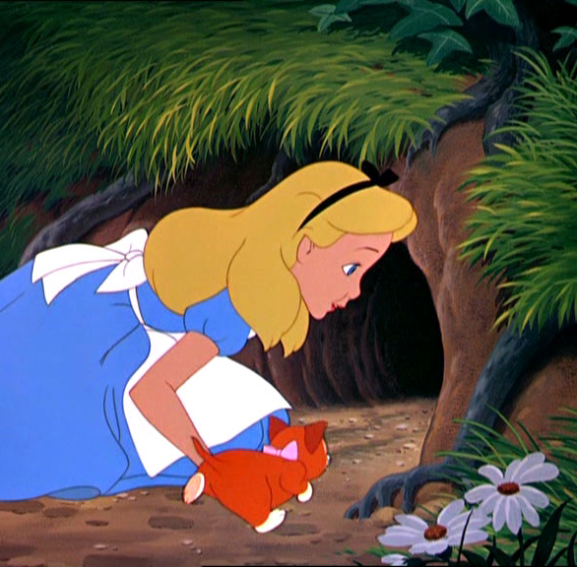
Our Accessibility Journey Begins
Initial Challenges
Lack of knowledge
Information overload
Understanding accessibility standards
How and where to begin
Inconsistent implementation
Constant change
“Every adventure requires a first step.” - (Cheshire Cat from Alice in Wonderland) Lewis Carroll

Slide 7
What are some challenges you face when implementing accessibility into your virtual courses?
“Would you tell me, please, which way I ought to go from here?” - (Cheshire Cat from Alice in Wonderland) Lewis Carroll

Slide 8
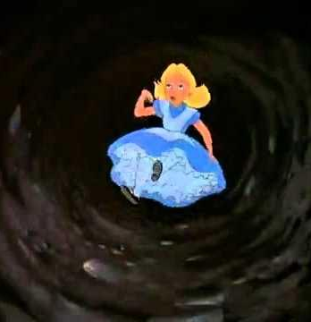
Our Accessibility Journey Begins, Cont…
Deconstructing Accessibility Standards
QM General Standard 8: Accessibility and Usability & WCAG Standards
QM and WCAG standards
Look at each one to get a better understanding
What level/version of WCAG do we need to hit?
What did we do well?
What needs improvement?
“Down, down, down. Would the fall never come to an end?” - (Alice in Wonderland) Lewis Carroll

Slide 9
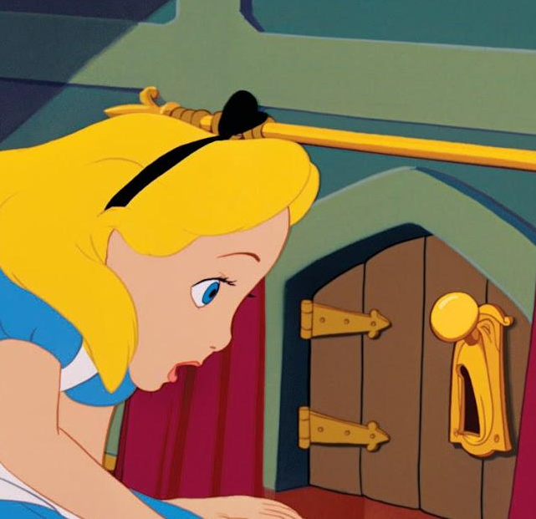
Our Accessibility Journey Begins, Cont…
Implementing Accessibility Changes
2. What do we need to focus on?
3. How are we going to prioritize?
4. Create a cultural mindshift
“Don’t you mean impossible.” “No impassible, nothing is impossible” - (Alice and the doorknob from Alice in Wonderland) Lewis Carroll

Slide 10
Key Turning Points & Lessons Learned
Start small
Prioritize based on your institution/student needs
Be proactive, not reactive
Create a cultural shift
Share knowledge
There is always more to learn and do
Don’t be afraid to pivot
Be patient and understanding
“Let your need guide your behavior.” - (Cheshire Cat from Alice in Wonderland) Lewis Carroll

Slide 11
Effective Strategies and Tools
Specific strategies that work for Launch
QA Check on all courses
The QA/Accessibility Specialists meet monthly
The QA/Dev team meets weekly
Training
Continuous Improvement
Tools & Technology
Course development templates
Launch Accessibility Guide
3rd party captioning/transcript
Student accessibility tools
Development accessibility tools
“I don’t see how he can ever finish if he doesn’t begin.” - (Alice from Alice in Wonderland) Lewis Carroll

Slide 12
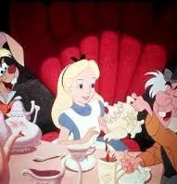
What are some ways you implement accessibility into your course design?
“And what is the use of a book,” thought Alice, “without pictures or conversation?” - (Alice, from Alice in Wonderland) Lewis Carroll

Slide 13
What’s Next?
Changes are coming!
K-12 6th Edition Rubric
Title II ADA changes
Who this affects
What this means
Next Steps
“One of the deep secrets of life is that all that is really worth doing is what we do for others.” - Lewis Carroll

Slide 14
Thank you!
Questions?
Contact Information:
Linda Ayres
lcayres@spsmail.org
linkedin.com/in/lindacayres

Slide 15
Thanks
Do you have any questions?
youremail@freepik.com
+91 620 421 838
yourcompany.com
Image Stills: Disney. Alice in Wonderland. Directed by Clyde Geronimi, Wilfred Jackson, and Hamilton Lusk, Walt Disney Productions, 1957.
Please keep this slide for attribution

