Slide 1
Conversations to Connections to Community
8th Annual Conference on Quality Assurance in Online Learning, "Blazing New Trails"

Slide 2
Session Objectives
Share stories of QM Conversations to Connections to Community
Invite participants to engage with the QM Community
Discuss purposeful efforts to keep the QM Community alive throughout the year

Slide 3
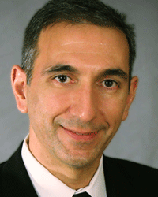
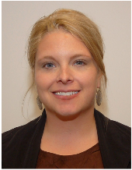
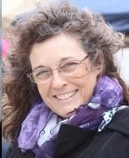
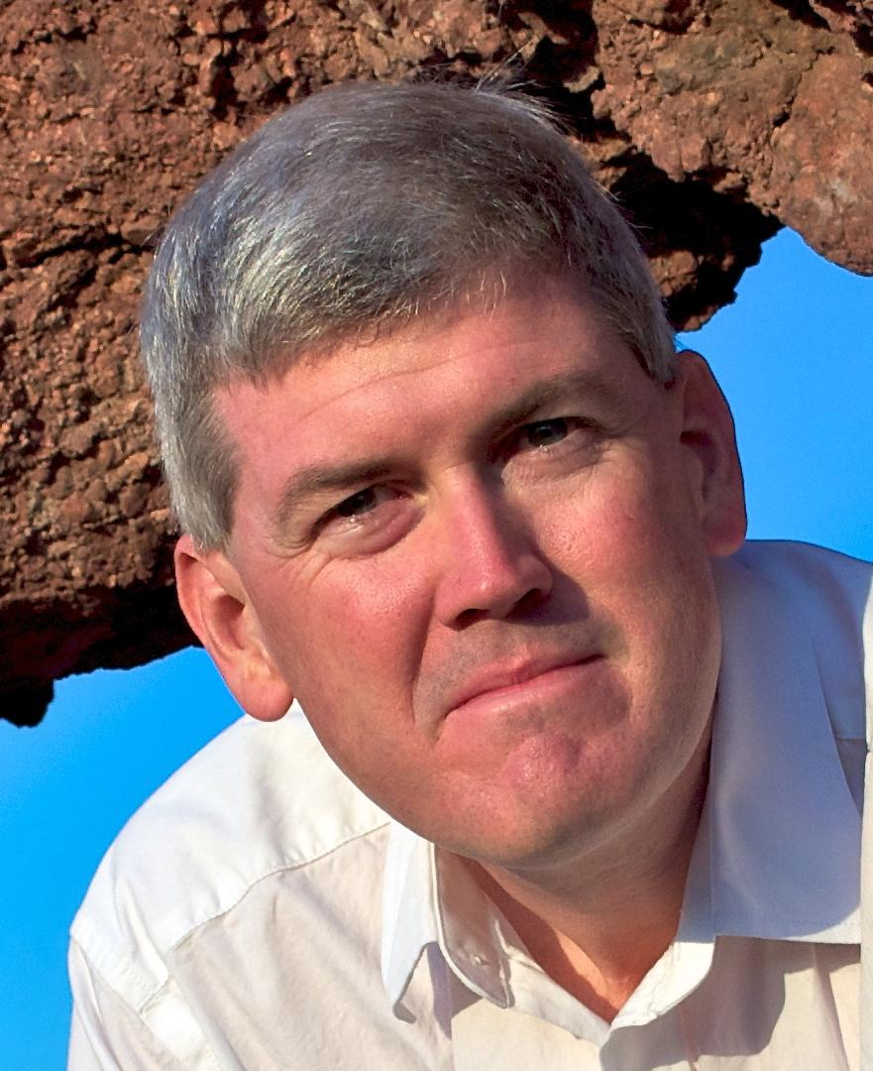
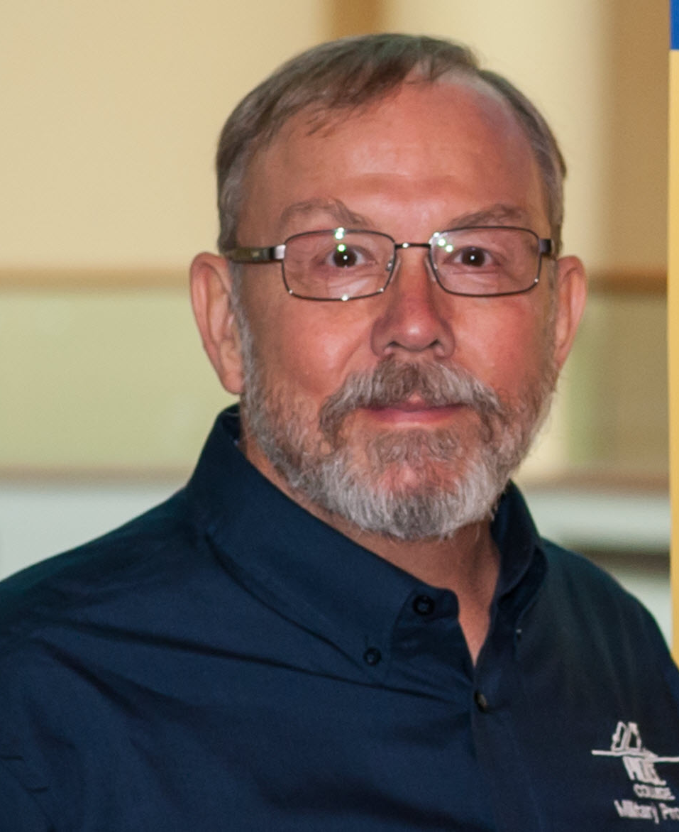
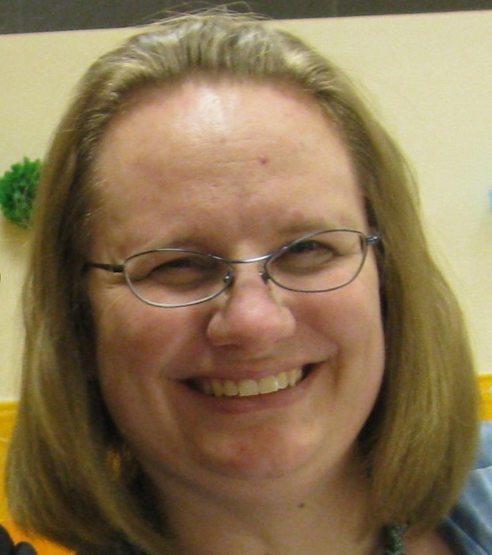
Eddie Andreo
Lisa Clark
Belle Cowden
Steven Crawford
JJ Johnson
Lisa Kidder

Slide 4
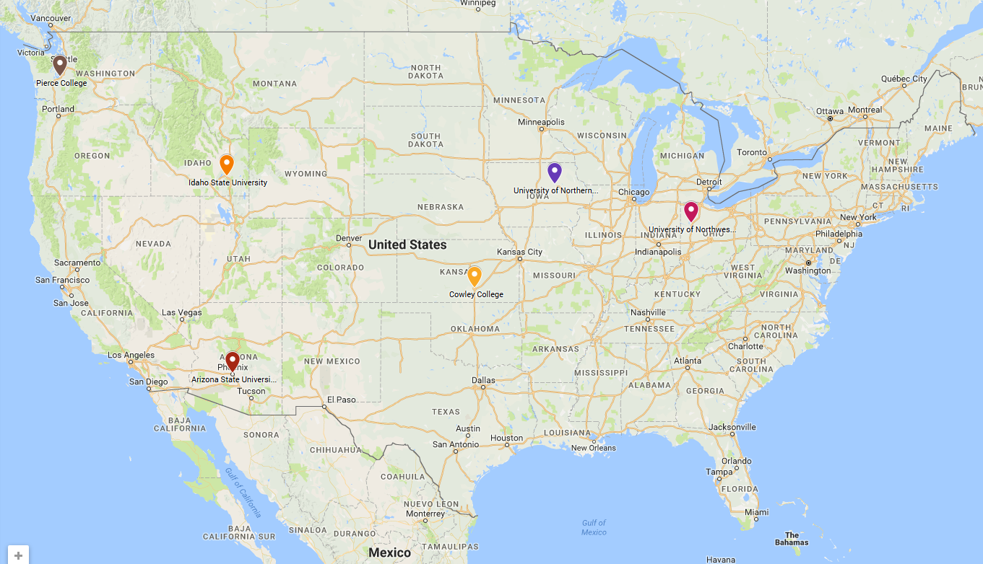
Map showing the distribution of the panelists across the United States.

Slide 5
What is the QM Community?
QM Principles
Continuous
Centered
Collegial
Collaborative

Slide 6
Share
What is a meaningful conversation you have had at a QM conference?
How have you felt connected?
What makes you keep coming back to QM conferences?
How do you know you are part of the QM Community?

Slide 7
Invite
What does QM look like at your institution?
How have you handled course reviews?
Do you have dinner plans tonight?
Can I contact you later to discuss more about _____?

Slide 8
Discuss
How do you build QM to support you?
How can we live QM on our campus?
What would help you keep the spirit of QM throughout the year?
GoogleDoc for Brainstorming
goo.gl/7raCPJ

Slide 9
Conversations to Connections to Community
Please complete your session evaluations
8th Annual Conference on Quality Assurance in Online Learning, "Blazing New Trails"

