Slide 1
Minimizing Distraction
QM Standards as a Framework for New Curriculum Development

Slide 2
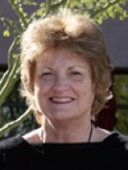
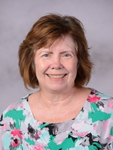
Presenters
Patricia L. Harris
Clinical Associate Professor and
Associate Director
RN-BSN Program
Diann Muzyka
Clinical Associate Professor and Program Director
RN-BSN Program
Charlotte Armbruster
Clinical Associate Professor
RN-BSN Program
Steven R. Crawford
Project Manager, Instructional Design,
Educational Support Services

Slide 3
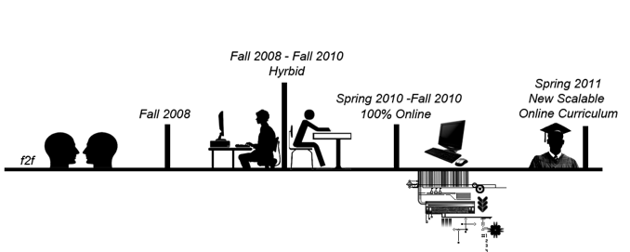
How we got here…

Slide 4
Composition of the design team
RN-BSN Faculty
Instructional Designer
Technical Writing Faculty
Librarian

Slide 5
Carousel model
NUR 391
NUR 315
NUR 464
TWC 361
NUR 392
NUR 445
NUR 440
NUR 460
NUR 444
NUR 495

Slide 6
Aligning standards

Slide 7
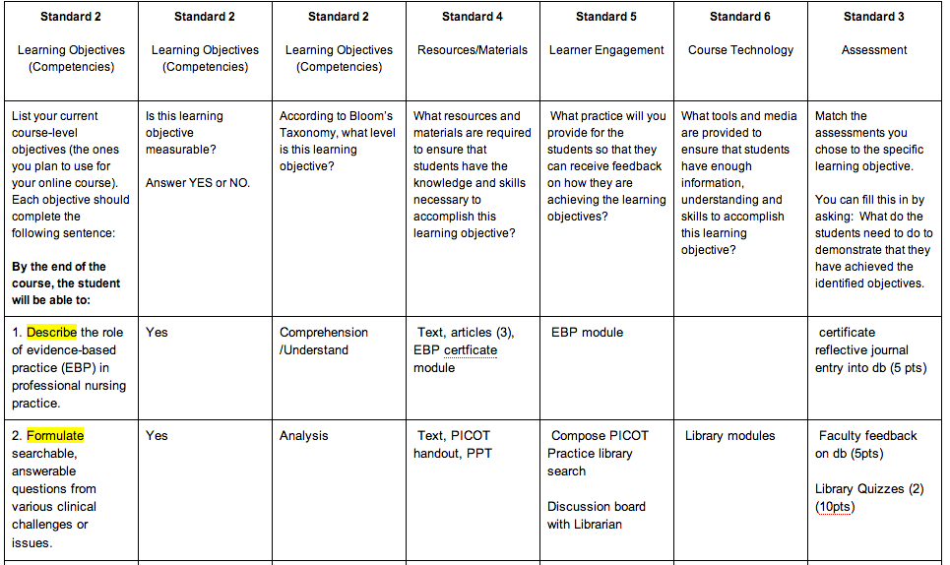
Building alignment

Slide 8
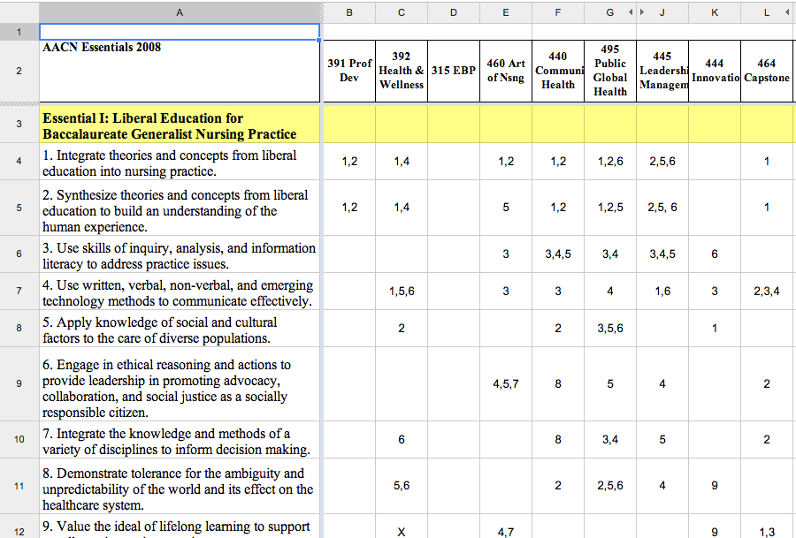
Crosswalking standards

Slide 9
QM Course Reviews
Courses Preparing for Review | Courses Review Application in Progress | Course Reviews in Progress | Courses Reviewed
NUR 315 | NUR 464 | NUR 440 | NUR 391 (4/2012)
NUR 460 |  | NUR 444 | NUR 445 (9/2012)
 |  | NUR 392* | NUR 495 (2/2013)
 |  |  | TWC 361 (2/2014)
*Reviewer selection pending

Slide 10
Questions?

Slide 11
Minimizing Distraction
QM Standards as a Framework for New Curriculum Development

