Slide 1
Launch & Learn – TEAM
with Quality Matters™:
Together Everyone
Achieves More
Anne Marie Hodges, M.A. Ed.
Manager, Web Development • Chamberlain College of Nursing
Himani Trivedi, M.S. Ed.
Manager, Instructional Design • DeVry Online Services
Joyce Whitlatch, EdD, MSN, RN
Assistant Professor • Chamberlain College of Nursing
Notes:
Welcome!
My name is Anne Marie Hodges. On behalf of my colleagues, Himani Trivedi and Joy Whitlatch, we would like to thank you for attending our presentation today.
Andrew Carnegie once said, “Teamwork is the ability to work together toward a common vision. The ability to direct individual accomplishment toward organizational objectives.” We, at Chamberlain College of Nursing, believe that teamwork with Quality Matters is a prime example of moving toward a common vision of high quality course design in nursing to support our students in becoming extraordinary! Through our adoption of the QM Rubric, course review process, and professional development opportunities offered by Quality Matters, Chamberlain College of Nursing is achieving our organizational objectives.

Slide 2
Objectives
Describe introduction and progress to implementing Quality Matters™ (QM) at our institution
Identify best practices and challenges involved
in planning and writing a plan
Discuss resources developed that encourage
colleague engagement with QM
Notes:
In this short time together, we intend to share with you our process of implementing the Quality Matters initiative and how we developed our first 3 Implementation Plan.
We will:
Describe introduction and progress to implementing QM at Chamberlain.
Identify best practices and challenges involved in planning and writing a Plan.
Discuss resources developed that encourage colleague engagement with QM.
And, we invite you to further dialogue about our success in implementing QM during the poster session, as a follow up to this presentation, later today.

Slide 3


Introduction and Implementation Plan
Evidence-Based Practice (NR-449)
Institution:
Chamberlain College of Nursing – Ohio
Course Representative(s):
Candice Phillips
Date Recognized:
2013-09-28
Program:
Higher Education
Notes:
Chamberlain College of Nursing has always sought and applied best practices and quality course design standards to its online courses, while not always formally recognized in conjunction with Quality Matters.
Our lead administration and all colleagues are committed to supporting the QM initiative throughout all programs.

Slide 4
Path to Develop Implementation Plan
Stakeholders
Action Items
Administration
Deans/Directors
Instructional Designers
Web Development
Managers
Full-time Faculty
Administrative
Coordinators
Online facilitator certification
Applying the
Quality Matters Rubric (APPQMR) workshop offerings – dedicated
Self-reviews
Internal peer reviews
Subscriber-managed reviews
Notes:
A taskforce, under the Program Director’s oversight, developed a team composed of stakeholders who could offer support and input on behalf of their faculty colleagues while designing the 3 Year Implementation Plan.
We ensured that stakeholders, such as a member from the instructional design team, the program dean, the program’s web development manager, and a program faculty manager were invited to participate on the taskforce, in addition to the three faculty members who volunteered to meet and collaborate with the QM Coordinator. Having faculty advocates is a key factor in successful design and execution of the Implementation Plan.

Slide 5
APPQMR Champions
Program Role | APPQMR
Admin Coordinator | 1
MSN
Associate Dean | 1
RN-BSN
Dean | 1
MSN
Director | 2
MSN
RN-BSN
FM | 11
DNP
MSN - FNP
MSN - Specialty
RN-BSN
FT Faculty | 34
DNP
MPH
MSN
MSN - FNP
RN-BSN
ID | 4
DeVry Online Serv.
Vice President | 1
Online Operations
WDM | 7
MPH
MSN - Specialty
MSN - FNP
Pre-Licensure
Grand Total | 62
Chamberlain College of Nursing colleagues have committed to supporting the QM initiative throughout all programs.
To date, approximately 75 percent
of our full-time online program colleagues have participated
in APPQMR.
Notes:
To date, approximately 75 percent of our fulltime, online program colleagues have participated in APPQMR.
This data includes the following post-licensure programs, in addition to several administrative leaders, such as our Vice President for Online Operations:
RN-BSN Online Degree Completion Option
Master of Science in Nursing – Family Nurse Practitioner Specialty Track
Master of Science in Nursing – Educator, Executive, Healthcare Policy and Informatics Specialty Tracks
Doctor of Nursing Practice

Slide 6
Quality Matters Implementation Plan
Notes:
While Chamberlain College of Nursing was using QM informally in its early adoption, it was not until Fall, 2014, that a formal, approved plan by QM, was in place. We are preparing our evaluation and writing our narrative update for QM as the first year has officially passed, and we are now in our second year of the plan.
Highlight aspects of the timeline, using the following slides…

Slide 7
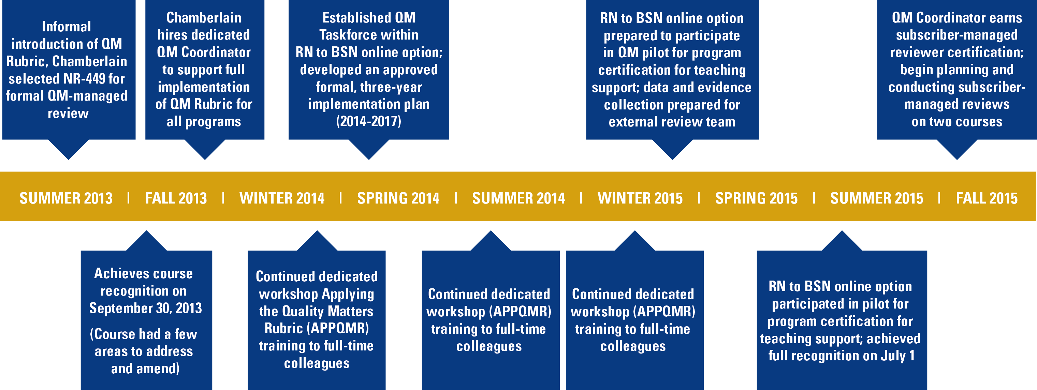
Chamberlain College of Nursing:
QM Implementation Timeline
Notes:
During our first year of formal implementation, we focused our initiative on training and development. By Fall, 2014, we identified one online program, RB-BSN online degree completion option, and conducted internal, informal self- and peer reviews on each of the 10 core courses. Course Leaders had an opportunity to complete the Course Representatives Worksheet, and receive feedback and comments addressing each of the QM Rubric Standards for the course which each leads.

Slide 8
Program Implementation Plan
Year 1 = 2014-15 FY
  Training & Development
  APPQMR
      Eight colleagues
  Peer Reviewer
  Certified (PRC)
      Two colleagues;
      Web Development
      Manager (WDM)
  RN to BSN QM Taskforce
      Dean
      Web Development Manager
      Faculty Manager
      2 Full-time Online Faculty
      QM Coordinator
      Instructional Designer –
      DeVry Online Services
Notes:
Chamberlain subscribes through The Quality Matters - Ohio Consortium, with more than 60 member institutions, it is the largest statewide consortium.
Our statewide members worked together to build a model to support the member institutions in conducting formal QM reviews by designing a bartering system.
The Quality Matters Ohio Consortium Bartering System database is under development and could evolve as utilization dictates.
Credits and debits for QM reviews are recorded in a “good faith effort” to create an affordable system for members to have courses reviewed. No other value is implied.
How did we fare in Year 1?
Chamberlain was able to complete all internal, informal, self and peer reviews on the 10 core courses in the RN to BSN program. As we prepared our Year 1 Progress narrative for Quality Matters, we reported that our planned Formal Subscriber-Managed Review is taking place in the 15-16 FY, in which we will then have completed 2 formal subscriber-managed reviews by the Year 2 Progress narrative. Our delay occurred when we decided to certify the QM Coordinator as a certified Subscriber-review Manager, whereby the fee associated with Subscriber-managed Reviews will be waived. ($100.00)

Slide 9
Program Implementation Plan
Year 1 = 2014-15 FY
  Course Review Process
Internal Self-Reviews
  Completed = 10 (07/14-09/14)
Internal Peer Reviews
  Completed = 10 (07/14-09/14)
Formal Subscriber-Managed Reviews
  Planned = 1 (bartering units)
Notes:
Chamberlain subscribes through The Quality Matters - Ohio Consortium, with more than 60 member institutions, it is the largest statewide consortium.
Our statewide members worked together to build a model to support the member institutions in conducting formal QM reviews by designing a bartering system.
The Quality Matters Ohio Consortium Bartering System database is under development and could evolve as utilization dictates.
Credits and debits for QM reviews are recorded in a “good faith effort” to create an affordable system for members to have courses reviewed. No other value is implied.
How did we fare in Year 1?
Chamberlain was able to complete all internal, informal, self and peer reviews on the 10 core courses in the RN to BSN program. As we prepared our Year 1 Progress narrative for Quality Matters, we reported that our planned Formal Subscriber-Managed Review is taking place in the 15-16 FY, in which we will then have completed 2 formal subscriber-managed reviews by the Year 2 Progress narrative. Our delay occurred when we decided to certify the QM Coordinator as a certified Subscriber-review Manager, whereby the fee associated with Subscriber-managed Reviews will be waived. ($100.00)

Slide 10

Program Implementation Plan
Year 1 = 2014-15 FY
Program Certification
The Online Teaching Support Certification
recognizes programs that:
Require all online faculty to undergo training in
best practices for online course delivery
Provide faculty with ongoing pedagogical support
Encourage faculty professional development
to increase their knowledge and skill
in online teaching
Notes:
In Year 1, Chamberlain RN-BSN Program also elected to participate in QM’s pilot for Program Certification in Teaching Support: External reviewers were provided with nearly 80 documents presenting data and evidence to support the achievement of five criteria related to teaching support.
On July 10, 2015, Chamberlain received the following commendation from Quality Matters recognizing high quality teaching support:
The Online Teaching Support Certification recognizes programs that require all online faculty to undergo training in best practices for online course delivery, provide faculty with ongoing pedagogical support, encourage faculty professional development to increase their knowledge and skill in online teaching, emphasize instructor availability and feedback to learners, and collect and use feedback from learners to improve online teaching.

Slide 11
Program Implementation Plan
Year 1 = 2014-15 FY (Continued)
Program Certification
The Online Teaching Support Certification
recognizes programs that:
Emphasize instructor availability and feedback
to learners
Collect and use feedback from learners to
improve online teaching
Notes:
In Year 1, Chamberlain RN-BSN Program also elected to participate in QM’s pilot for Program Certification in Teaching Support: External reviewers were provided with nearly 80 documents presenting data and evidence to support the achievement of five criteria related to teaching support.
On July 10, 2015, Chamberlain received the following commendation from Quality Matters recognizing high quality teaching support:
The Online Teaching Support Certification recognizes programs that require all online faculty to undergo training in best practices for online course delivery, provide faculty with ongoing pedagogical support, encourage faculty professional development to increase their knowledge and skill in online teaching, emphasize instructor availability and feedback to learners, and collect and use feedback from learners to improve online teaching.

Slide 12
Program Implementation Plan
Year 2 = 2015-16 FY
  Training & Development
  APPQMR
      Two colleagues
  QM managed Professional Development (PD) workshops
      Courses vary
          Fees vary ($0-$500.00)
  Peer Reviewer Certified (PRC)
      Planned = 1
      Build into Individual
      Professional Plan
Course Review Process
Formal
Subscriber-Managed Reviews
  Planned = 1
    Bartering units
Formal QM
Managed Reviews
  Planned = 0
    Budget $0
Notes:
We are managing our initial formal course reviews through the Subscriber-Managed Review process. By managing the subscriptions under a certified Course Review Manager, we can inform our teams and prepare for the formal QM-managed reviews in the next fiscal year, with a low risk, low cost implementation, This also offers a better understanding of what is necessary for the formal course review process with our stakeholders.
Under the Subscriber Managed Review process, we will begin to use our bartering units:
For each formal review conducted, points are deducted in the following manner (if the reviewer is not from the institution requesting the review).
Debit of 2 points for having someone Chair a review (Master Reviewer).
Debit of 1 point for having a second Reviewer serving as the Subject Matter Expert (SME).
Debit of 1 point for having a third Reviewer, (at least one external review must sit on the review team).

Slide 13
Program Implementation Plan
Year 3 = 2016-17 FY
  Training & Development
  APPQMR
      Consider VPs (dedicated)
  QM managed PD workshops
      Courses vary
          Fees vary ($0-$500.00)
  Peer Reviewer Certified (PRC)
      Planned = 1 ($200.00)
  Master Reviewer
  Certified (MRC)
      Planned = 1 ($500.00)
Course Review Process
Formal QM Managed Reviews
  Planned = 2
    Budget $2,000.00
Notes:
During our next two years of implementation, the RN-BSN Program will pursue the three additional Program Certifications:
Quality Matters Learner Success Certification
Quality Matters Support for Online Learners Certification
Once all 10 core courses are formally reviewed and certified by QM, we will work toward achieving the final certification and recognition:
Quality Matters Program Design Certification Process
Ultimately, upon recognition of all four certification areas, QM can designate Chamberlain College of Nursing’s RN-BSN Program with Exemplary Program Recognition.

Slide 14
Challenges & Best Practices
Is there interest in assuring quality design?
Knowledge/training – what do faculty already know
about course design?
Stakeholders to engage in the initiative – who are the advocates to support the execution of a plan?
How can we dispel fears that one might have asking
for external reviewers to look in on “their course”?
How can the process support evidence-based course redevelopments for our annual development cycles?
Notes:
Chamberlain College of Nursing has always sought and applied best practices and quality course design standards to its online courses. Getting busy faculty to adopt a process in quality assurance was not a challenge when I arrived to Chamberlain College of Nursing. Our faculty and administrators were eager to have a colleague on board to champion and support the development and implementation of the QM Rubric.
I knew in order to be successful in leading the charge, I felt is was very important to educate and develop a common language between colleagues using the QM Rubric and the formal course review process; this applied to stakeholders outside the realm of faculty, too. It was easy to begin conversations with faculty – they see their direct involvement of course development. But what about other stakeholders, like the librarian, the instructional designer programming the content, the textbook fulfillment team? How do they fit into the course design process?
Himani would like to share a few words regarding challenges faced from the Instructional Design team as well as best practices, and what processes they adopted to support implementation of the QM rubric within the course development cycle.

Slide 15
Best Practices
Pre-planning phase for Planned Course
Redevelopment (18 month cycles)
Monthly Meetings (program taskforces)
Newsletters (Care Connections)
Outreach by faculty to new colleagues
Faculty forums
Notes:
Himani would like to share a few words regarding challenges faced from the Instructional Design team as well as best practices, and what processes they adopted to support implementation of the QM rubric within the course development cycle.
Himani may wish to display the following document (loaded to Box), https://devry.box.com/s/sb4xyc8a62kj4reu93m4na41cjg8qj00.

Slide 16
Resources for Colleague Involvement
QM Sponsored Resources
Quality Matters Research Library:
https://www.qmprogram.org/qmresources/research/
Quality Matters Research Resources:
https://www.qualitymatters.org/QM-Research-Resources
Sample Implementation Plans
https://www.qualitymatters.org/sample-implementation-plans
Notes:
Over the course of the past two years, several resources have been shared or developed, prepared both externally and internally. We are starting to recieve requests from faculty indicating they are ready to use the self-review tool to evaluate the course in the redevelopment cycle (18 month span), and we well aware of the multi-section policy in place by QM.
QM Resources:
Quality Matters Research Library:
https://www.qmprogram.org/qmresources/research/
Quality Matters Research Resources:
https://www.qualitymatters.org/QM-Research-Resources
Sample Implementation Plans
https://www.qualitymatters.org/sample-implementation-plans

Slide 17
QM Multi-Section Policy
Notes:
Recognition of the QM Multi-Section Policy
Chamberlain College of Nursing colleagues have reviewed the Multi-Section Policy, and the QM Coordinator has responsibility for completing the form with QM to use the certification mark on edits applied to the responsibility for completing the form with QM to approve use of the certification mark on edits applied to the course where Standards 1.4, 1.8, 3.2, 3.3, and 5.3 are re-evaluated.

Slide 18
Testimonial from an Instructional Designer who has completed APPQMR training at QM
“QM gave me a firsthand chance to feel like a student. Utilizing
their demo course I quickly learned what it feels like to navigate
in an unfamiliar LCMS and a course structure. I have now put
my learning into my every day responsibilities as an Instructional Designer… All of our courses implement the latest tools and software, and we develop content rich media while ensuring
it remains accessible. QM rubric has helped me and my team
to create quality online courses!”
– Michael David
Instructional Designer DeVry Education Group
Notes:
Our instructional design and media specialist teams incorporated QM principles.

Slide 19
Testimonial from RN to BSN
Web Development Manager
“This practice experience not only helped Course Leaders gather information to aid in curriculum decision-making, it also served as a test-run for this component of applying for QM certification. The Course Leaders became more familiar with each other’s courses and how the content fit together with their own. Feedback from the review was shared with the Course Leaders, who incorporated it as part of the course redevelopment process. The effort provided insight into Quality Matters and its standards.”
– Julie McAfooes
Web Development Manager Chamberlain College of Nursing
Notes:
Our web development managers incorporated QM principles.

Slide 20
Testimonial from our faculty who were applying QM standards in course development
“We utilized the Quality Matters rubric to ensure that all components were present such as ensuring the outcomes
are measurable… The types of assessments selected
measure the stated learning objectives and are consistent
with course activities and resources.”
– Leslie Schoenberg, RN, MSN, CPNP, CNE
RN to BSN Option Chamberlain College of Nursing
Notes:
Our course leaders (faculty) incorporate QM principles.

Slide 21
Quick Checklist of QM Standards
Notes:
Himani will address how the instructional design team incorporate review of the standards during the course build process.

Slide 22
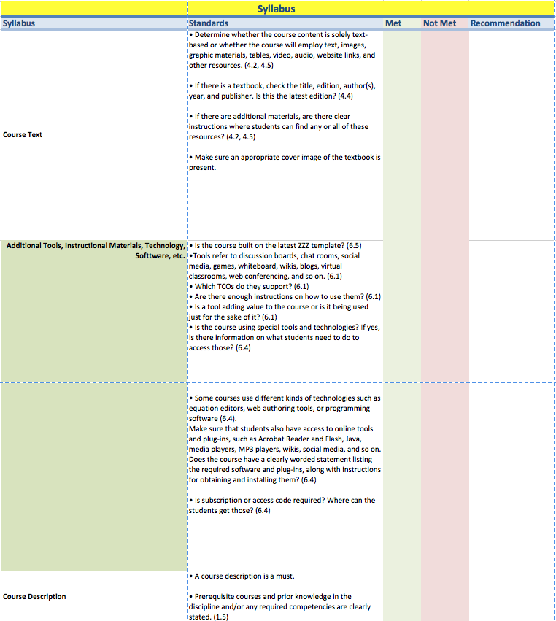
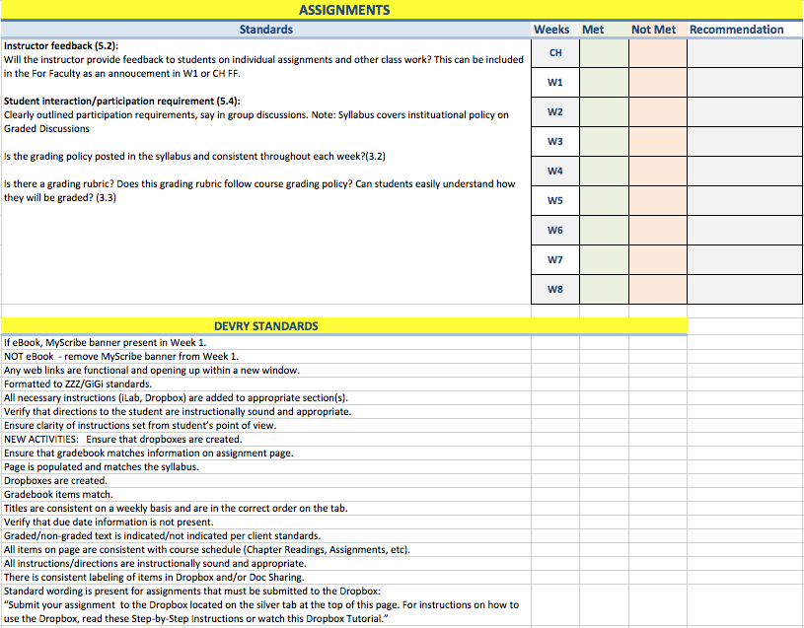
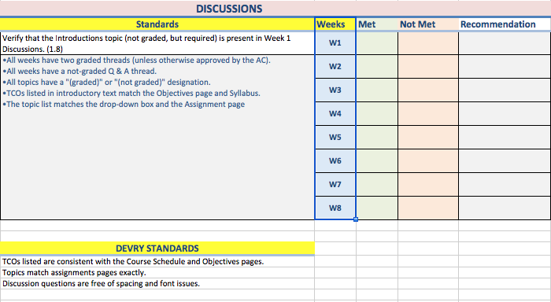
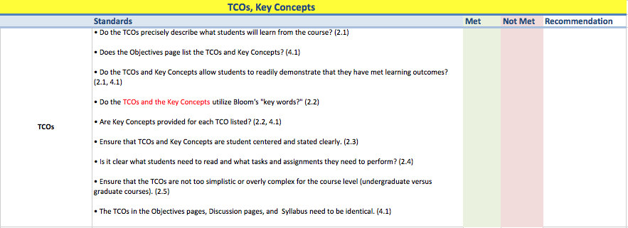
QM Checklist
Syllabus
TCOs, Key Concepts
Discussions
Assignments
For Faculty
Etc.
Notes:
Discuss how colleagues are informed of the results of the build-review between instructional designer and faculty.

Slide 23
Internal Resources
Information distribution
  Newsletters
  Emails
  Weebly Site
Fiscal support
  Administration committed to providing
  all full-time colleagues training for APPQMR
  (dedicated training – statewide consortium)
Instructional Design Support
Notes:
Information distribution
Newsletters
Emails
Weebly Site
http://ccnqualitymattersqualitydesign.weebly.com/
Fiscal support
Administration committed to providing all FT colleagues training for APPQMR (dedicated training – statewide consortium)
Instructional Design Support
DOS IDs use checklist https://devry.box.com/s/sb4xyc8a62kj4reu93m4na41cjg8qj00

Slide 24
References
Finley, D. (2012). Using quality matters (qm) to improve all courses. Journal of Teaching and Learning with Technology, 1(2), 48-50. Retrieved from http://jotlt.indiana.edu/article/download/3093/3046
Legon, R. (2015) Measuring the Impact of the Quality Matters Rubric™: A Discussion of Possibilities, American Journal of Distance Education, 29:3, 166-173, DOI:10.1080/08923647.2015.1058114
Roehrs, C., Wang, L., & Kendrick, D. (2013). Preparing faculty to use the quality matters model for course improvement. Journal of Online Learning and Teaching, 9(1), 52-67. Retrieved from http://jolt.merlot.org/Vol9_No1.htm
Notes:
Finley, D. (2012). Using quality matters (qm) to improve all courses. Journal of Teaching and Learning with Technology, 1(2), 48-50. Retrieved from http://jotlt.indiana.edu/article/download/3093/3046
Legon, R. (2015) Measuring the Impact of the Quality Matters Rubric™: A Discussion of Possibilities, American Journal of Distance Education, 29:3, 166-173, DOI:10.1080/08923647.2015.1058114
Roehrs, C., Wang, L., & Kendrick, D. (2013). Preparing faculty to use the quality matters model for course improvement . Journal of Online Learning and Teaching, 9(1), 52-67. Retrieved from http://jolt.merlot.org/Vol9_No1.htm

Slide 25
References
Shattuck, K. (2012). What we’re learning from quality matters-focused research: research, practice, continuous improvement. Informally published manuscript, Retrieved from https://www.qualitymatters.org/node/1866/download/What we're learning paper_FINAL_May 18, 2012_Dec2012ks.pdf
Shattuck, K. (2014). Assuring quality in online education: Practices and processes at the teaching, resource, and program levels. Sterling, Virginia: Stylus Publishing, LLC.
Shattuck, K. (2015) Focusing Research on Quality Matters, American Journal of Distance Education, 29:3, 155-158, DOI: 10.1080/08923647.2015.1061809
Simunich, B. (2015) Speaking Personally–With Ron Legon, American Journal of Distance Education, 29:3, 220-226, DOI: 10.1080/08923647.2015.1059624
Notes:
Shattuck, K. (2012). What we’re learning from quality matters-focused research: research, practice, continuous improvement. Informally published manuscript, Retrieved from https://www.qualitymatters.org/node/1866/download/What we're learning paper_FINAL_May 18, 2012_Dec2012ks.pdf
Shattuck, K. (2014). Assuring quality in online education: Practices and processes at the teaching, resource, and program levels. Sterling, Virginia: Stylus Publishing, LLC.
Shattuck, K. (2015) Focusing Research on Quality Matters, American Journal of Distance Education, 29:3, 155-158, DOI: 10.1080/08923647.2015.1061809
Simunich, B. (2015) Speaking Personally—With Ron Legon, American Journal of Distance Education, 29:3, 220-226, DOI: 10.1080/08923647.2015.1059624

Slide 26
Questions/Comments
Notes:
If you have additional questions, please join me in the Poster Presentation Hall, where a poster will be displayed, sharing this same information. Thank you, again, for allowing me to share how Chamberlain College of Nursing is TEAMING with QM to design quality online programs in nursing education, where we are graduating extraordinary nurses!

