Slide 1


QM 411: A Shared Directory for Design & Best Practices
Quality Matters NW Regional Conference
Track: Strategies and Applications for Meeting
QM Standards at the Course Level
April 9-10, 2015; Seattle, WA

Slide 2
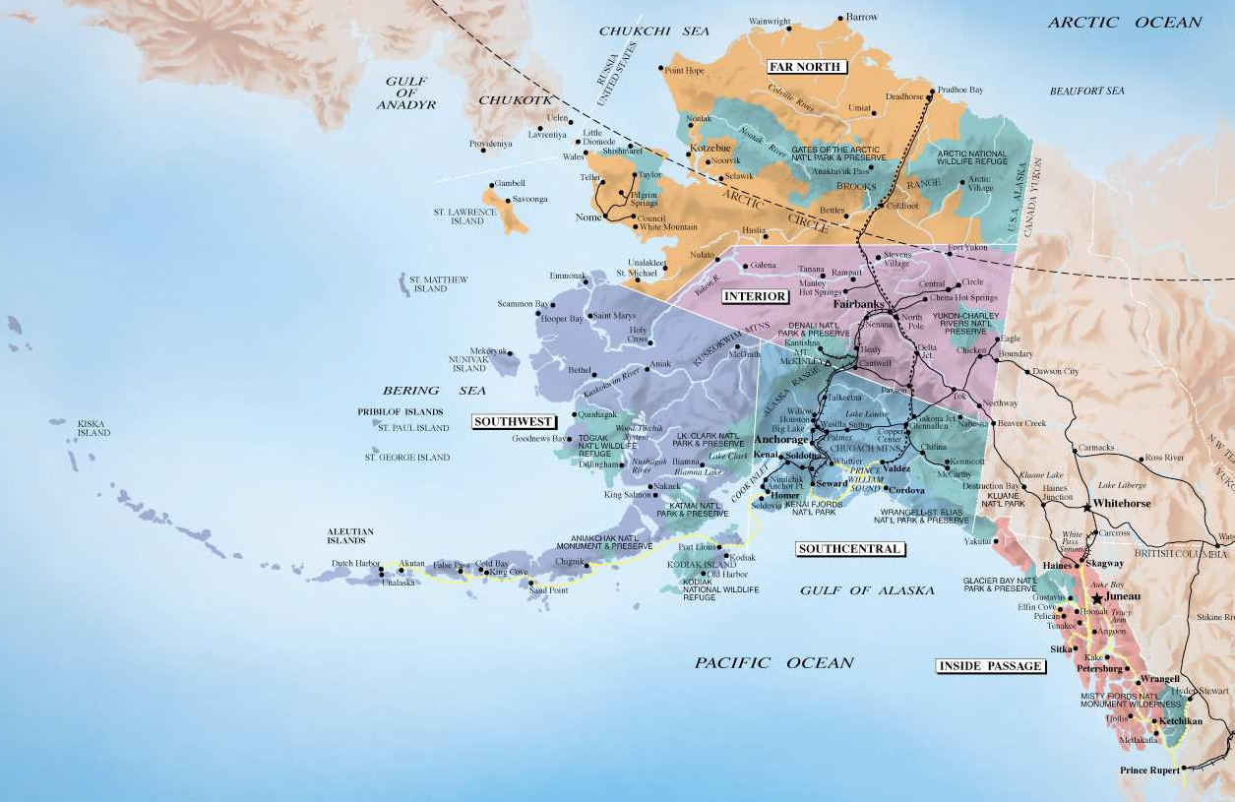
Cama’i – Hello & Introductions
Debbi Canavan
Title III Activity Director & eLearning Instructional Specialist
Kodiak College is a rural community campus of the University of Alaska Anchorage.
Kodiak Island, Alaska
http://www.travelalaska.com/Destinations/~/media/Images/Travel%20Alaska/Maps/AlaskaMap.ashx

Slide 3
Objectives / Agenda
Compare directory, showcase & template models
Identify strategies & resources for meeting QM standards in designing courses
Share & recommend resources for inclusion in a QM directory setting

Slide 4
Our Journey to QM!
2008
Title III Grant written: focus eLearning
2010
Title III Grant received
2011-2012
Identified Master Reviewers and trained early adopter full time faculty in APPQMR
2012-2013
5 Master Reviewers, 11 Peer Reviewers, 27 faculty trained in APPQR
2014-2015
QM adopted statewide
2013-2014 5 Master Reviewers, 47 faculty trained in APPQMR, collaborative training with Kenai Peninsula College

Slide 5
Sharing Design Resources and Best Practices in eLearning
Showcase Approach
Template Approach
Directory Approach

Slide 6
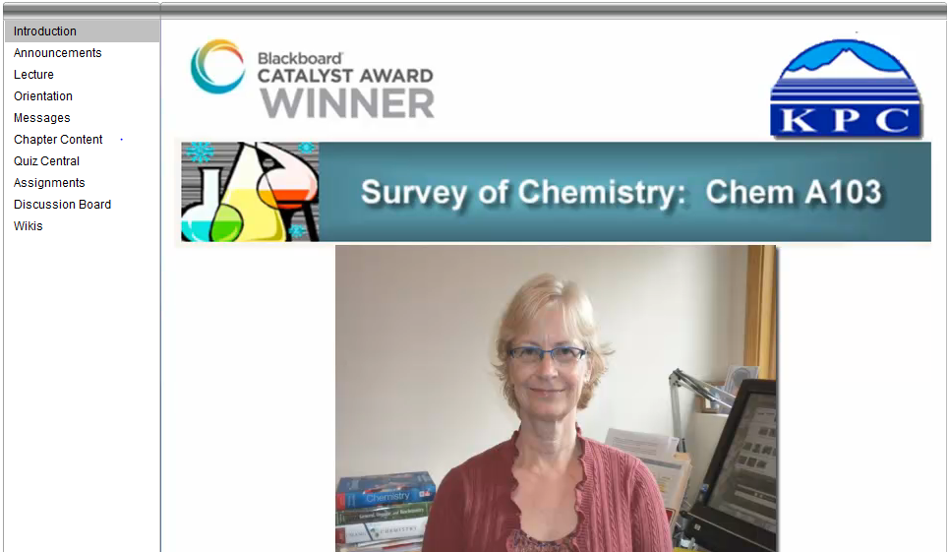
Showcase Model
Highlights a course as exemplary
http://chinook.kpc.alaska.edu/~ifscm/MircovichSurveyofChemistryTourshort/MircovichSurveyofChemistryTourshort.html

Slide 7
Showcase Model
PROs
CONs
Provides concrete examples of exemplary practices
Acknowledges the good work of the course developer
Provides motivation to create one’s own course to standards
The course must first be developed and then reviewed for best practices
Course developers must spend the time to replicate standards in their own courses

Slide 8
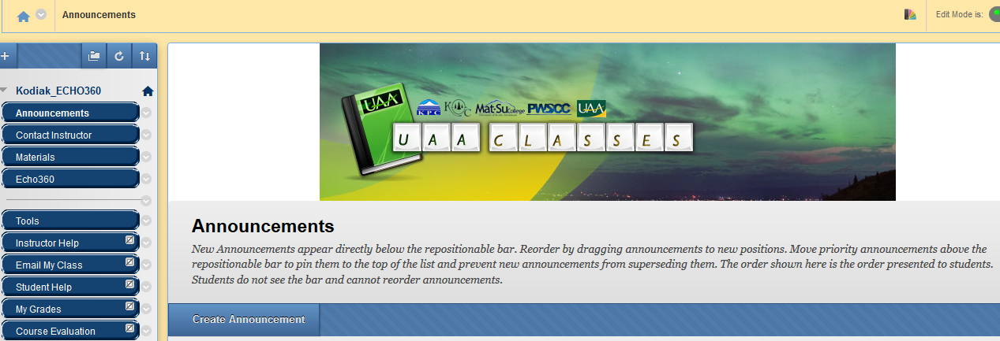
Template Model
Establishes a framework into which content is placed

Slide 9
Template Model
PROs
CONs
Provides a standard applied to all courses
Consistency and time savings as template is pre-designed
A template design must be developed, agreed upon and adopted by the institution
The faculty must be persuaded to use the template
Does not allow for creativity and individual preferences in course development

Slide 10
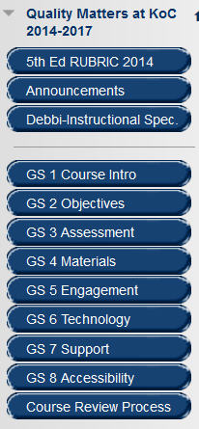

Directory Model
Files, ideas, and resources are shared among users
        Items developed to meet QM standards are posted in a shared Blackboard directory and can be “rolled” for use in any course by any member.

Slide 11
Directory Model
PROs
CONs
Provides examples in best practice that can be adopted and “tweaked”
Time savings in development as items are shared
Course developers maintain creativity and preferences in course, emphasizes academic freedom
Builds a spirit of collaboration and collegiality among users
Items must be “housed” for borrowing
Training must be provided to find and copy items
Faculty must be persuaded to use shared items

Slide 12
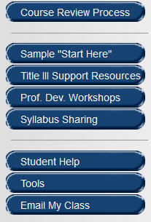
Our Shared Directory
24/7 access in Blackboard Learn LMS
Collegial & collaborative
Inclusive—for all instructors
Current—updated every semester

Slide 13
Blackboard: Quality Matters at KoC
QM Standards from 5th edition for designing
Directions for tools and training resources
KoC & System-wide Course Review Process
Updated each semester = continuous improvement

Slide 14
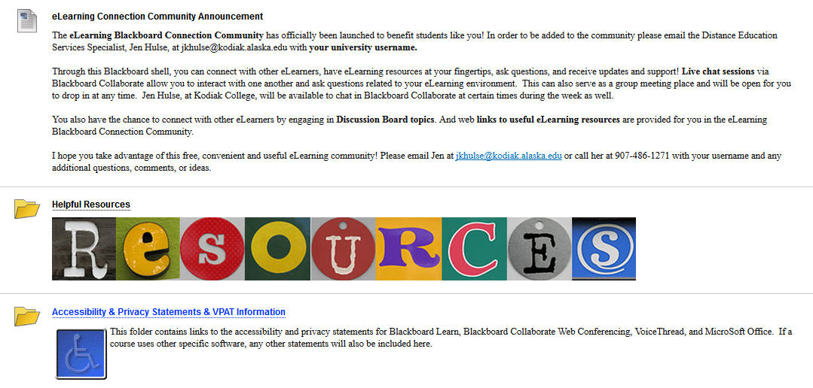
Bb: Quality Matters at KoC

Slide 15
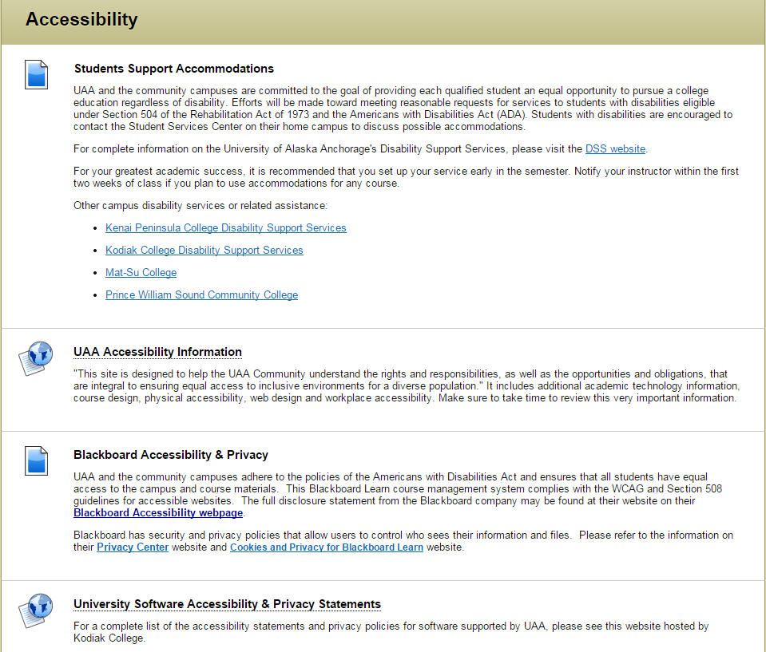
Bb: Information Maintenance

Slide 16


Sharing the Shared Directory
Now We’re Taking It to the Next Level
by inviting you to join us in

Slide 17
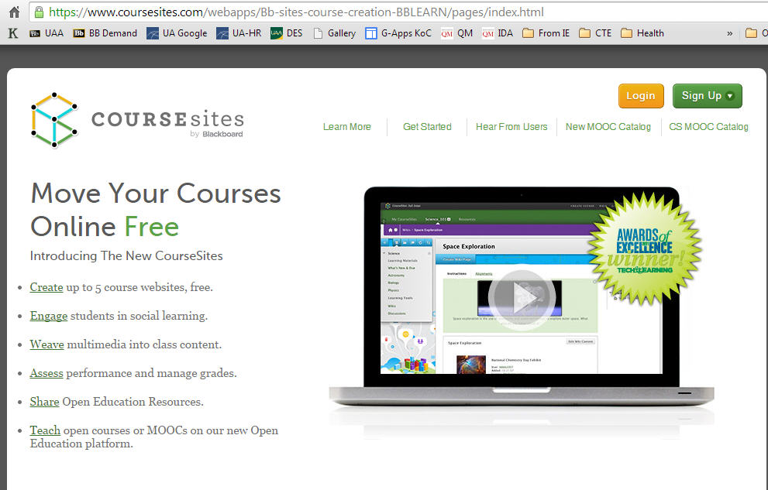
CourseSites (by Blackboard)
www.coursesites.com

Slide 18
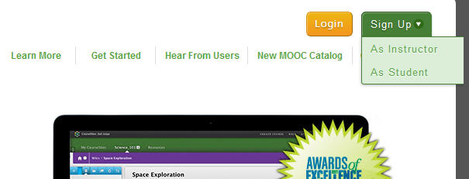
Create Coursesites Instructor Account
Sign up for FREE Instructor account
Accounts are distinguished by both username and email address—do not use same email for Instructor & Student accounts

Slide 19
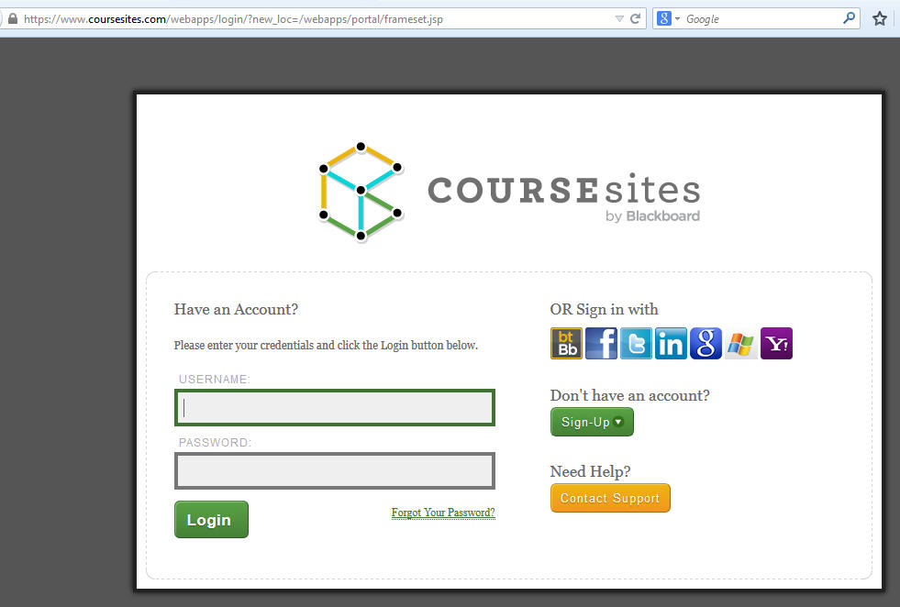
Log in to Coursesites.com
Log in with Instructor Account username and password.
WARNING: Accounts are deleted after 60 days of inactivity!

Slide 20
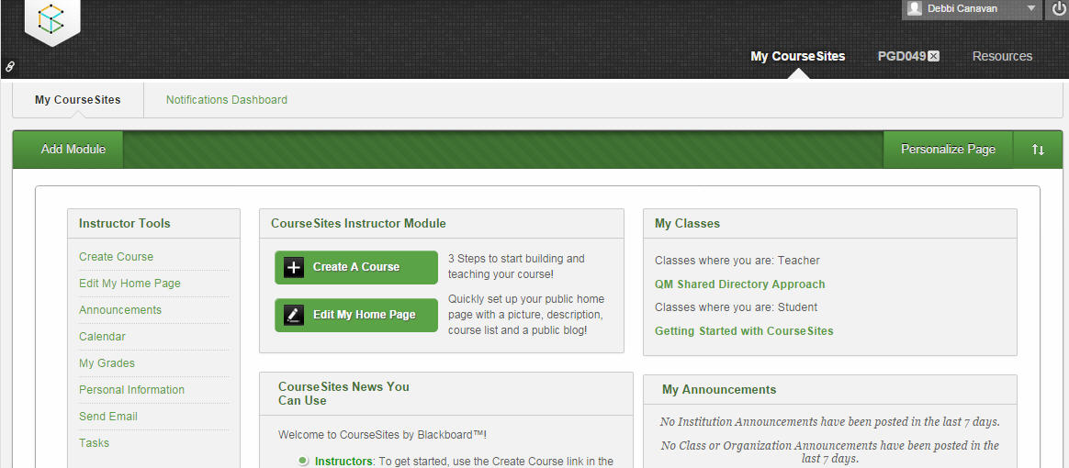
MyCourseSites Home Page

Slide 21
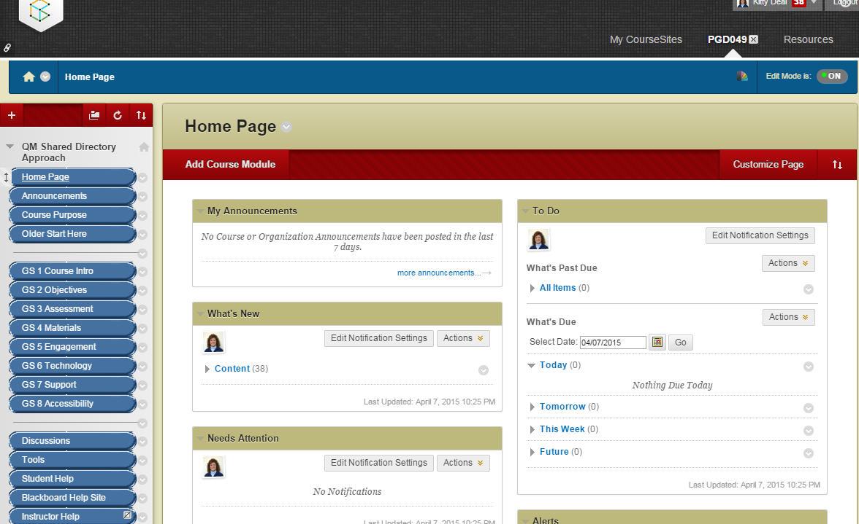
CourseSites QM Shared Directory “Course”
As Instructor:
Edit Mode On = make changes
Edit Mode Off = view

Slide 22
Sharing the Shared Directory
Provide email on sign-up sheet,
or email Debbi (or Kitty) for access to the course!

Slide 23
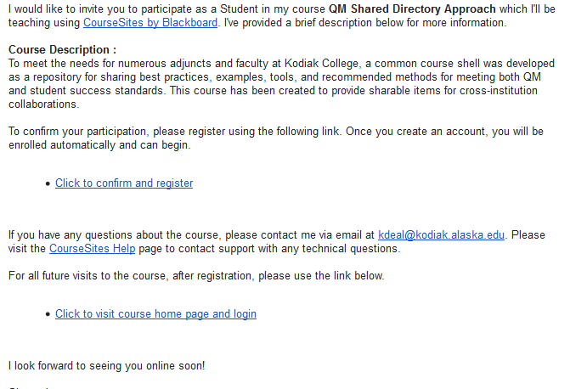
Confirm & Register for Access
You will receive an email from Blackboard with an invitation to join the QM Shared Directory Approach Course
You must “Click to confirm and register.” You will be prompted to create your user profile and information, then you will gain access to the course

Slide 24
Contacts
Debbi Canavan
Kitty Deal
Kodiak College
(907) 486-1202
Email
dacanavan@kodiak.alaska.edu
Kodiak College
(907) 486-1223
Email
kldeal@kodiak.alaska.edu

Slide 25

Sharing the Shared Directory
Questions & Wrap-up

Slide 26
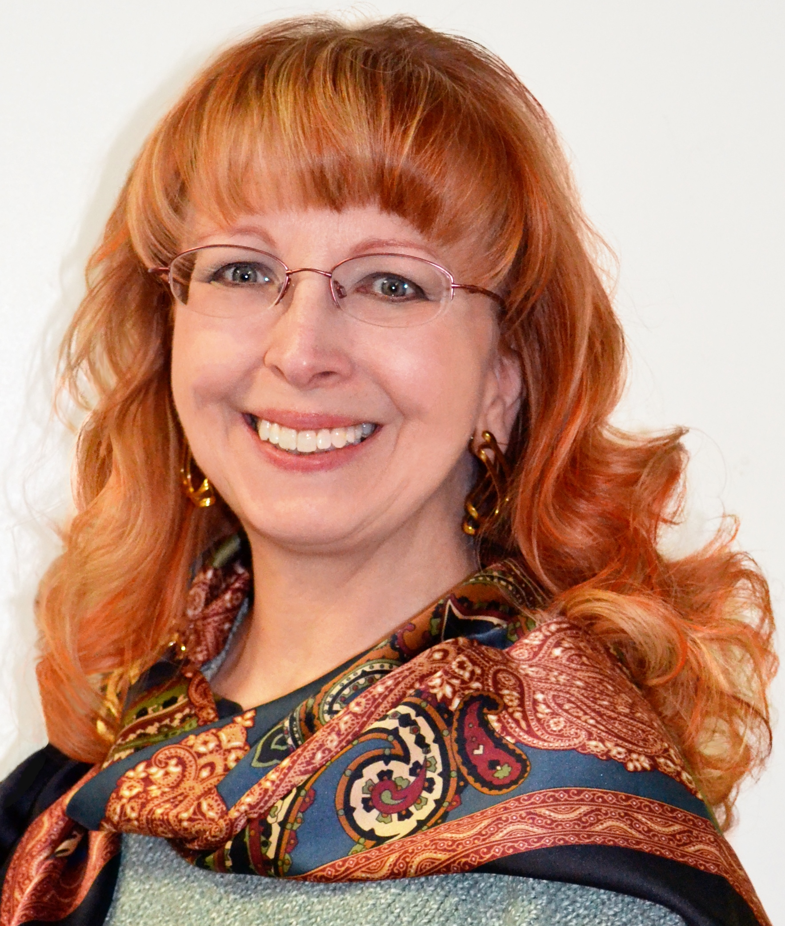
Quyanaa—Thank you !
Debbi Canavan
Kodiak College
(907) 486-1202
Email
dacanavan@kodiak.alaska.edu

