Slide 1
QM for MOOCs: Results of QM Reviews of Gates Foundation-Funded MOOCs
5th Annual
QM Conference
October 1-4, 2013
Nashville, TN
Deb Adair, QM Managing Director and Chief Planning Officer

Slide 2
Learning Objectives
Relate the purpose of the Gates MOOC project and QM’s role
Explain the aggregate outcomes of the QM reviews
Discuss the implications of these outcomes for non-credit and for-credit MOOCs

Slide 3
Your Experience with MOOCs?
How many have taken a MOOC?
Anyone served as a reviewer for the applications for the Gates MOOC RFP?
Anyone served as a QM reviewer for one of the Gates-funded MOOCs?

Slide 4
The Context
What, Why, and How

Slide 5
Project Purpose and Timing
Gates Foundation RFP:
To stimulate the development of (14) high quality introductory and remedial MOOCs
To encourage rigorous research on important questions
RFP: Sept 2012
Proposals Due: October 1, 2012
Grantees Selected: October 19, 2012
Courses offered & completed, June 2013

Slide 6
QM’s Role in Gates Project
Consulting on grant application review tool
Providing two MRs to review each application
Managing the external application review process
Providing QM-Managed course reviews for all MOOCs
Analyzing and reporting findings from course reviews

Slide 7
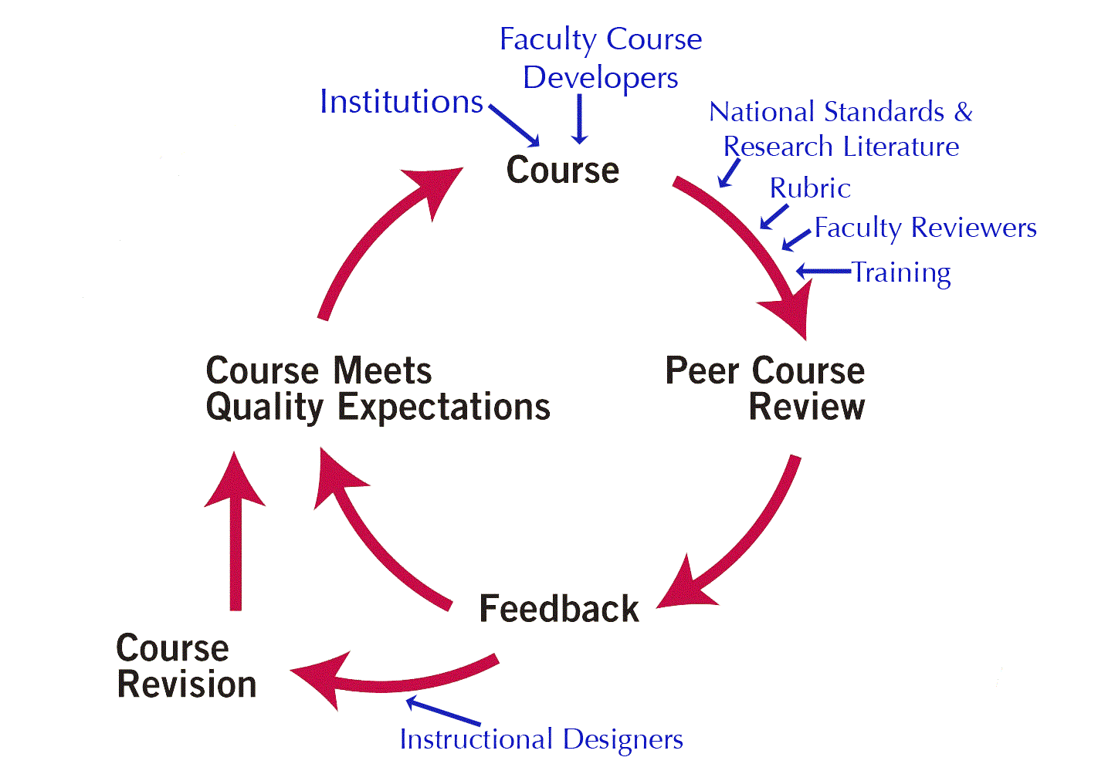
MOOC Course Reviews for Gates
QM Reviews
Followed the official QM review process
Courses had to be fully developed before review began
Used the QM CPE Rubric

Slide 8
Reviews Used QM CPE Rubric
Consisting of:
8 key areas (general standards) of course quality
41 specific review standards
99 points
85 points to meet standards, plus all essential
Notes:
Note that the detailed explanations of the 41 review standards is contained in the annotations to each standard. The annotations are quite extensive and deal with the nuances in each standard, issues of interpretation and examples of good and poor practice.
QM has a pdf on our website of the rubric standards for public view. The fully annotated version of the rubric cannot be distributed outside your subscribing institution, but may be published on your password protected intranet.
8

Slide 9
Modified Standards for CPE
Courses can meet standards without active instructor facilitation, e.g.,
No direct student to instructor communication
No personalized instructor self-introduction
No ready student access to an instructor
Exclusively machine graded assessment
Courses can meet standards without direct student to student contact, e.g.,
No student self-introductions
No student to student discussion boards
No group activities

Slide 10
Modified Standards for CPE
Reduced expectations of institutional support
Technical Support
Academic Support
Disability Support
And no Student Support Services (Counseling, etc.)

Slide 11
Compensating Expectations
Enriched student to content interaction
Student engagement through creative assignments and technology
Expanded opportunities for student self-assessment
Automated feedback to students on activities and assessments
Clear descriptions of resources available to the continuing education student
In course introduction, orientation materials, and provider website
Explanation of forms of recognition available to successful students (in lieu of academic credit)

Slide 12
MOOC Review Outcomes

Slide 13
Reviewer Profiles
34 Reviewers Total
31 Master Reviewers
17 participated as MOOC application reviewers
All hold multiple QM roles across rubrics
(e.g. PR, MR, IR, Facilitator)
Review Experience:
Aggregate total: 811
Avg: 18 (excluding outliers)

Slide 14
Review Results
14 MOOCs received funding, 13 submitted for review, 11 completed
Representative sample
Institution diversity: 2- and 4-year institutions
Discipline diversity: math, english, science, statistics
Platform diversity: BB, Udacity, Coursera, D2L
Of 11 reviewed,
3 met standards in first review
1 met after amendment (receiving full points)
1 other plans to make amendments

Slide 15
Review Scores
Notes:
Score Range:63-98 (one was 99 after amendment)
3 met in first review, one additional later

Slide 16
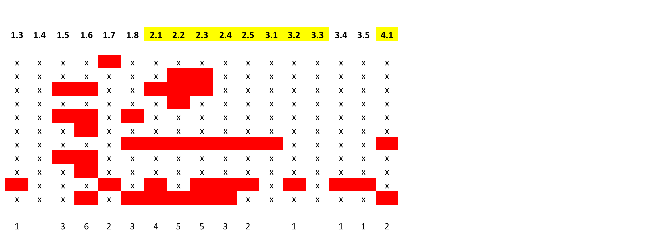
Standards Not Met: 1-4

Slide 17
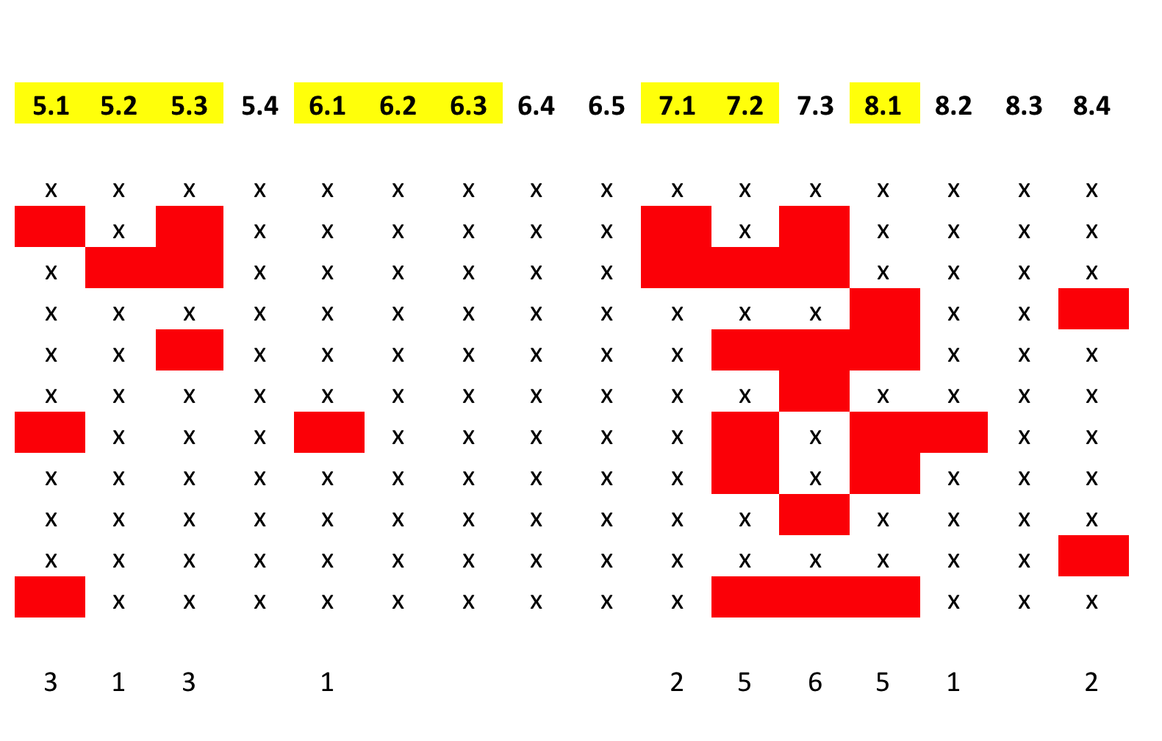
Standards Not Met: 5-8

Slide 18
Most Frequently Missed Standards
1.6 (55%) - Tech skills expectations clearly stated
2.1 (36%) - Course learning objectives measurable
2.2 (45%) - Module learning objectives measurable
2.3 (45%) - Learning objectives clearly stated
7.2 (45%) - articulate accessibility policies
7.3 (55%) – articulate course support services
8.1 (45%) – uses accessible technologies

Slide 19
Reviewer Survey Results
27 (79%) reviewers responded to post-review survey:
63%: - the course was ready to be reviewed
100% - course could meet standards (before or after amendment)
96% - review was appropriate reflection of quality of the MOOC’s design
67% - fully online MOOC can be effective for students in general/developmental MOOCs
Some qualified this as not-for-credit option
Those responding “no” identified poor fit for target learner
Notes:
63%: - the course was ready to be reviewed. Comments indicated that those who said it was NOT ready still felt the course was fully developed but that attention to specific areas like learning objectives and policies would have made a significance difference in the review outcome

Slide 20
Reviewer Survey Feedback
Where were most deficiencies?
LOs, communication, policy statements, accessibility
What difficulties did reviewers have?
For-credit & non-credit learners in MOOCs
Did the CPE Rubric & worksheet work? Yes
Reviewer reflections
Course content and pedagogy praised
Institution policies & responsibilities different in MOOCs
Accessibility an issue with platform rather than MOOC
Establishing learning communities problematic

Slide 21
Analysis & Discussion
What are your thoughts to the questions raised by this first attempt to review MOOCs?

Slide 22
Summary Analysis
MOOCS fared well, but
Deficiencies in essential standards
Of 4 major deficiency areas, 3 are LO’s, communicating learner support, and accessibility
CPE (non-credit) reduced expectations for support
All standards in GS 3 & 4 met by most
Content and pedagogy strengths
Reviewers question MOOC responsibility for support and achieving learning outcomes

Slide 23
Discussion & Implications
MOOCs can meet QM CPE standards
Easy to fix
Imperative to fix for a global & diverse audience?
Learning materials a strength of the MOOCs
Assessment standards met
but expectations reduced in CPE V HE (for-credit) Rubric
What is responsibility for learner support?
How to handle credit and non-credit in same MOOC
How do we DESIGN effective learning communities in MOOCs?
Notes:
Do institutions offering MOOC have greater responsibility for supporting learners - in offering or pointing out support resources – than they are currently taking on?
What happens if MOOC participants are enrolled students, but taking non-credit. What about for-credit? How do you manage both in same MOOC?

