Slide 1
How the QM Community is Making Quality Matter: 10 Years of Continuous Improvement
Adair QM NYC Regional Conference 3-18-16

Slide 2
“Life can only be understood backwards;
but it must be lived forwards.”
― Søren Kierkegaard
Notes:
This is our challenge at Quality Matters and a challenge, I believe, for anyone involved in quality assurance. We have to evaluate performance that has already occurred to identify how to make improvement. The timelines of most education research, and the requirements for robust, replicable research that yields usable evidence, means that we have to rely on lessons from the past to help interpret the present and guide the future.

Slide 3



State of online learning: 2006*
Students
    3.5 Million
Growth
9.7%, 2-year colleges highest growth
Strategic Importance
  59% critical; 13.5% not
Barriers
  Disciplined students, faculty acceptance
Quality
  27% say online=F2F
*Allen, E. & Seaman, J. 2007
Notes:
Students
3.5 Million students taking at least 1 online course
Growth
9.7% growth vs 1.5 overall, but rates already slowing. 2-year institutions highest rates. 4-years had least # online and slowest growth rates). Indications that growth would occur at schools already engaged with online. Others not planning to go online.
Strategic Importance
Barriers – Leaders did not believe lack of acceptance by employers, development/delivery costs a barrier only for those not yet offering online
Quality – asked about level of respect for online v F2F, did not ask about outcomes

Slide 4
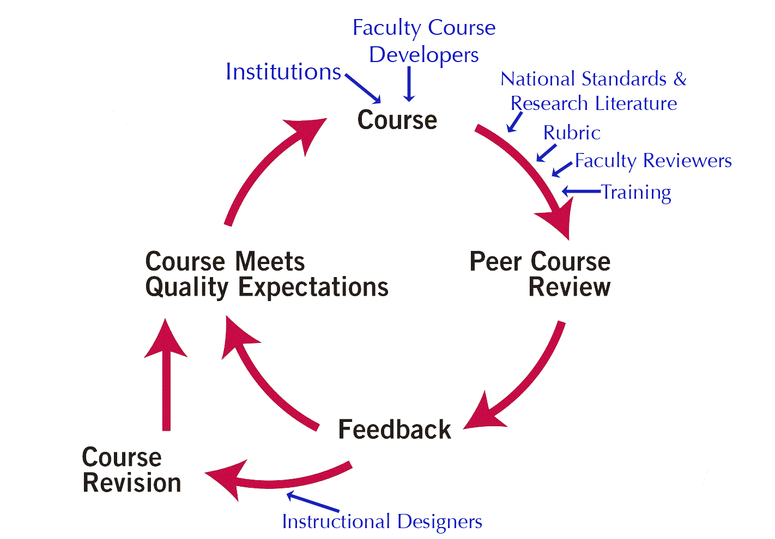
Where QM started: 2006
Academic heritage
  FIPSE-funded, consortia project
Practical QA for course design
Research-centered
Non-profit, membership-based
  84 institutions
  2000 trained faculty
  85 courses certified

Slide 5

Tools & processes introduced
QM Rubric
Professional Development
Peer Course Reviews
Principles
Peer Review
Continuous Improvement Process
Research-based
Faculty-centered
Notes:
The integration of he tools we use, and that we provide to institutions for their use, was the key element to a successful QA process. These major tools are the rubric (standards made usable), professional development for faculty, and course reviews.

Slide 6
Some observations about Quality in ‘06
Courses being developed as students were taking them
Lectures posted online; faculty did not appreciate need for different pedagogical approaches
Design discouraged students to be “disciplined” in their learning process
Design did not support navigation and “findability”
Design did not facilitate interaction
Design was not accessible
Notes:
Design did not enable students to be “disciplined” in their learning process
Lacked specificity and clarity of directions to students about what was expected and how to measure their own progress
Design did not support navigation and “findability”
organization and navigation of courses were often cumbersome or unclear
Design did not facilitate interaction
Lacked etiquette expectations about how to communicate online and how/when to expect to communicate with faculty
Design was not accessible
Lack of equivalent materials for auditory and visual content

Slide 7
Online Learning Today
And QM’s Perspective

Slide 8

State of online learning today*
2006
2014
7.1 Million+
3.7%
  70.8% critical
  57.9%
3.5 Million
9.7%
  59% critical
  Disciplined students, faculty acceptance
  27% online=F2F
*Allen, E. & Seaman, J. 2015
Notes:
Students
3.5 Million students taking at least 1 online course. In 2014, IPEDs data source had incomparable numbers, 2013 Babson data said 7.1 M
Growth
9.7% growth vs 3.7% rates slowing. Growth still outpaces overall enrollment; growth is unequal in sectors, base rate is much higher now. Highest growth now in 4-years (public and private non-profit).
Strategic Importance: From 59% critical, 13.5%not to 70.8% critical, 8.6% not
Barriers – We are still talking about the same barriers.
Quality – Later surveys asked about quality in outcomes

Slide 9
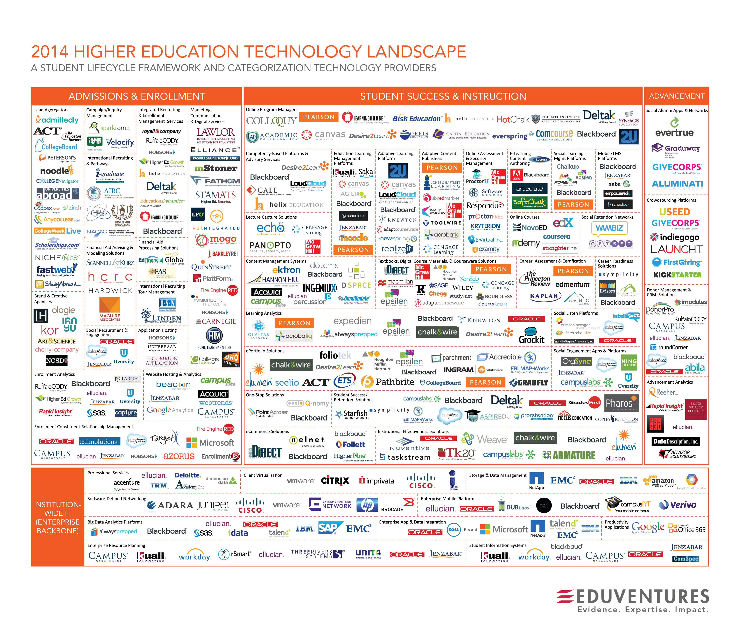
Notes:
Technological innovations and non-academic providers of content, delivery, management, marketing, and – most notably – tools – abound today.

Slide 10
Influencing quality since 2006
New tools enabled growth; not necessarily quality
Increased use/professionalism of instructional designers
Team approaches to developing courses
Recognizing the need for different pedagogy for online courses - it’s not your mother’s F2F course
Understanding course design matters, just as teaching, learner support, and learner success
Keeping faculty in the center of quality
  e.g. peer review
Notes:
I’d like to think that QM and its community has had an impact on the last three points.

Slide 11
Frequently missed standards 06 v 14
Notes:
QM course reviews consist of an initial review by three trained and certified reviewers, report with feedback/recommendations to developer, and then an amendment period where the developer is given an opportunity to implement recommendations as desired.

Slide 12
Frequently missed standards 06 v 14

Slide 13
Frequently missed standards 06 v 14

Slide 14
Where QM stands today
950 HE institutions; 1,045 total
48 US states; 6+ countries
45,000+ trained (faculty and staff)
5,000+ national Peer Reviewers
5550+ certified courses
QM IDA with 578 instructional designers
Broad application
  Rubrics beyond HE (5), Customizable review tools, Program Certification
Notes:
Quality Matters has become a widely adopted program of quality assurance. It currently has more than 900 institutional subscribers across 48 states + District of Columbia, Guam and Puerto Rico, as well as subscribers in Canada, Saudi Arabia, China, Australia, Figi and Greece). Statewide systems also subscribe to provide coordination and more economical access to QM tools for their member institutions. Please visit our website for a list of current subscribers. http://www.qualitymatters.org/Documents/Subscriber%20List%20for%20Publication.
Quality Matters has trained well over 30,000 faculty and instructional design staff and has been recently recognized by both the Sloan Consortium and USDLA for excellence.

Slide 15
Faculty at the center of quality
QM Course Review
QM Peer Reviewer
QM Peer Reviewer
QM Peer Reviewer
Notes:
QM becomes scalable at the national level when you look at the exponential influence of QM course review. Once course review can actually impact all of the students in all of the courses offered by the course developer AND the reviewers. It starts with a single course review. The three reviewers (from different institutions across the country) consult with the faculty course developer to improve the course. The course is taught, and the (say 20) students are positively impacted. But that course developer teaches other courses – and 30 students in each of the other courses are impacted. And the three reviewers are also faculty. And 30 students in each of their courses are impacted, etc.

Slide 16
Student impact: Instructor’s courses
1
2
3

Slide 17
Student Impact: Peer reviewers’ courses

Slide 18
Impact of single QM course review

Slide 19
Exponential Impact (potential)

Slide 20
QM PD Impact
A recent study by Kearns & Mancilla noted influence on faculty behavior/course modification:
Revised learning objectives
Improved course alignment
Greater focus on communication with students
Changes in assessment practices
Improved accessibility
Redesigned learning activities to increase learner-learner interaction
Notes:
The Impact of the Quality Matters Professional Development
on Teaching across Delivery Formats
Lorna R. Kearns and Rae Mancilla
University of Pittsburgh

Slide 21
Looking Ahead
And where QM is headed

Slide 22
Drivers for change
Blurring of onsite & online
Value of Ed?
Innovation
Outputs Focus
Learning beyond the classroom
Adaptive Learning
Credentialing
Blurring role of vendors & schools
Learning becomes fixed, time is variable
Learning Analytics
CBE
Unbundling of the course & faculty role
Employers as partners
Notes:
Three major drivers for change in higher education include increasingly articulated concerns about the value and ROI of education – from the public and legislators – and the DOE is listening. These concerns, and the genuine interest from many corners, have spurred much innovation and experimentation. There are many innovations and trends that could have appeared on this slide. But all of this is driving a focus on outputs in a way, and with a consistency of message, that we simply can’t ignore.

Slide 23

Trends that could mainstream
Learning beyond the classroom
Blurring of onsite & online
Adaptive Learning
Credentialing
Personalized Learning
Blurring role of vendors & schools
Learning becomes fixed, time is variable
Learning Analytics
CBE
Unbundling of the course & faculty role
Employers as partners
Notes:
I’ve selected these 4 as trends that may go mainstream in the relatively near future. Not necessarily in all of the “cutting-edge” forms we see experimented with now, but it terms of the general principles and the potential they bring to enhance learning. What connects these 4 is the focus on customizing or personalizing to meet learner needs. In my opinion, the more these innovations can keep the faculty role at their center and the gold-standard of faculty-student interaction, the more successful they will be in wide-spread adoption. This is what it takes for learning to be “personable.”
It’s not technology for technology’s sake.
What I note in the boundary spanning roles I play is that the mainstream does not see an urgency for why we need to change, does not understand what technology can really do, does not value what it thinks technology does, and distrusts what it might be used to do. If we could have a shared understanding that these technology-enabled innovations are critical for making learning more personal and personalized, we could see the trends broadly embraced.

Slide 24
The Challenge for Quality Assurance
Understanding quality in a new context
Looking backwards while moving forward

Slide 25
Quality in new contexts
What does a quality CBE program look like?
What are the characteristics of an effective micro-credentialing system?
How can adaptive technology be paired with faculty expertise to improve student learning?
What does quality look like in different faculty roles?
What does quality education look like outside the boundaries of the academic classroom?

Slide 26
Applying what we know to CBE Research
Personalized and experiential learning and support
Use of technology enables and enhances the learning experience
GS-1
GS-7
GS-7
Challenging and engaging learning opportunities
GS-5
GS-1
GS-2
GS-3
Clear and credential-appropriate expectations, requirements and learning outcomes
GS-5
GS-8
GS-3
GS-4
Socially and culturally responsive learning environments
Flexibility in when, where and how learning happens
GS-1
GS-3
GS-4
Learner agency and choice
*Survey of the Shared Design Elements & Emerging Practices of Competency-Based Education Programs. Public Agenda, 2016
Notes:
QM’s perspective on the Shared Design Elements is that these elements are well supported by QM’s research-based standards for design to enhance student learning. Standards have been annotated to specifically support CBE. The mapping isn’t directly one-to-one, but all of the design elements support evidence-based practice in the design of learning.

Slide 27

QM heading into 2016
Academic non-profit org.
Robust research
Quality assurance at course & program level
Online faculty competencies
QM for Teaching
International initiatives
Notes:
July 1, 2014 QM became a standalone 501©3
QM conducts research on its own data, has a set of research colleagues that conduct an ongoing literature review, and is looking ahead to embark on a national survey that will be announced later this year
QM has participated in validation research on a rubric for online faculty competencies around which we are building an online teaching certificate program
QM has active subscribers in a number of countries, including 36 in Canada alone. But we are in conversations with a number of other countries who are inquiring about how to bring QM to their institutions and in their native languages. Mexico, Chili, Sri Lanka, We are further along in these conversations with China. We now have a partnership with Fudan University in China to develop a translated and culturally appropriate version of the Rubric for dissemination in China.

Slide 28
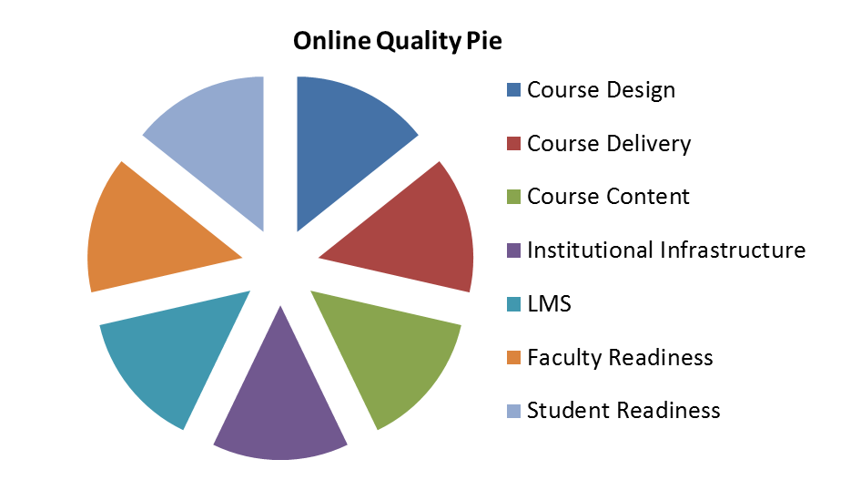
Quality has many pieces
QM will look backwards to understand these
And will work forwards with our community and many partners
Merrill, M.D., Drake, L., Lacy, M.J., Pratt, J. & ID2 Research Group. (1996). Reclaiming Instructional Design. Educational Technology, 36(5), p. 5-7.
Notes:
There are many factors that affect the quality of an online course. QM will be considering quality and quality assurance issues with many of these areas.
the course design (the forethought and planning that goes into an online course,)
the course delivery (i.e. the way the course is taught, also known as faculty performance),
the course content,
the learning management system and its functionality; technical support
the institutional infrastructure (help desk, online library access, online tutoring access, etc),
a faculty member’s training and readiness for online teaching,
and the students’ role with respect to engagement and readiness for an online course.
QM reviews just one aspect of online course quality – Course Design.

Slide 29
QM’s achievements belong to our community
Thank You All
for Making Quality Matter

Slide 31
Behavior Change Data
An example from QM’s Higher Education Course Review Exit Survey Data
February – October 2015
All roles, N=1794
Self-report data about behavior and intended behavior

Slide 32
Impact for Online Courses
As a result of your participation as a _______ in QM course reviews, have you or do you intend to make changes in your online courses?
Role | N | Yes (N) | Yes (%) | No (N) | No (%) | N/A
QMC | 158 | 57 | 36% | 21 | 13% | 78 | 49%
PR | 851 | 588 | 69% | 144 | 17% | 115 | 14%
CR | 311 | 264 | 85% | 14 | 5% | 32 | 10%
Chair | 474 | 273 | 58% | 153 | 32% | 47 | 10%
Total |  | 1182 |  | 332 |  | 272
Notes:
85% of Course Reps (CRs) have made or plan to make changes in their online courses as a result of the review. Only 5% say they are NOT planning to make changes. We don't know if the CRs are answering this question about the particular course that was reviewed or for other online courses. But even if it was for the course that was reviewed, it's a powerful stat.
Since the rate of meeting standards in the first review period is 55% (65% for subscriber-managed), we should see only 30% of CRs who have to make changes to their course in order to meet standards. So this stat seems to indicate that the CRs are doing what we hoped and intended - they use the feedback from the review to Go BEYOND the quality threshold to improve their online courses.

Slide 33
Impact for F2F Courses
As a result of your participation as a _______ in QM course reviews, have you or do you intend to make changes in your F2F courses?
Role | N | Yes (N) | Yes (%) | No (N) | No (%) | N/A
QMC | 158 | 26 | 16% | 14 | 9% | 117 | 74%
PR | 851 | 308 | 36% | 183 | 22% | 351 | 41%
CR | 311 | 155 | 50% | 35 | 11% | 120 | 39%
Chair | 474 | 148 | 31% | 164 | 35% | 161 | 34%
Total |  | 637 |  | 396 |  | 272 | 749
Notes:
Further supporting the extended impact of a QM course review, we see that fully 50% intend to make changes in their F2F courses - and 39% of respondents indicated N/A because they don't teach F2F (assumption). So it looks to me like the vast majority of those CRs who also teach F2F are improving their practice their as a result of having their course officially reviewed and certified.
What might be most remarkable is the number in each role category that respond the have not or will not make changes to their F2F – very low.

