Slide 1
Integrating QM into Graduate Teaching Assistant Training for Online Teaching
By
Ray Lum, MPhil, MS
Kim Stott, PhD

Slide 2
Abstract
The University has approximately 2,000 teaching assistants. Recently, these teaching assistants have expressed interest in being trained for online teaching.
The focus of this presentation is to address the benefits of integrating teaching assistants into Drexel’s initiatives related to online course quality. These quality measures are based on the Quality Matters© Standards and the Drexel University Core Design Element Checklist.

Slide 3
Learning Outcomes
By the end of this session, attendees will be able to:
Describe several strategies to effectively prepare faculty and teaching assistants for online teaching and course design.
Identify elements of sustainable models for TA training of Quality Matter Standards.
Select and Customize the QM standards for TA Professional Development.

Slide 4
Drexel University
Background and Context
Online Learning Successes
U.S. News and World Report ranks Drexel University at # 37 in the nation for Best Online Bachelor’s Programs for 2015.
In 2015, U.S. News and World Report ranked Drexel’s graduate nursing programs 24^{th;} graduate engineering ranked 29th; and graduate education programs ranked 48^{th.}
  In 2012, Drexel University ranked second in the United States in its online graduate nursing program according to U.S. News and World Report Ranking
Ref: Professional Development for Online Faculty (2013) : Presented by Drexel University Online Council Fellows

Slide 5
Drexel University
Background and Context
Online Learning Successes
2010 Sloan-C Award for Excellence in Institutional-Wide Online Education
United States Distance Learning Association’s USDLA 21st Century Distance Learning Award
Drexel received special acclaim for ‘Student Services and Technology ‘ and ‘Student Engagement and Accreditation’
Ref: Professional Development for Online Faculty (2013) : Presented by Drexel University Online Council Fellows

Slide 6
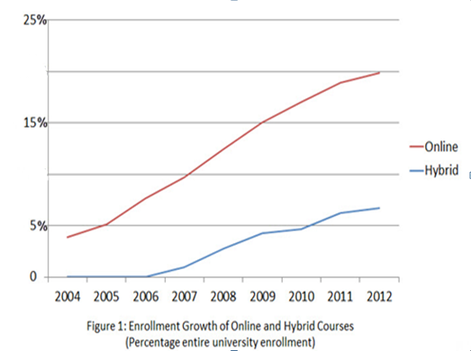
Drexel University
Background and Context
Tremendous Growth

Slide 7
Voices of the Teaching Assistants
At Drexel University

Slide 8
Voices of the Teaching Assistants

Slide 9
Voices of the Teaching Assistants

Slide 10

What Other Schools are Doing to
Develop Teaching Assistants &
Graduate Assistants
Penn State Worldwide
  Graduate Student Teaching Series

Slide 11

What Other Schools are Doing to
Develop Teaching Assistants &
Graduate Assistants
UMASS Online
  Teaching Assistant Orientation
  Teaching Documentation Program
  Workshop Series on Presenting Your Teaching on the Academic Job Market
  Teaching Portfolio Series

Slide 12

What Other Schools are Doing to
Develop Teaching Assistants &
Graduate Assistants
Liberty University
  GSA Teaching/Training Workshops
  Certificate of University Teaching

Slide 13

What Other Schools are Doing to
Develop Teaching Assistants &
Graduate Assistants
UMUC
  TA’s are invited to/permitted to attend any faculty development opportunity including New Faculty Orientation, webinars, etc.

Slide 14
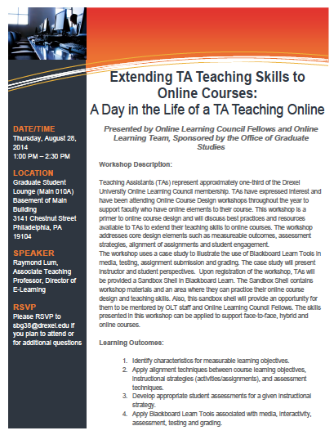
Benefits to Teaching Assistants
and the University

Slide 15
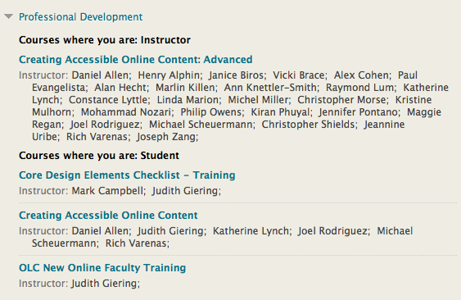

Benefits to Teaching Assistants
and the University

Slide 16
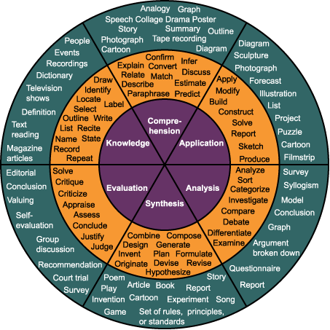
Benefits to Student, Faculty & Program
Bloom’s Taxonomy
Benjamin Bloom and a committee of educators wrote “Taxonomy of educational objectives: The classification of educational goals” (1956)
This taxonomy addresses learning goals in terms of:
  cognitive,
  affective and
  psychomotor skills
Bloom’s taxonomy has evolved with numerous variations over the decades
  Digital taxonomy
Graphical representations have been developed to enhance understanding

Slide 17
Benefits to Student, Faculty and Program
Key sections that must align…
Course Learning Objectives (2)
Learner Interactions & Activities (5)
Resources, Materials (4) & Technology (6)
Assessment and Measurement (3)
Notes:
Quality Matters Peer Reviewer Training
© MarylandOnline, Inc.
17

Slide 18
Benefits to Student, Faculty and Program
The QM Rubric
Eight General Standards:
  Course Overview and Introduction
  Learning Objectives
  Assessment and Measurement
  Resources and Materials
  Learner Interaction
  Course Technology
  Learner Support
  Accessibility
Key components must align.
Alignment: Critical course elements work together to ensure that students achieve the desired learning outcomes.

Slide 19
Benefits to Student, Faculty and Program
Course Design Review Options
There are three options for Course Design Reviews:
  Self-Review
  Drexel University Core Design Element Checklist: Peer-review
  Quality Matters Rubric: Peer-review

Slide 20
Benefits to Student, Faculty and Program
THE DREXEL UNIVERSITY CORE DESIGN ELEMENTS CHECKLIST
1. A course description is provided.
a. This may include a statement that introduces the student to the purpose of the course and its
components.
b. In the case of a hybrid course, there is a statement that clarifies the relationship between the
‘face-to-face’ and ‘online’ components.
c. The number of credit hours earned for successful completion is clearly posted.
2. The grading policy is clearly stated.
a. Specific/descriptive criteria are provided for the evaluation of student work and participation.
b. Instructions for completion and submission are provided.
c. Grading scales and weights are provided.
3. Course learning objectives describe outcomes that are measurable.
4. Assessment and evaluation are aligned with course learning objectives.
a. Assessment and evaluation tools are appropriate for measuring the stated learning outcomes.
b. Assessment and evaluation goals are clearly communicated.
5. Information about student feedback is provided.

Slide 21
Benefits to Student, Faculty and Program
THE DREXEL UNIVERSITY CORE DESIGN ELEMENTS CHECKLIST
6. Instructor contact and availability information is provided.
7. A list of textbooks, supplies, and other instructional materials needed for the course is provided.
8. Due dates and deadlines are provided.
a. A disclaimer that dates are subject to change should be included.
9. A code of conduct and information about academic integrity are provided.
a. Links to university policies should be provided.
b. Netiquette standards should be provided as needed.
10. Links, email addresses, and/or phone numbers to technical support are provided.
11. Content is sequenced and structured in a manner that enables learners to achieve the stated goals.
a. The course content is divided into learning units that are labeled and presented in a logical
manner.

Slide 22
Benefits to Student, Faculty and Program
THE DREXEL UNIVERSITY CORE DESIGN ELEMENTS CHECKLIST
The course is easy to navigate.
a. The components and structure of the course are clear and understandable.
b. Instructions about how to get started and where to find various course
components is provided.
Broken or outdated links are corrected or removed. a. Required online resources
are accessible.
14. Links to academic resources are provided. a. Links to Drexel Express, library,
tutoring centers, counseling services, Provost Office, DragonCard Office, and
bookstore are provided.
15. The university statement regarding ADA compliance is provided. a. Information
about how to request special services is provided.

Slide 23
Benefits to Student, Faculty and Program
Overview of the Process
Request for Course Design Review
Peer-Review
Self-Review
Drexel University
Core Design Elements Checklist
Quality Matters Rubric
Tools and materials
provided to the Instructor
OLC Fellow(s) assigned
Drexel University
Core Design Elements Checklist:
self-paced online training course
Initial Meeting/Consultation
Between Fellow and Instructor
Fellow(s) conducts the review
Review conducted by instructor
Confidential feedback to instructor
Consultation with Fellows as needed
Follow-up, additional
consultation as needed

Slide 24
References
Drexel University. (March 18, 2012). Drexel University Decennial Reaffirmation of Accreditation Review 2011-2012, Drexel University Self-Study Middle States Commission on Higher Education, Office of the Provost Drexel University.
Drexel Online. (2012). Drexel Online Accreditations & National Rankings, Retrieved from http://www.drexel.com/accreditation.aspx
College of Nursing and Health Professions. (January 17, 2012). Drexel University’s Online Nursing Programs Earn Top Honors in U.S. News and World Report Rankings, Drexel University, Retrieved from http://drexel.edu/cnhp/newsEvents/news/2012-1-17_USWorldNews/.
Linda S. Marion, Allen C. Grant, Marlin Killen, Ray Lum, Frances H. Cornelius, Karyn E. Holt. (2014). We built it, they came, and now . . . culture change in a university (January 22, 2014), INTED 2014 8th International Technology, Education and Development Conference Valencia, Spain, March 10-12, 2014. http://library.iated.org/publications/INTED2014
MarylandOnline, Inc. (2010). What is the QM Program? Retrieved from http://www.qmprogram.org/.
Cornelius, F., Lum, R., Marion, L., Holt, K., Killen, M., Solan, A., Giering, J., Grant, A. (2013). If you build it, will they come? An innovative approach to shift the culture of a university. Challenges and realities of academic integrity: Best practices for instilling sustainable change in students and faculty. INTED 2013 7th International Technology, Education and Development Conference Valencia, Spain, March 4-6, 2013. http://www.iated.org/concrete2/technical_program.php.
INSPIRE: Innovation for New Scholarship, Pedagogy, Innovation & Research in Education. (2014). Overview. Retrieved from http://www.drexel.edu/inspire/about/overview/
U.S. News and World Report 2015 Best Colleges (2014). Retrieved Nov. 6 from - http://www.usnews.com/education/online-education/drexel-university-212054

Slide 25
Questions?

