Slide 1
Leveraging the CPE Rubric to Strengthen the Evaluation Component of a Training Grant
By
Ray Lum, MPhil, MS
Shannon Marquez, PhD, MEng
S. DeVose, MA

Slide 2
ABSTRACT
The Opening Doors Program's (ODP) application of QM's Continuing and Professional Education (CPE) Rubric plays a critical role in the evaluation component of this training grant. The CPE provides the best practices for ODP to develop and maintain a quality online seminar series. CPE assures measurable learning outcomes from the online seminar series. The illustration
of the alignment of learning activities, measurable learning outcomes and program outcomes demonstrates competencies more clearly. This in turn, may provide a better opportunity for funding renewal.

Slide 3
Learning Outcomes
Identify the benefits of CPE in grant evaluations
Leveraging QM Infrastructure/Knowledge in Higher ED to CPE
Illustrate the Integration of CPE with Learning Outcome Techniques and Program Mapping.

Slide 4
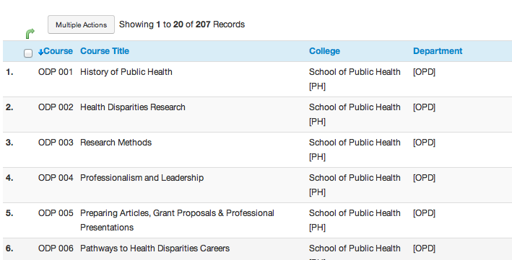
Program Courses
Ref: http://publichealth.drexel.edu/students/overview/opening-the-doors-for-diverse-populations-to-health-disparities-research/

Slide 5
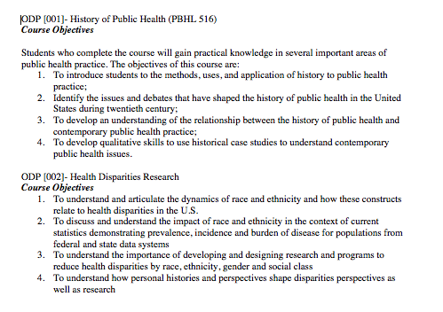
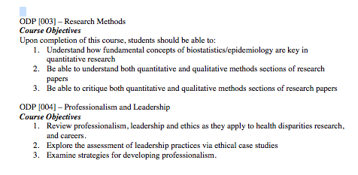
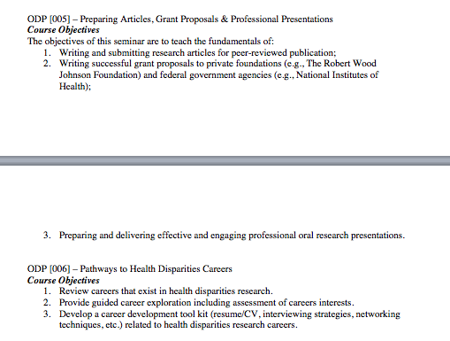
Program Course Objectives
Ref: http://publichealth.drexel.edu/students/overview/opening-the-doors-for-diverse-populations-to-health-disparities-research/

Slide 6
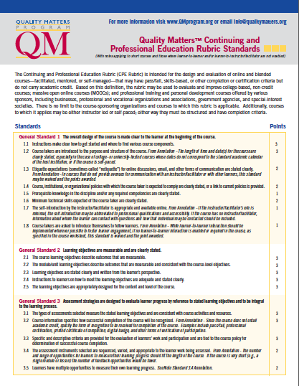
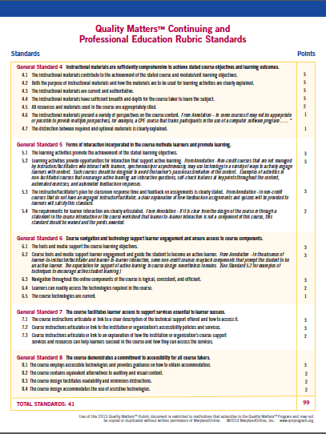
Quality Matters Continuing and Professional
Education Rubric
Ref: https://www.qualitymatters.org/about-continuing-and-professional-education-rubric-0

Slide 7
Quality Matters Continuing and Professional
Education Rubric
General Standard 2 – Learning Objectives are measurable and are clearly stated
General Standard 3 – Assessment strategies are designed to evaluate learner progress by reference to stated learning objectives and to be integrated to the learning process.
General Standard 4 – Instructional materials are sufficiently comprehensive to achieve stated course objectives and learning outcomes.
General Standard 5 – Form of interaction in the course motivates learners and promote learning
Ref: https://www.qualitymatters.org/about-continuing-and-professional-education-rubric-0

Slide 8
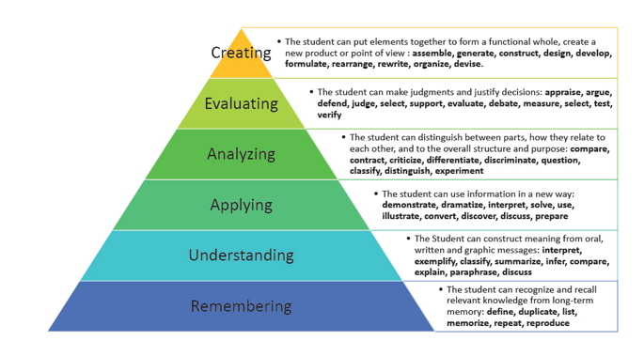
Bloom’s Taxonomy Revised
Ref: http://www.mtvernoncsd.org/staff

Slide 9
Program Mapping Templates

Slide 10

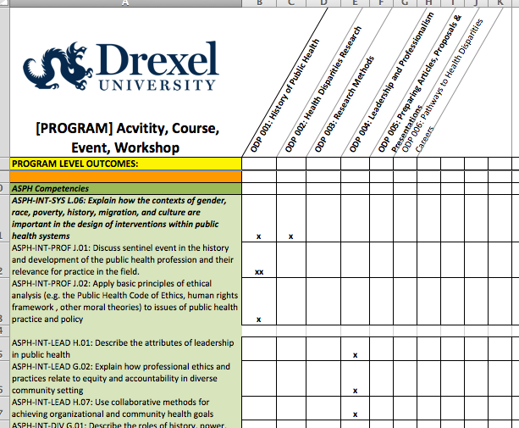
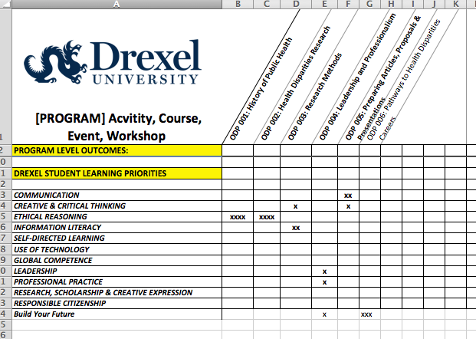
Program Mapping Grid

Slide 11
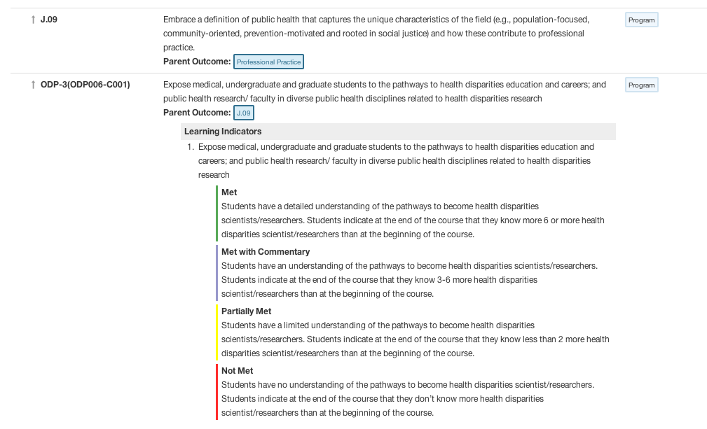
Alignment of PLOs, CLOs and
Learning Indicators
Ref: http://www.aefis.com/

Slide 12
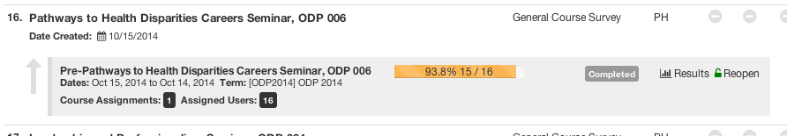
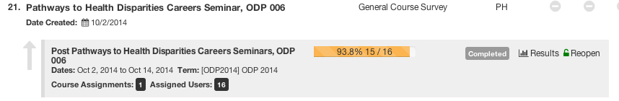
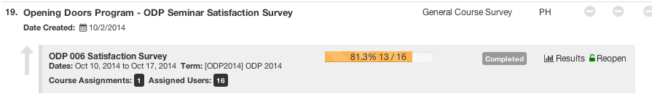
Indirect Assessments
Pre-Post and Satisfaction Surveys
Ref: http://www.aefis.com/

Slide 13
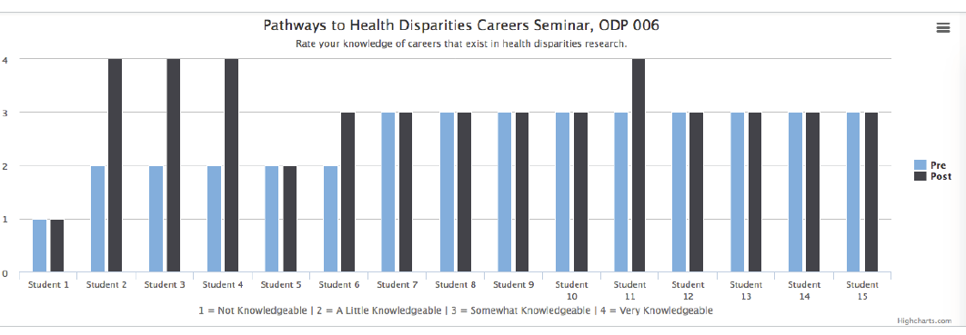
Indirect Assessments
Pre-Post Survey Results
Ref: http://www.aefis.com/

Slide 14
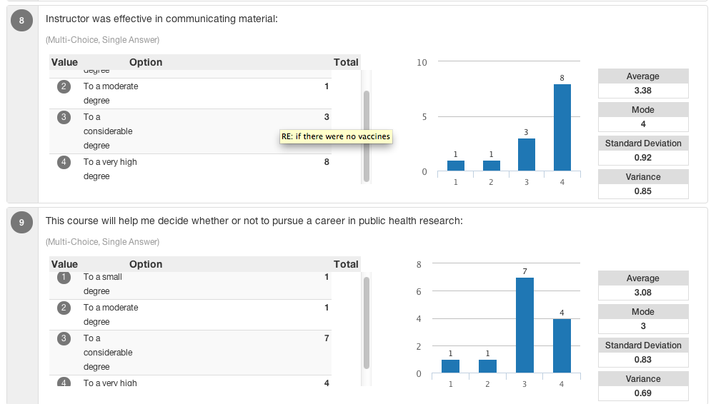
Indirect Assessments
Satisfaction Survey Results
Ref: http://www.aefis.com/

Slide 15
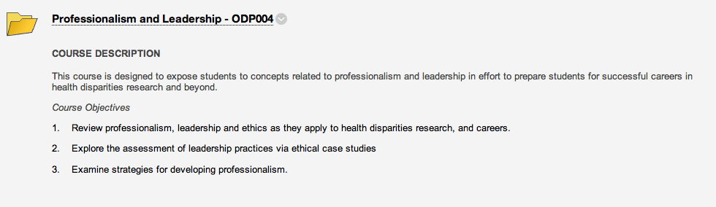

Slide 16
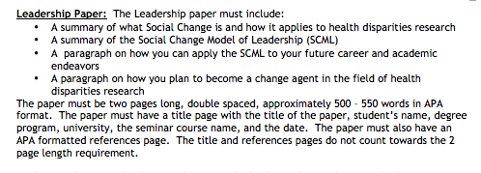

Slide 17
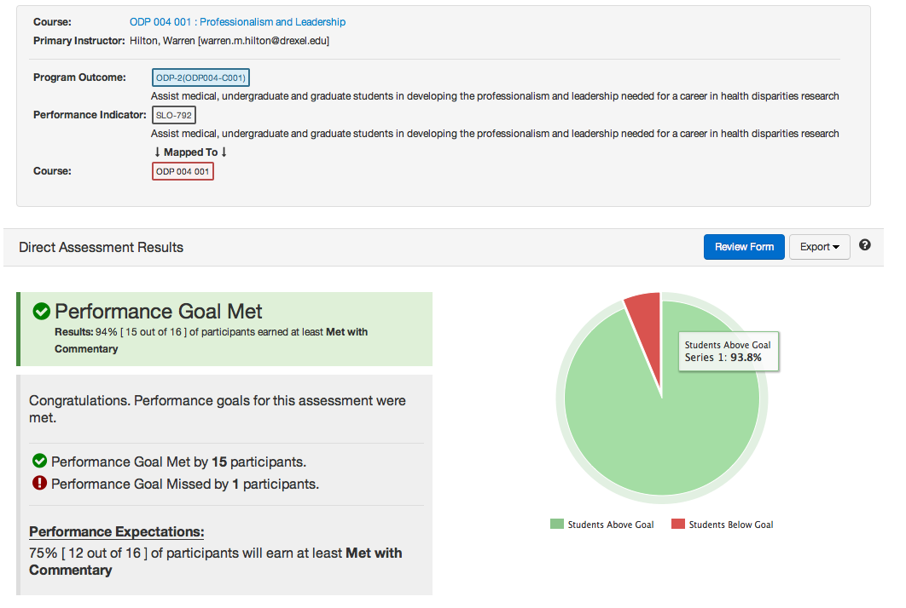
Direct Assessment

Slide 18
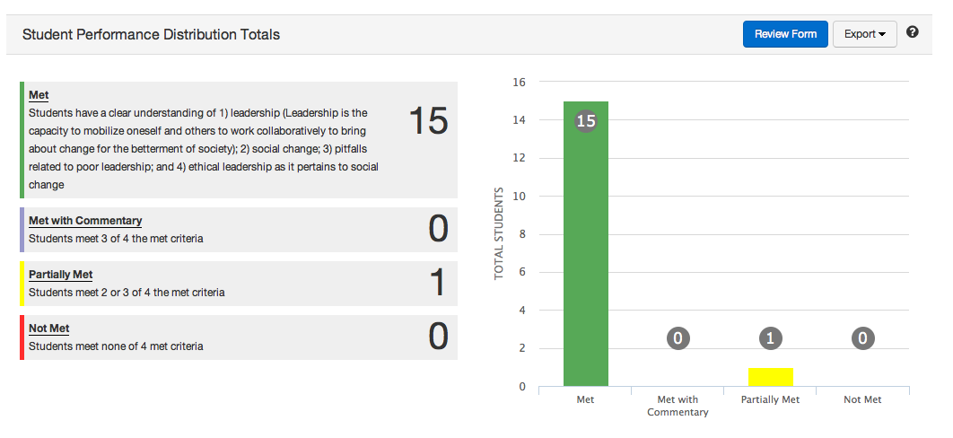
Direct Assessment

Slide 19
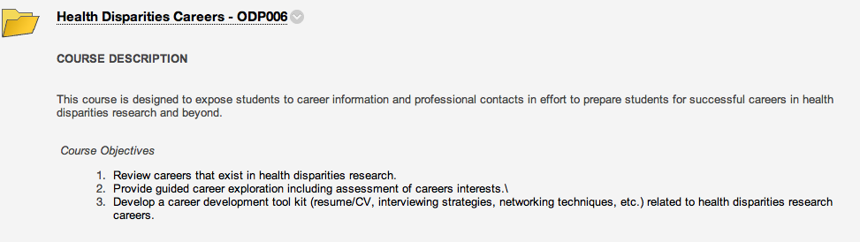

Slide 20
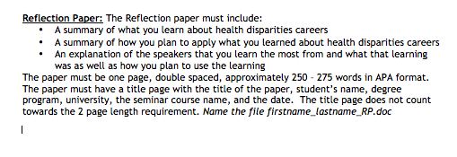

Slide 21
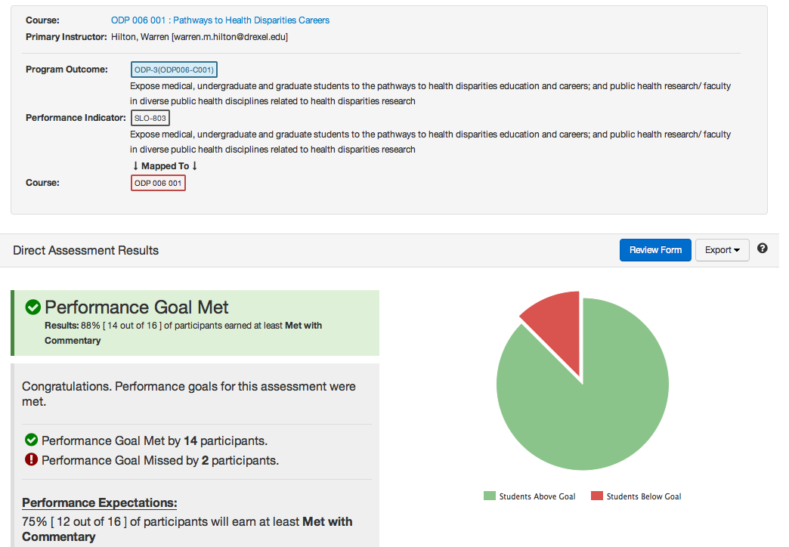
Direct Assessment

Slide 22
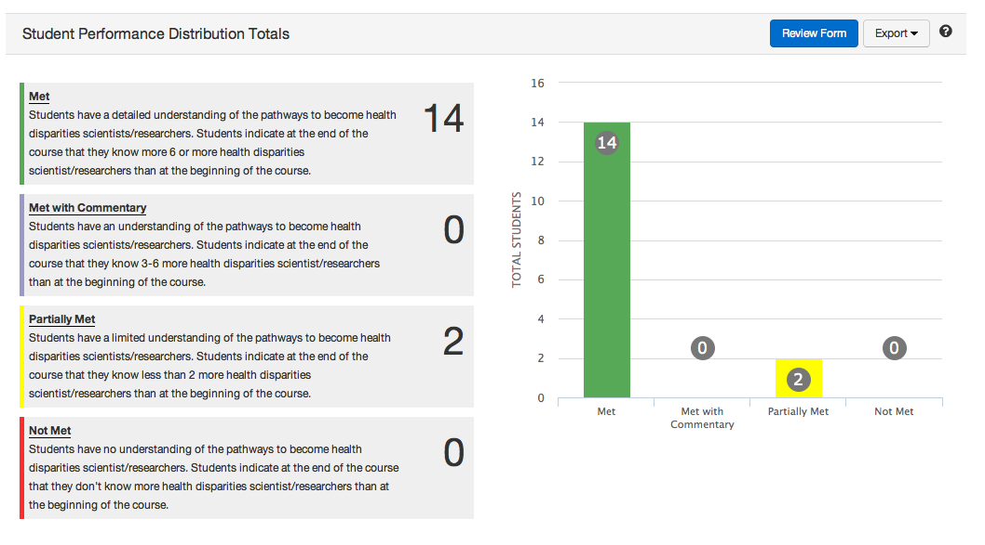
Direct Assessment

Slide 23

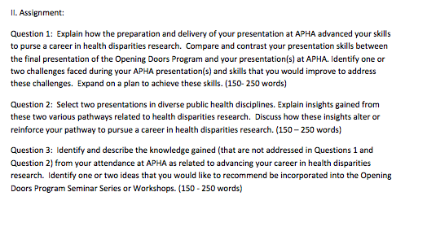
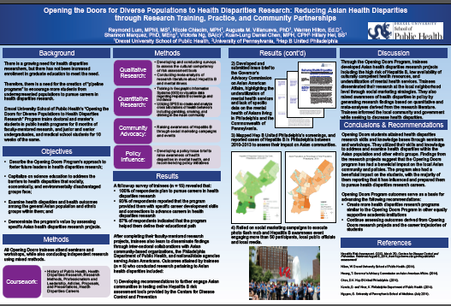
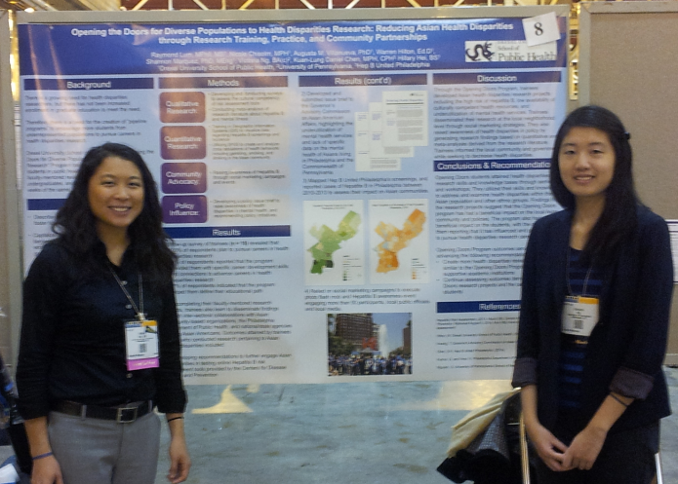
Direct Assessment
Reflective Analysis

Slide 24
References
Drexel University. (March 18, 2012). Drexel University Decennial Reaffirmation of Accreditation Review 2011-2012, Drexel University Self-Study Middle States Commission on Higher Education, Office of the Provost Drexel University.
Drexel Online. (2012). Drexel Online Accreditations & National Rankings, Retrieved from http://www.drexel.com/accreditation.aspx
College of Nursing and Health Professions. (January 17, 2012). Drexel University’s Online Nursing Programs Earn Top Honors in U.S. News and World Report Rankings, Drexel University, Retrieved from http://drexel.edu/cnhp/newsEvents/news/2012-1-17_USWorldNews/.
Opening the Doors for Diverse Population to Health Disparities Research. (2015). Retrieved fromhttp://publichealth.drexel.edu/students/overview/opening-the-doors-for-diverse-populations-to-health-disparities-research/
Quality Matters. (2015). About. Retrieved from https://www.qualitymatters.org/about
Academic Evaluation, Feedback and Intervention System. (2015). Retrieved from http://www.aefis.com/
Association of Schools and Programs of Public Health: MPH Core Competency Model. (2015). Retrieved from: http://www.aspph.org/educate/models/mph-competency-model/
Quality Matters. (2015). Continuing and Professional Development Rubric. Retrieved from https://www.qualitymatters.org/about-continuing-and-professional-education-rubric-0
ABET IDEAL Scholar training program, August 7-10, 2012 and Prus, J. and Johnson, R. (1994). A critical review of student assessment options. New Directions for Community Colleges 1994: 69-83. doi: 10.1002/cc.36819948811.

Slide 25
Questions?

