Slide 1
Research Webinar
CHLOE 4 – Navigating the Mainstream
Notes:
[Please begin the recording.]
Good afternoon, everyone! Thank you for joining us for today’s QM Research Webinar, CHLOE 4 – Navigating the Mainstream with our presenters, Richard Garrett and Ron Legon.
Today’s session is being recorded, and the recording and slides will be sent to you one week from today.
This session is also being live captioned at https://www.streamtext.net/player?event=QualityMatters

Slide 2
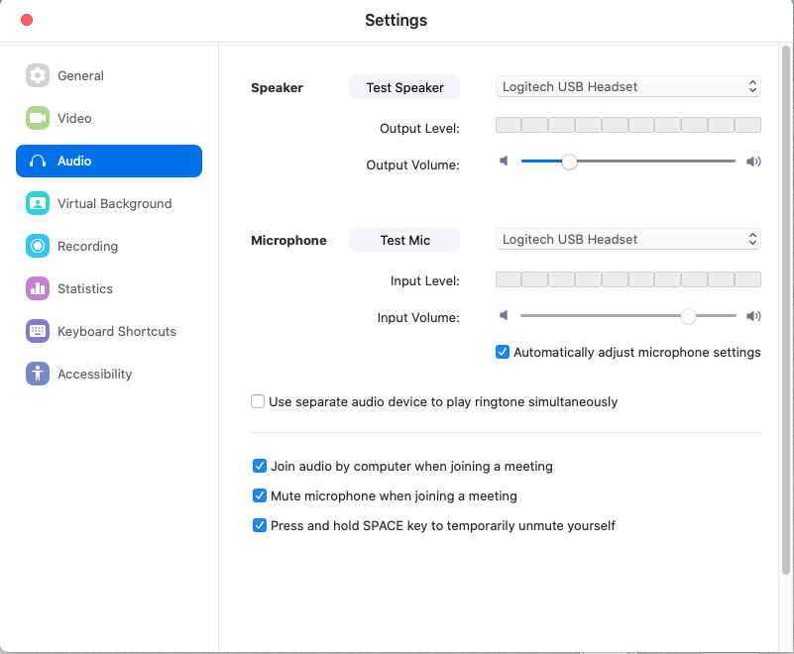
Please Check Your Audio Setup
You will be muted during this session, but please test your speaker.
Notes:
Good afternoon, and welcome to today’s QM Research Webinar!
We will begin at the top of the hour. For now, please check your audio setup. You will not need your mic for this webinar.

Slide 3
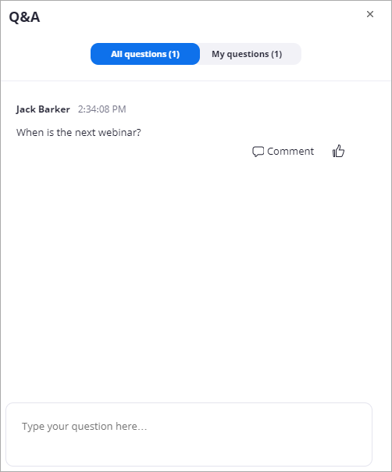
Asking Questions Using the Q&A
Only the host and panelists will see your questions. This is the best way to have your question seen and answered.
Notes:
Please type your questions into the Q&A during the webinar, and the presenter will answer them at the end of the session.

Slide 4
Let’s chat…
Select “All panelists and attendees” so everyone sees your comment.
Notes:
To talk with the other attendees, type in the Chat.

Slide 5
Quality Matters Research Webinar: Online Learning Navigating the Mainstream Findings of the CHLOE 4 Survey
Richard Garrett and Ron Legon
Co-Directors of the CHLOE Project

Slide 6
Agenda
Introduction to CHLOE 4 in Today’s Environment
CHLOE 4: Online Leadership & Policy
CHLOE 4: Scale
Concluding Remarks

Slide 7
Growth in CHLOE Survey Participation
Year | Public 2Y | Public 4Y | Private 4Y | For-Profit | TOTAL
CHLOE 3 | 76 | 91 | 98 | 11 | 280*
CHLOE 4 | 99 | 135 | 123 | 8 | 367*
% Increase CHLOE 4 vs. CHLOE 3 | 30% | 48% | 26% | -27% | 31%
* Including a handful of other institutional types
Statistical reliability: margin of error of 5% at 95% confidence.

Slide 8
CHLOE 4 Sample By Online Enrollment Size
Less than 1,000 online students = 34% = 125
1000 – 7,500 online students = 54% = 198
More than 7,500 online students = 9% = 33

Slide 9
Multi-factor Institutional Models
Enterprise – 4-year public, private nonprofit, and for-profit institutions with more than 7,500 fully and partly online students
Flagship – NEW - The leading 4-year public universities, with research and public service roles, as designated by their home states and recognized by the Association of American Universities, with fewer than 7,500 fully and partly online students. The CHLOE 4 Survey included 20 out of 60 flagship school in the U.S. – 33%.
Regional Public – 4-year public institutions (excluding state flagships) with between 1,000 and 7,500 fully and partly online students
Regional Private – 4-year private nonprofits with between 1,000 and 7,500 fully and partly online students
Low Enrollment – 4-year public and private nonprofits with fewer than 1,000 fully and partly online students
Community College – 2-year public institutions with fewer than 7,500 fully and partly online students

Slide 10
Do CHLOE Findings Shed Light on Higher Education’s Response to the Covid-19 Pandemic?
CHLOE has explored how well online learning is establishing itself alongside face-to-face learning
CHLOE has focused on a glass half full, but Covid-19 forces us to consider the consequences of a glass half empty
CHLOE has not explored the degree to which online learning capabilities have penetrated the non-participating segment of the faculty and student body
In this webinar will attempt to address the empty portion of the glass: How ready is online learning to assume responsibility for all learning – temporarily or permanently?

Slide 11
What do CHLOE 4 Results tell us about online leadership and policy?
Role of Chief Online Officer, Training & Orientation, OPMs, and Faculty

Slide 12
Is someone in charge of online learning? Chief Online Officers (COO) in CHLOE Sample

Slide 13
COO Core and Co-Responsibilities Who do you call? (49% or more COOs report each of these responsibilities)
COO Core Responsibilities | COO Co-Responsibilities
Faculty training | Selection of LMS and online tools
Instructional design | Online support services
Quality assurance | Regulatory compliance
Online policies | Contracting with external providers
LMS support and administration | Data gathering and reporting
Course development | Online technical support
Coordination with academic units | Online program development
External representation | Intellectual property protection
Budgeting of online | Market research
Student orientation | Accessibility issues
Strategic planning | On-campus technology
 | Open educational resources support
 | Marketing of online programs

Slide 14
Growing Influence of COOs
80-85% of COOs report to an Academic Affairs officer.
61% of COOs in our sample have a collaborative peer-to-peer relationship with the CIO.
How might coronavirus affect the influence of the COO position?

Slide 15
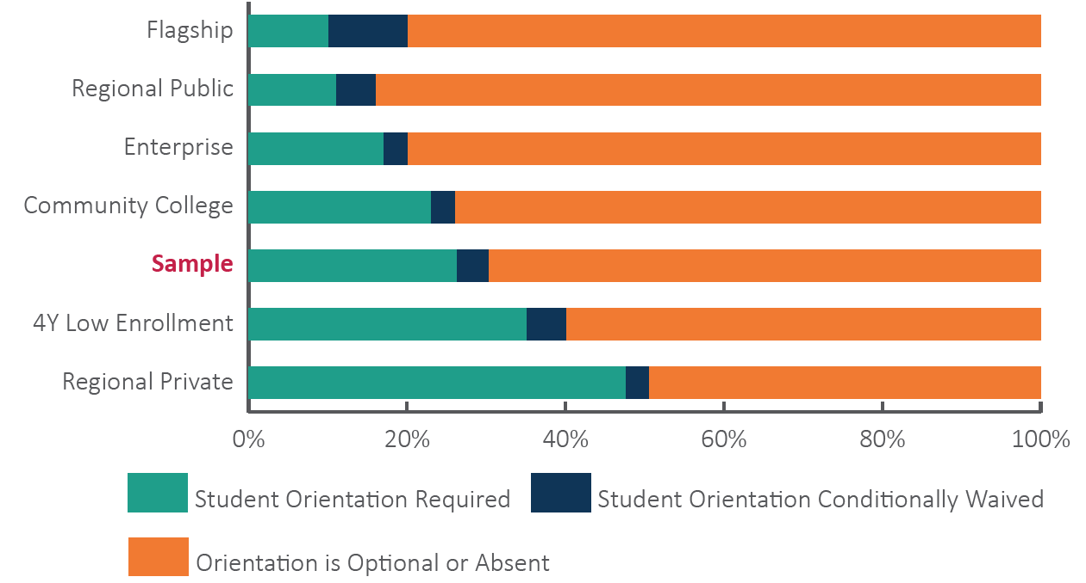
Only 30% of Schools Require Online Student Orientation How will the other 70% prepare all students for online?
Notes:
Most common in sectors claiming that online students outperform on-ground students
Least common in sectors claiming equivalent results for online and on-ground students
Other factors clearly influence student outcomes
e.g., student selectivity, faculty preparedness, course design, etc.

Slide 16
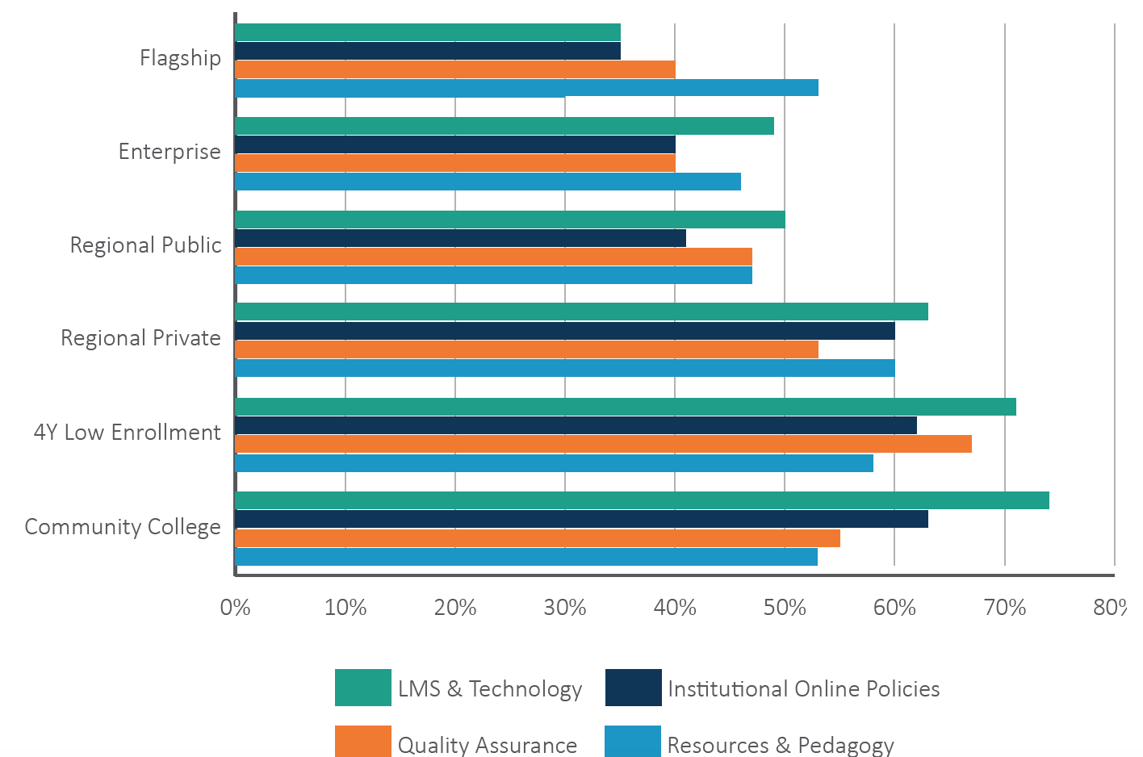
60% of Schools Require Faculty Preparation for Online Teaching How quickly can the other 40% of institutions prepare faculty?
Notes:
~60% of COOs report some required training for faculty
Community colleges (61%) and 4-Year low online enrollment schools (64.5%) are most likely to require faculty training
Flagships (35%) are least likely to require faculty training
Training typically encompasses the following areas:
LMS and technology (57%)
Quality standards and assurance measures (50%)
Institutional rules and policies (50%)
Resources and pedagogy (49%)

Slide 17
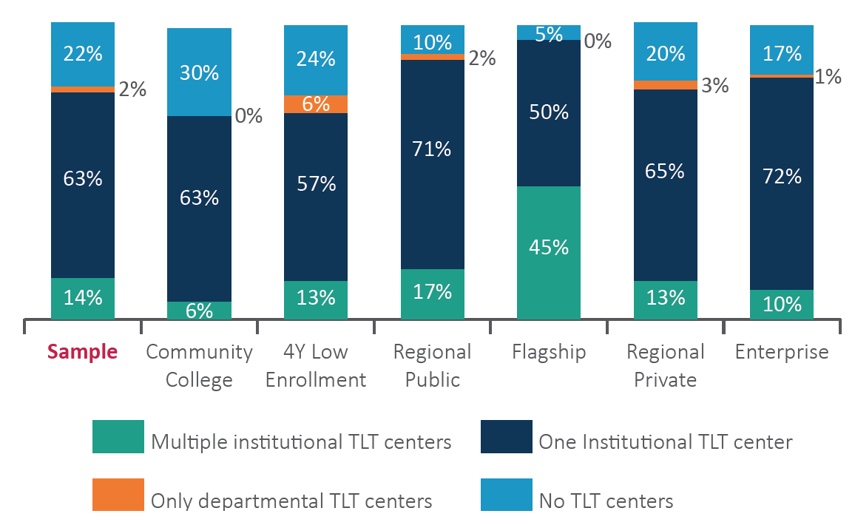
How much can Teaching, Learning, & Technology Centers contribute to faculty readiness?
Notes:
TLT Centers are playing a key role in shifting classroom courses online during Covid-19 pandemic.
At least one TLT center in 78% of surveyed institutions
14% of surveyed schools have more than one
Available to play a key role in preparing faculty for online teaching
Worthy of more detailed study of impact on faculty readiness

Slide 18
Online Program Management (OPM) Partnerships Can they help some institutions make a rapid transition to online learning…
Half of OPM users cite these advantages:
OPMs can provide rapid scaling (49%)
OPMs enable rapid development (48%)
Heaviest users – Flagships and Regional Privates
Institutions that typically have more discretionary resources

Slide 19
But many will not or cannot rely on external assistance:
Community Colleges, 4-year low online enrollment and regional public institutions are least frequent OPM users
More limited or absent discretionary resources
Frequently cited reasons:
Assert they can meet their needs internally
Concerned about costs
Concerned about revenue sharing
Preference for short-term limited contracts

Slide 20
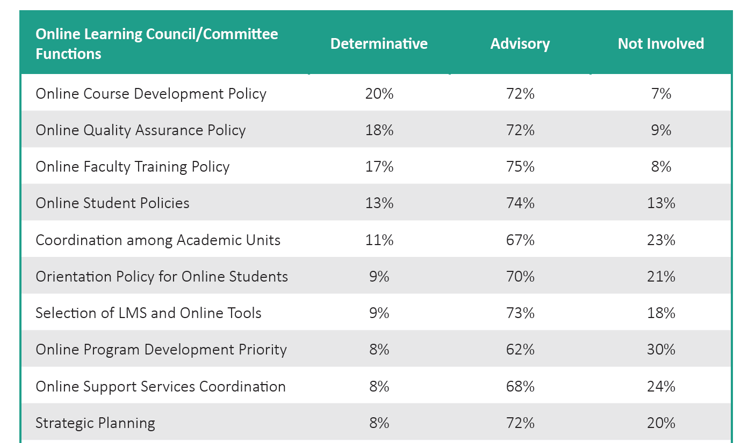
Faculty Input to Online Policies & Priorities
Notes:
62% of the COOs report one or more standing committees or councils dedicated to online learning
87% include faculty members
75% include senior administrators
75% have COOs as members or chairs (60%)
Mostly advisory, but more influential on policy issues:
Course/Program expansion
Quality Assurance
Faculty Training
Student Rules and Policies
Coordination among Academic Units

Slide 21
What do CHLOE 4 Results suggest about online and scale?
Price, Cost & Online Course Design

Slide 22
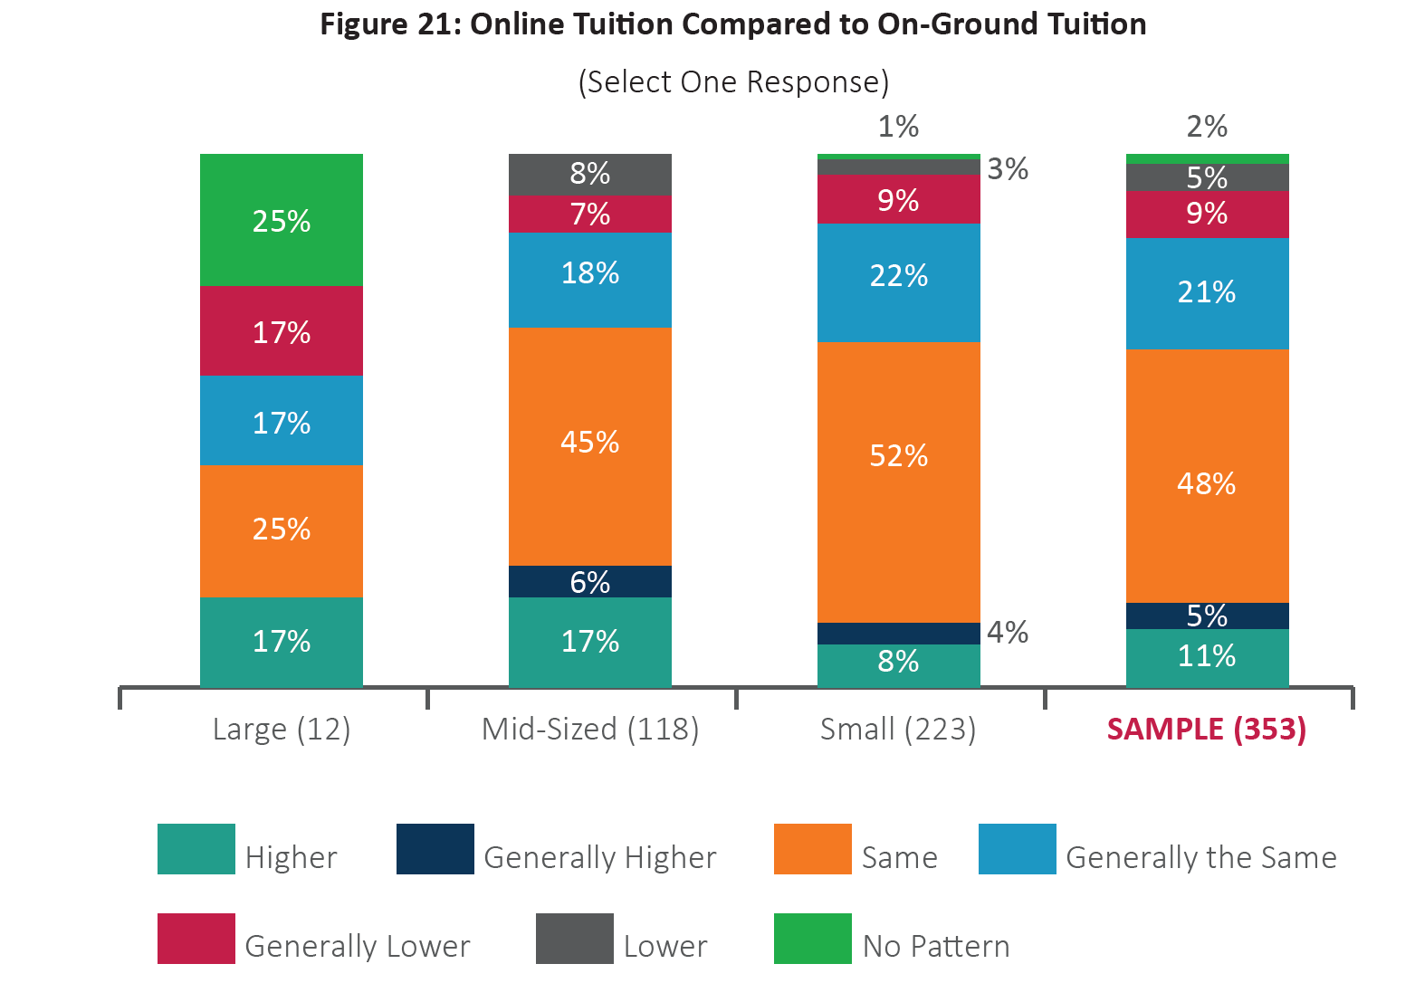
Online Pricing: The pandemic will test assumptions

Slide 23
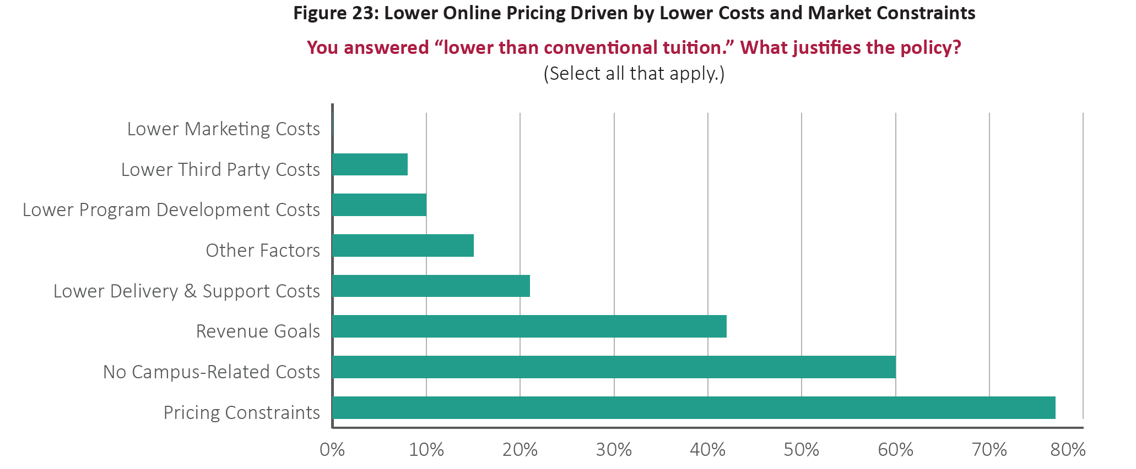
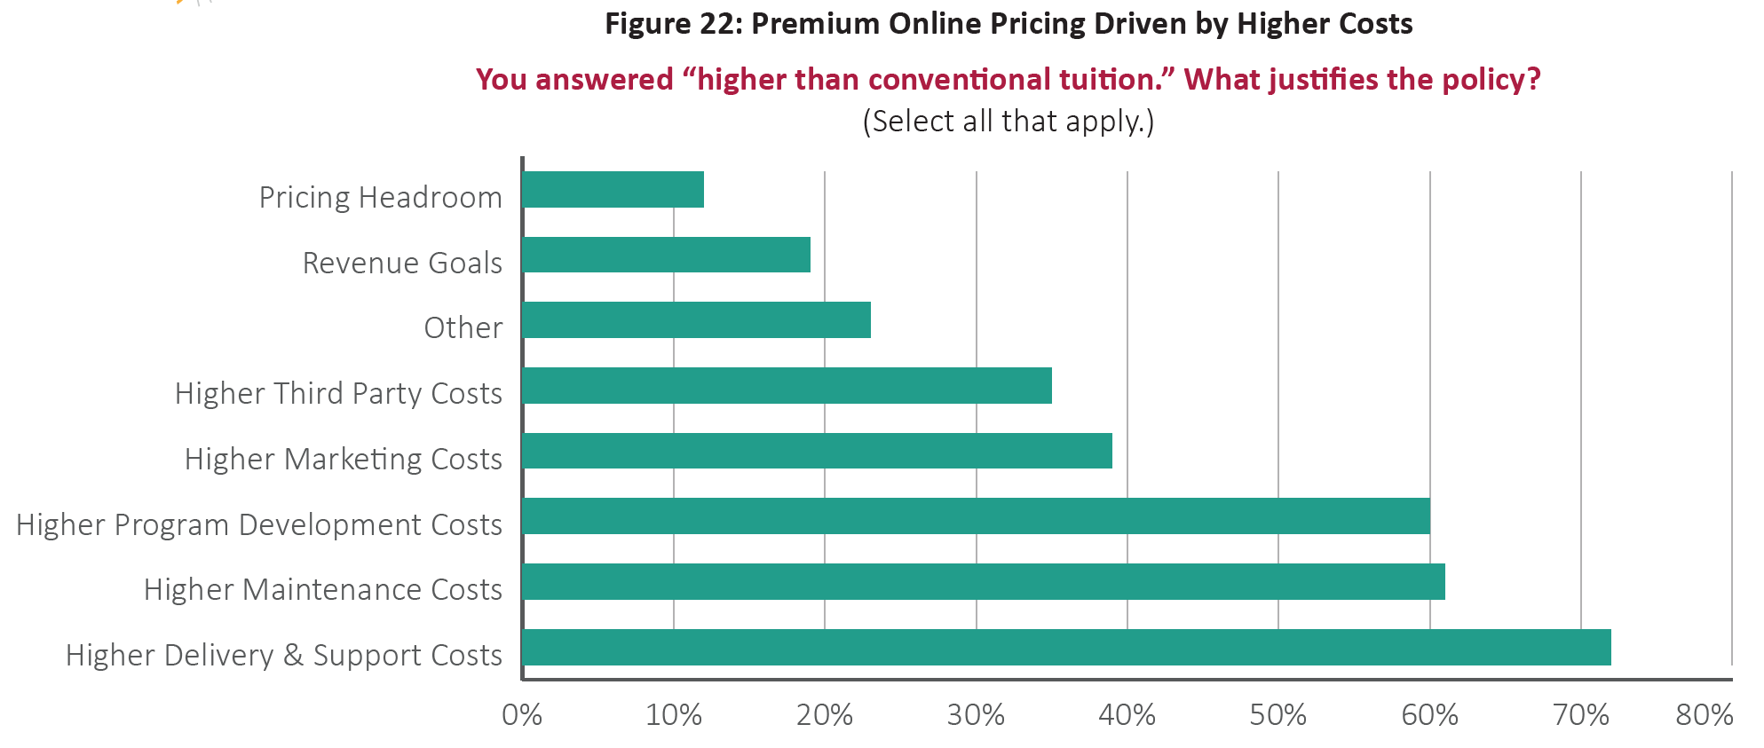
Pricing Logic: Online really does cost more?

Slide 24
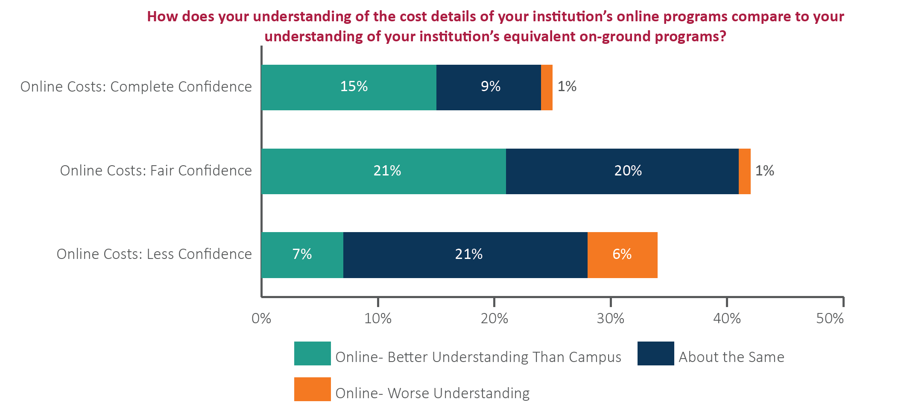
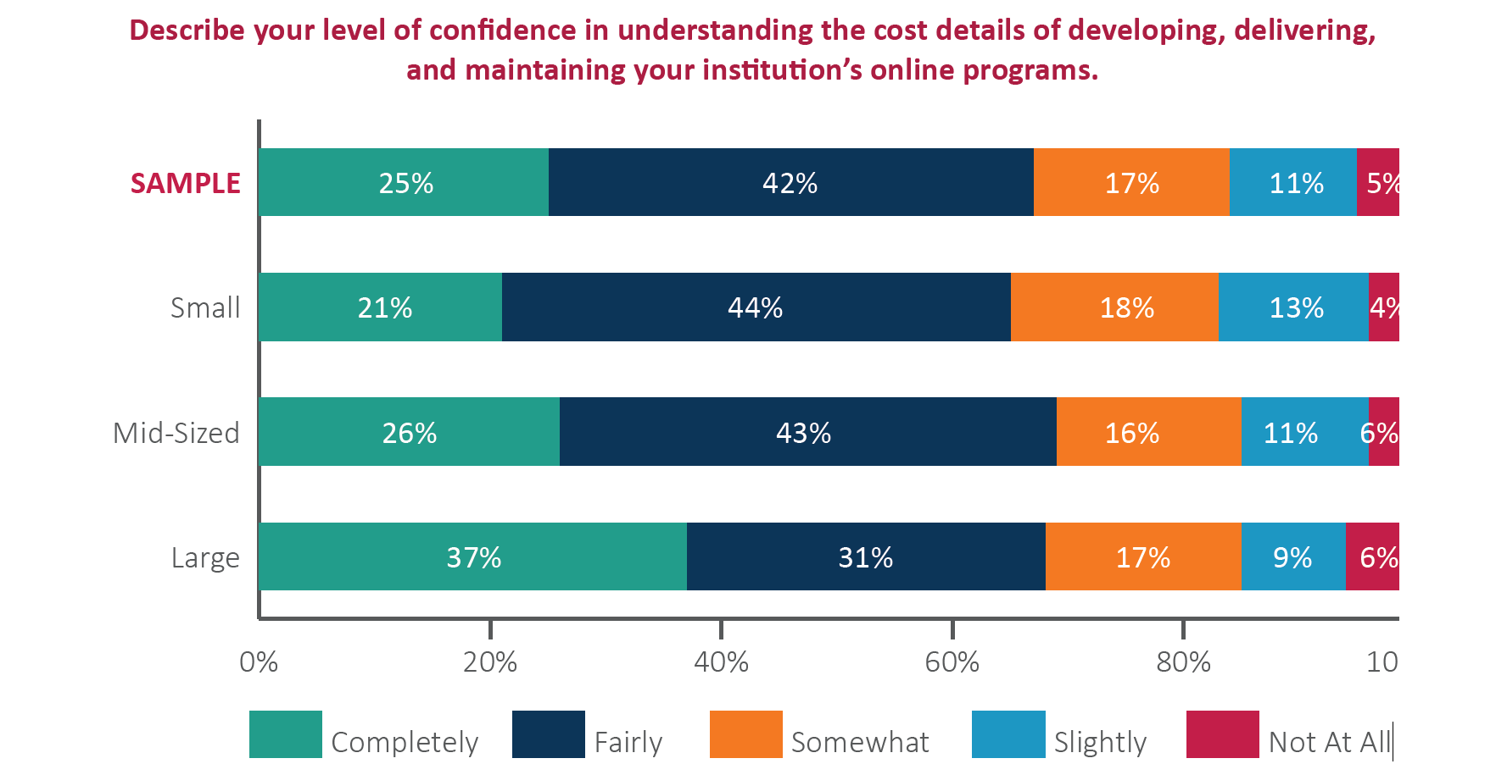
Cost Understanding: will new revenue pressures demand clarity?

Slide 25
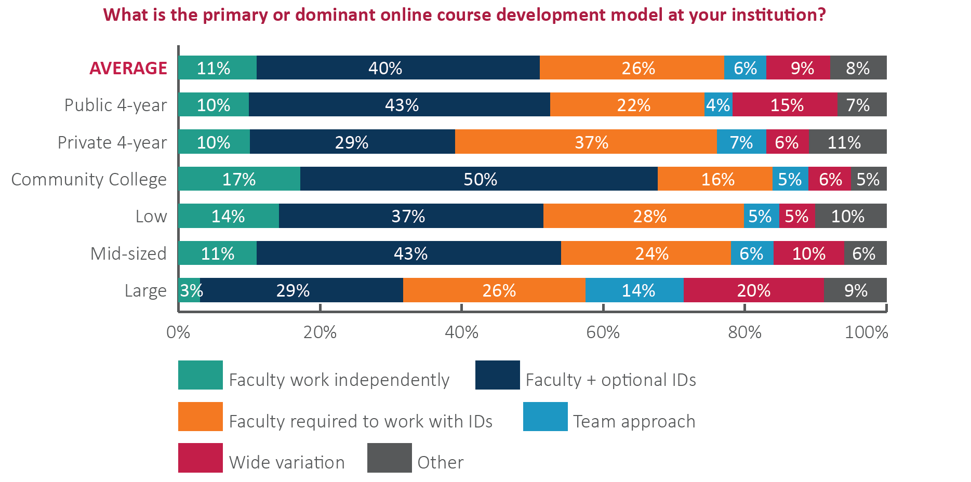
Online Course Development: Right model for true scale?

Slide 26
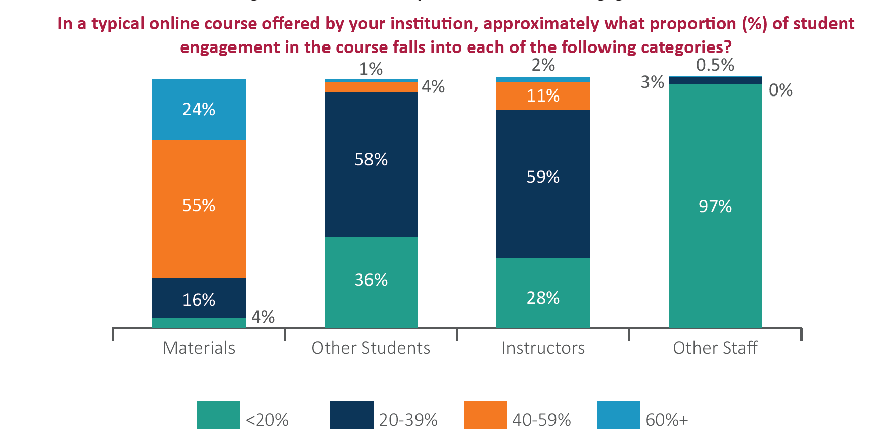
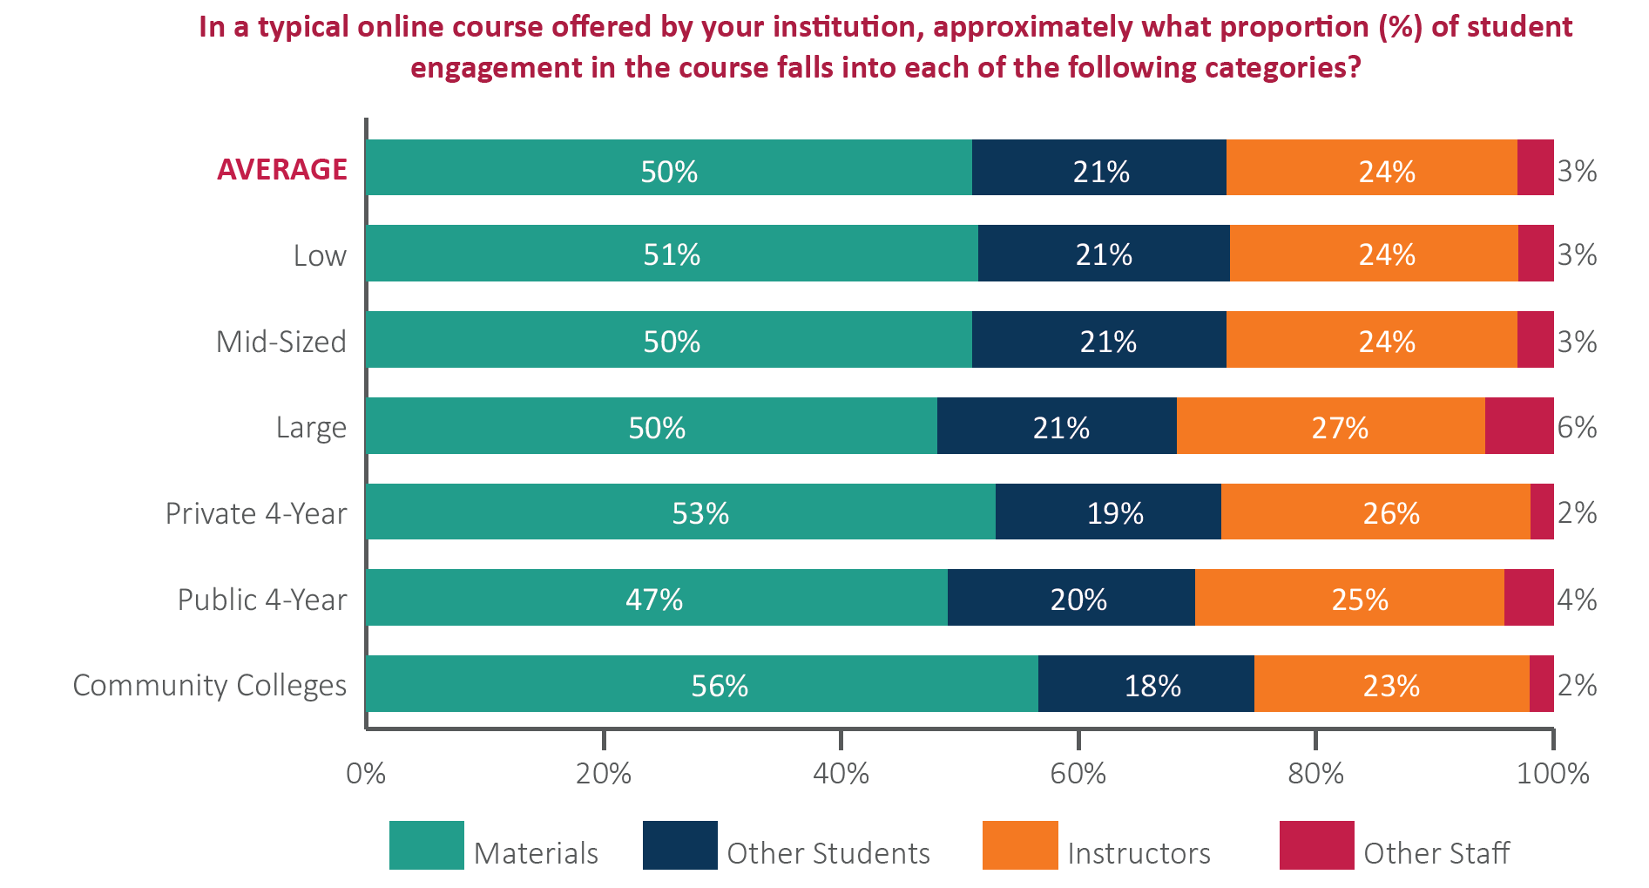
What is an online course? What is remote instruction?

Slide 27
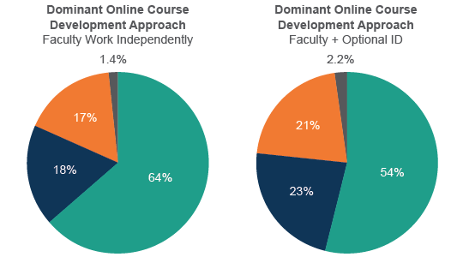
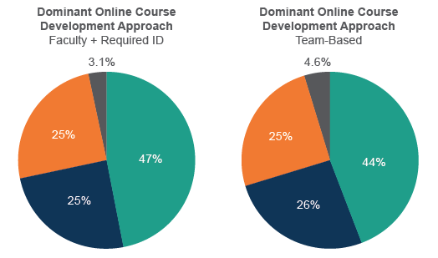
Reminder from CHLOE 3: Design means better courses?

Slide 28
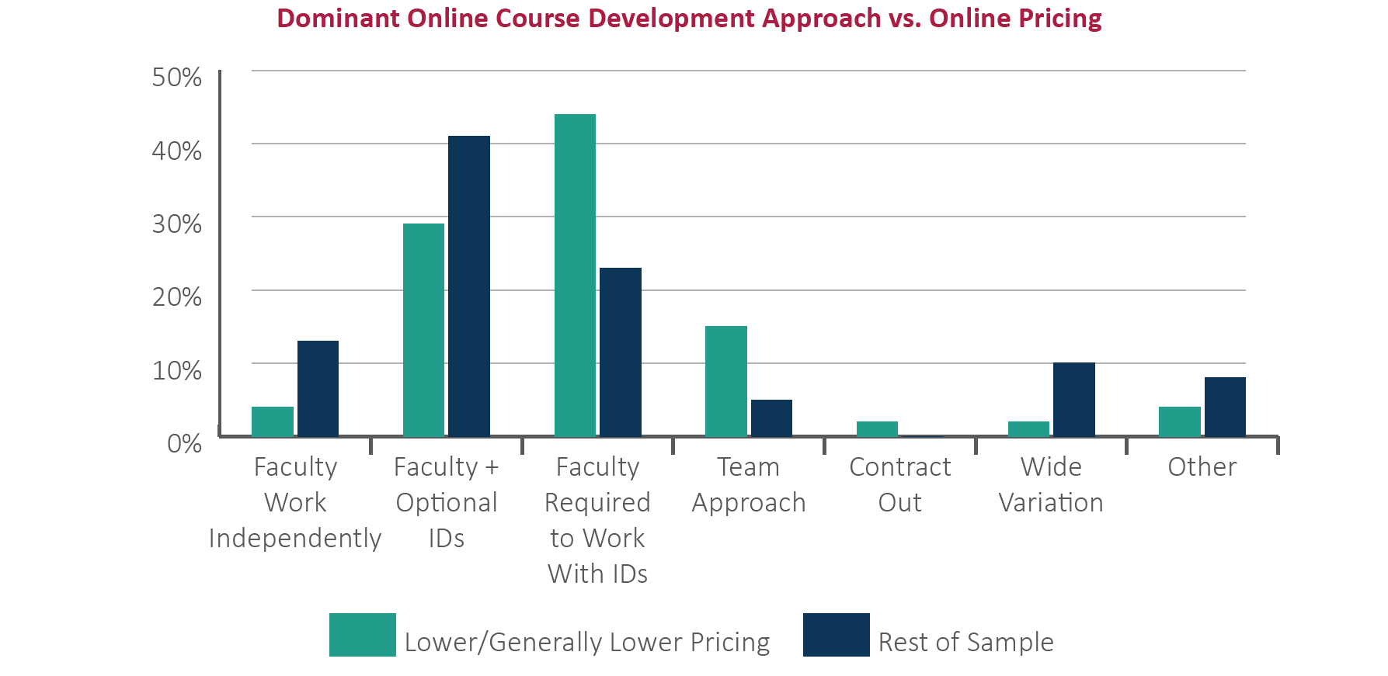
Coherent and consistent design drives cost understanding

Slide 29
Less Traditional Students More Likely to Struggle Online How to mitigate for Fall 2020?
(Source: Eduventures analysis of IPEDS data)

Slide 30
Online goals & plans for chloe 5
Concluding Remarks

Slide 31
Top Five-Year Online Program Goals
Improve quality (27%)
47% improve overall program quality
39% improve online course quality
13% meet external quality standards
8% improve the student learning experience
8% achieve consistency across online curriculum, policies, and practices
Increase online enrollment (24%)
Add online courses and programs (22%)
Notes:
Increase accessibility of online courses, programs, and services (5%)
Improve online support services (4%)
Standardize widely varied online standards and practices (3%)
Other goals with less than 2% support
Provide online faculty support and professional development
Increase institutional capacity for sustainable growth and learning
Improve & streamline online course & program development processes

Slide 32
Will Coronavirus Disrupt Top 5-Year Goals?
Top 5-Year Online Program Goals | Coronavirus Impact
Improve online quality (27%) | NO
Improve overall program quality (47%) | NEGATIVE
Improve online course quality (39%) | NEGATIVE
Meet external quality standards (13%) | NEGATIVE
Improve the student learning experience (8%) | DOUBTFUL
Achieve consistency across the curriculum (8%) | DOUBTFUL
Increase online enrollment (24%) | YES – BUT TEMPORARILY
Add online courses and programs (22%) | YES – BUT OF VARIABLE QUALITY

Slide 33
CHLOE 5 – Looking Ahead
COVID-19 Upends CHLOE 5 Plans
The Online Market Survey postponed
Focus shifts to assessment of online learning’s readiness to assume the entire instructional burden
Brief survey focused on scale and scope of the challenge
Re-analysis of CHLOE 1-4 findings on relevant resources
Mid-Summer CHLOE 5 Report on the challenges ahead

Slide 34
Your questions and Comments
Thank You!

Slide 35
Platinum Sponsor
Gold Sponsors
Ron Legon, Co-Director of the CHLOE Project- rlegon@qualitymatters.org
Richard Garrett, Co-Director of the CHLOE Project- rgarrett@eduventures.com

Slide 36
About Quality Matters
Quality Matters (QM) is the global organization leading quality assurance in online and innovative digital teaching and learning environments.
It provides a scalable quality assurance system for online and blended learning used within and across organizations.
When you see QM Certification Marks on courses or programs, it means they have met QM Course Design Standards or QM Program Review Criteria in a rigorous review process.

Slide 37
@QMProgram
#highered
Share how you’ll use something you learned today!

Slide 38
Research Webinar
CHLOE 4 – Navigating the Mainstream
Notes:
At this time, I’d like to Richard and Ron. . .

Slide 39
Upcoming Opportunities with QM
The ABCs of Online Research – Next session begins 2/19: https://www.qualitymatters.org/professional-development/workshops/abcs-of-qm-focused-research
QM Regional Conferences – April 2&3 in California, April 23&24 in New York: https://www.qualitymatters.org/events/attend

Slide 40
Verification of Attendance
Title: CHLOE 4 – Navigating the Mainstream
Date & Time: April 14, 2020, 1 p.m. Eastern
QM Research Webinar

